Slide 2
Part 2 – Respiratory Physiology
22.4 Mechanics of Breathing
Pulmonary ventilation consists of two phases
Inspiration: gases flow into lungs
Expiration: gases exit lungs

Slide 3
https://www.youtube.com/watch?v=Cqt4LjHnMEA

Slide 4
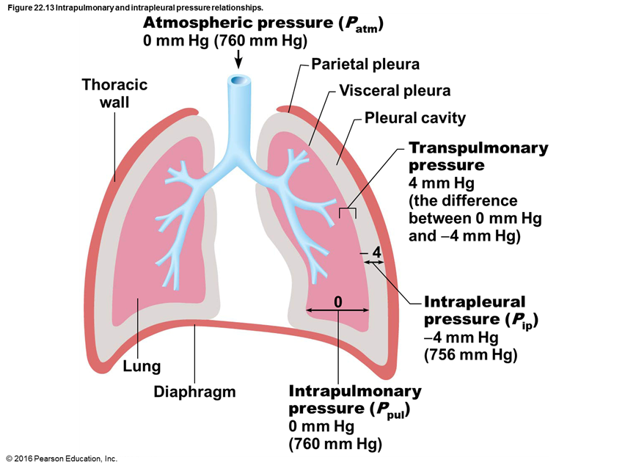
Pressure Relationships in the Thoracic Cavity
Atmospheric pressure (P_{atm})
Pressure exerted by air surrounding the body
760 mm Hg at sea level = 1 atmosphere
Respiratory pressures described relative to P_{atm}
Negative respiratory pressure: less than P_{atm}
Positive respiratory pressure: greater than P_{atm}
Zero respiratory pressure: equal to P_{atm}

Slide 5
Pressure Relationships in the Thoracic Cavity (cont.)
Intrapulmonary pressure (P_{pul})
Pressure in alveoli
Fluctuates with breathing
Always eventually equalizes with P_{atm}

Slide 6
Pressure Relationships in the Thoracic Cavity
Intrapleural pressure (P_{ip})
Pressure in pleural cavity
Fluctuates with breathing
Always a negative pressure (<P_{atm} and <P_{pul})
Fluid level must be kept at a minimum
Excess fluid pumped out by lymphatic system
If fluid accumulates, positive P_{ip} pressure develops
Lung collapses
Two inward forces promote lung collapse
Lungs’ natural tendency to recoil
Because of elasticity, lungs always try to assume smallest size
Surface tension of alveolar fluid
Surface tension pulls on alveoli to try to reduce alveolar size

Slide 7
Pressure Relationships in the Thoracic Cavity (cont.)
Intrapleural pressure (P_{ip}) (cont.)
One outward force tends to enlarge lungs
Elasticity of chest wall pulls thorax outward
Negative P_{ip} is affected by these opposing forces but is maintained by strong adhesive force between parietal and visceral pleurae

Slide 8
Pressure Relationships in the Thoracic Cavity (cont.)
Transpulmonary pressure
Transpulmonary pressure = (P_{pul} − P_{ip})
Pressure that keeps lung spaces open
Keeps lungs from collapsing
Greater transpulmonary pressure, the larger the lungs will be
Lungs will collapse if:
P_{ip} = P_{pul} or
P_{ip} = P_{atm}
Negative P_{ip} must be maintained to keep lungs inflated

Slide 9
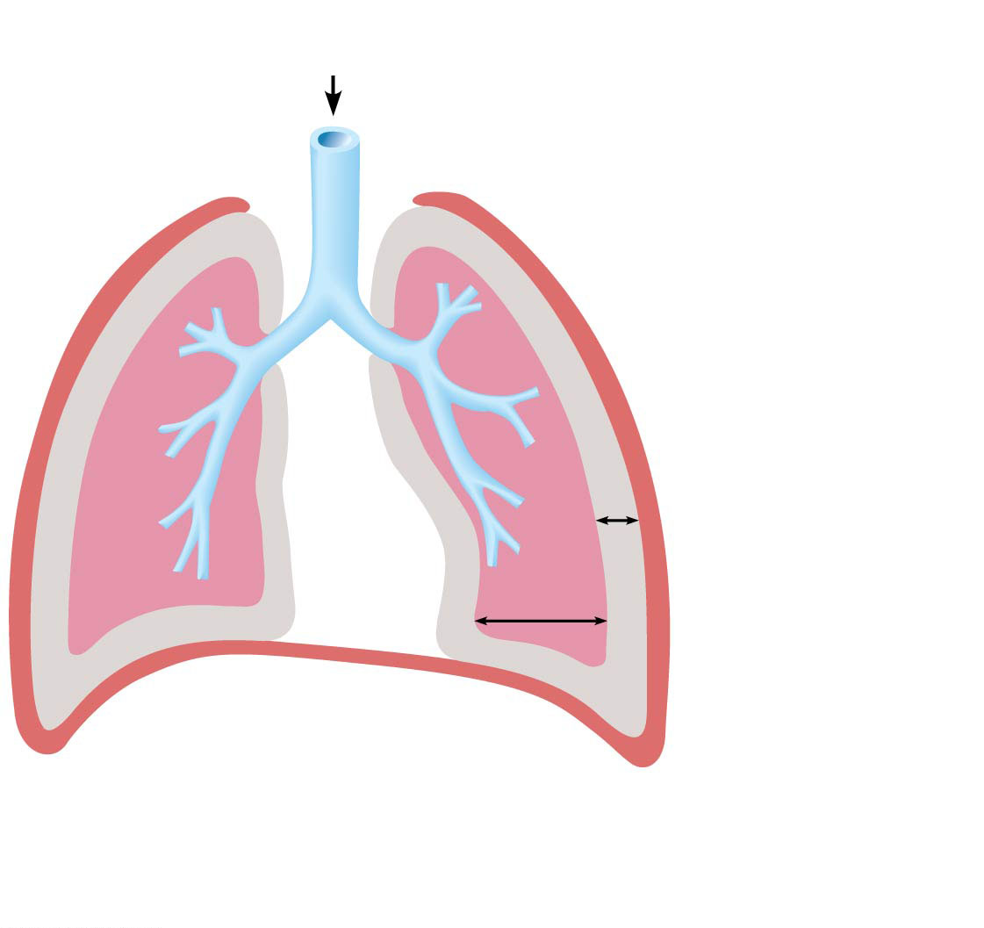
Figure 22.13 Intrapulmonary and intrapleural pressure relationships.
Atmospheric pressure (P_{atm})
0 mm Hg (760 mm Hg)
Parietal pleura
Thoracic
wall
Visceral pleura
Pleural cavity
Transpulmonary
pressure
4 mm Hg
(the difference
between 0 mm Hg
and −4 mm Hg)
− 4
0
Intrapleural
pressure (P_{ip})
−4 mm Hg
(756 mm Hg)
Lung
Diaphragm
Intrapulmonary
pressure (P_{pul})
0 mm Hg
(760 mm Hg)

Slide 10
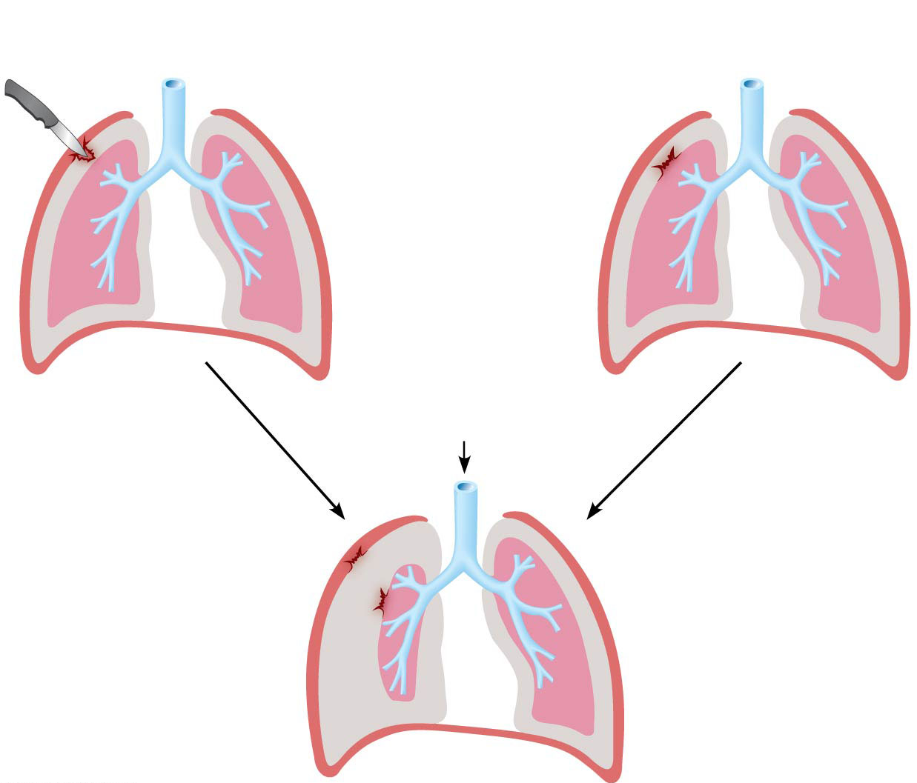
Figure 22.14 Pneumothorax.
Punctured parietal pleura
(e.g., knife wound)
Ruptured visceral pleura
(often spontaneous)
Parietal pleura
Visceral pleura
Pleural cavity
(Intrapleural pressure
= −4 mm Hg)
0
0
0
0
−4
Intrapulmonary
pressure (0 mm Hg)
−4
−4
−4
Atmospheric pressure
0 mm Hg (760 mm Hg)
Pneumothorax (air
in pleural cavity):
intrapleural pressure
becomes equal to
atmospheric pressure
Intrapleural
pressure
( −4 mm Hg)
0
0
0
Intrapulmonary
pressure (0 mm Hg)
Collapsed lung
(atelectasis)
−4

Slide 11
Pulmonary Ventilation
Consists of inspiration and expiration
Mechanical process that depends on volume changes in thoracic cavity
Volume changes lead to pressure changes
Pressure changes lead to flow of gases to equalize pressure

Slide 12
Pulmonary Ventilation (cont.)
Boyle’s law: relationship between pressure and volume of a gas
Gases always fill the container they are in
If amount of gas is the same and container size is reduced, pressure will increase
So pressure (P) varies inversely with volume (V)
Mathematically:
P₁V₁ = P₂V₂

Slide 13
Pulmonary Ventilation (cont.)
Inspiration
Active process involving inspiratory muscles (diaphragm and external intercostals)
Action of the diaphragm: when dome-shaped diaphragm contracts, it moves inferiorly and flattens out
Results in increase in thoracic volume
Action of intercostal muscles: when external intercostals contract, rib cage is lifted up and out
Results in increase in thoracic volume

Slide 14
Pulmonary Ventilation (cont.)
Inspiration (cont.)
As thoracic cavity volume increases, lungs are stretched as they are pulled out with thoracic cage
Because of difference between atmospheric and intrapulmonary pressure, air flows into lungs, down its pressure gradient, until P_{pul} = P_{atm}
During same period, P_{ip} lowers to about 6 mm Hg less than P_{atm}

Slide 15
Pulmonary Ventilation (cont.)
Inspiration (cont.)
Forced (deep) inspirations can occur during vigorous exercise or in people with COPD
Accessory muscles are also activated
Act to further increase thoracic cage size, creating a larger pressure gradient so more air is drawn in

Slide 16
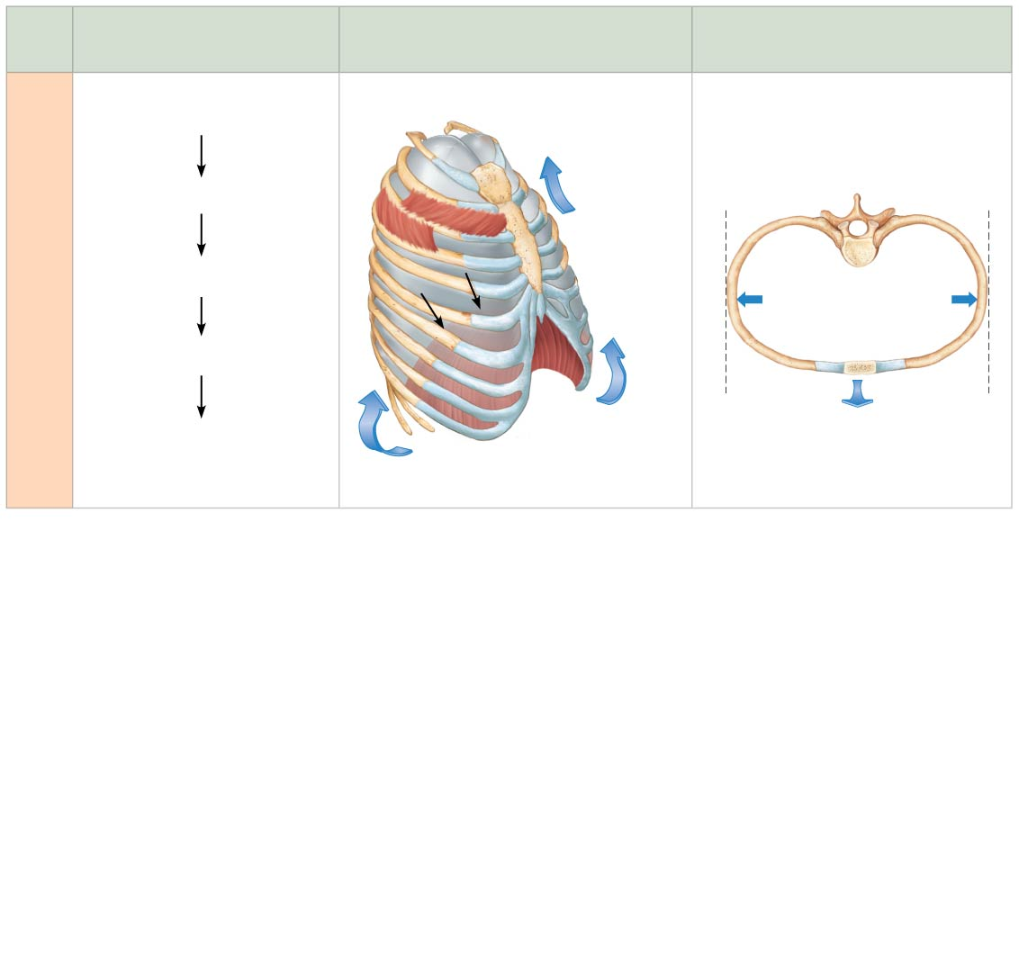
Figure 22.15 Changes in thoracic volume and sequence of events during inspiration and expiration.
Slide 6
Sequence of events
Changes in anterior-posterior and
superior-inferior dimensions
Changes in lateral dimensions
(superior view)
1
Inspiratory muscles contract
(diaphragm descends; rib cage
rises).
Ribs are
elevated and
sternum flares
as external
intercostals
contract.
Thoracic cavity volume
increases.
2
3
Lungs are stretched;
intrapulmonary volume increases.
Inspiration
External
intercostals
contract.
4
Intrapulmonary pressure
drops (to −1 mm Hg).
5
Air (gases) flows into lungs
down its pressure gradient until
intrapulmonary pressure is 0
(equal to atmospheric pressure).
Diaphragm moves
inferiorly during
contraction.

Slide 17
Pulmonary Ventilation (cont.)
Expiration
Quiet expiration normally is passive process
Inspiratory muscles relax, thoracic cavity volume decreases, and lungs recoil
Volume decrease causes intrapulmonary pressure (P_{pul}) to increase by +1 mm Hg
P_{pul} > Patm so air flows out of lungs down its pressure gradient until P_{pul} = P_{atm}
Forced expiration is an active process that uses oblique and transverse abdominal muscles, as well as internal intercostal muscles

Slide 18
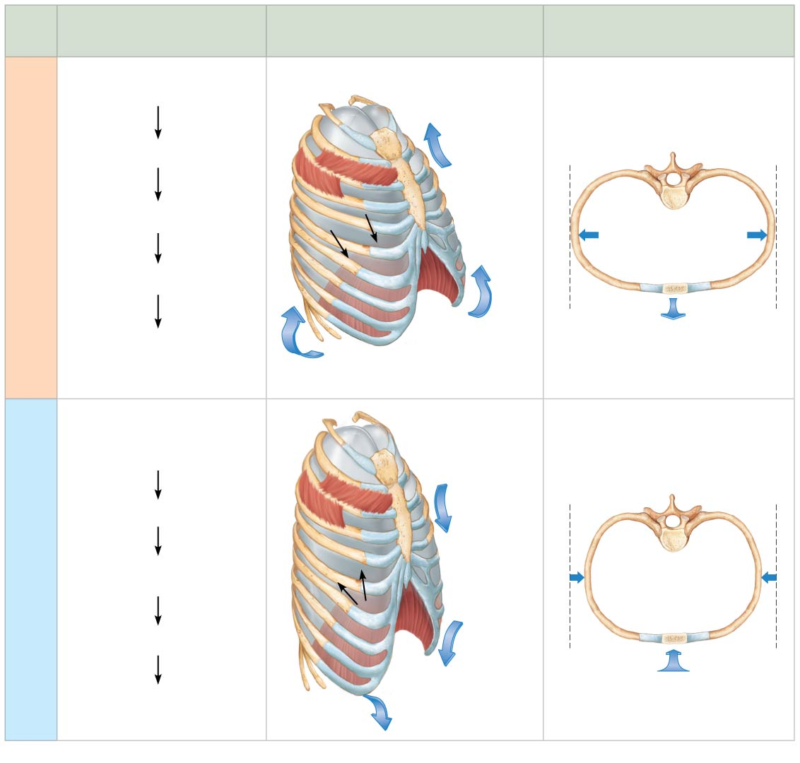
Figure 22.15 Changes in thoracic volume and sequence of events during inspiration and expiration.
Slide 11
Sequence of events
Changes in anterior-posterior and
superior-inferior dimensions
Changes in lateral dimensions
(superior view)
1
Inspiratory muscles contract
(diaphragm descends; rib cage
rises).
Ribs are
elevated and
sternum flares
as external
intercostals
contract.
Thoracic cavity volume
increases.
2
3
Lungs are stretched;
intrapulmonary volume increases.
Inspiration
External
intercostals
contract.
4
Intrapulmonary pressure
drops (to −1 mm Hg).
5
Air (gases) flows into lungs
down its pressure gradient until
intrapulmonary pressure is 0
(equal to atmospheric pressure).
Diaphragm moves
inferiorly during
contraction.
1
Inspiratory muscles relax
(diaphragm rises; rib cage
descends due to recoil of costal
cartilages).
Ribs and
sternum are
depressed as
external
intercostals
relax.
2
Thoracic cavity volume
decreases.
3
Expiration
Elastic lungs recoil
passively; intrapulmonary
volume decreases.
External
intercostals
relax.
4
Intrapulmonary pressure rises
(to +1 mm Hg).
5
Diaphragm
moves
superiorly
as it relaxes.
Air (gases) flows out of lungs
down its pressure gradient
until intrapulmonary pressure is 0.

Slide 19
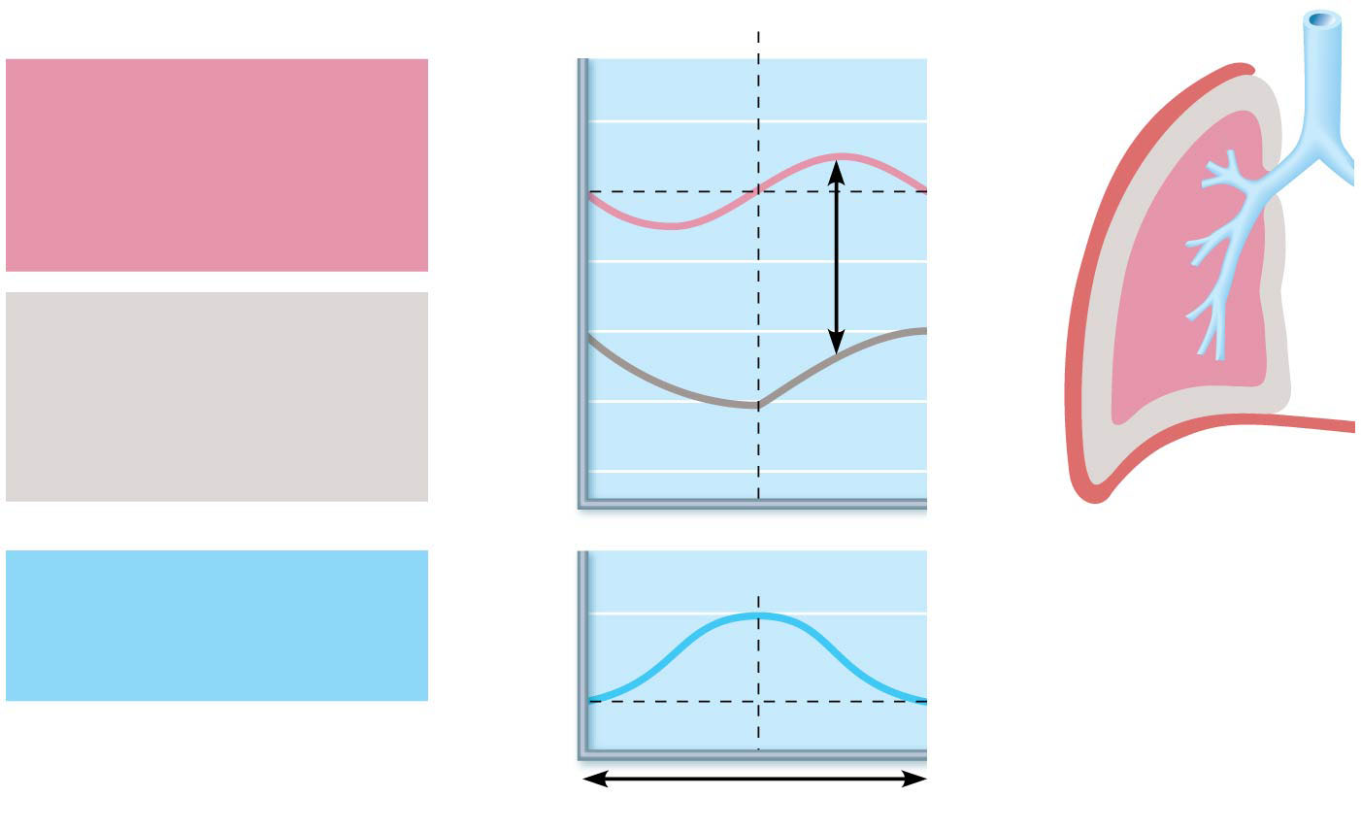
Figure 22.16 Changes in intrapulmonary and intrapleural pressures during inspiration and expiration.
Inspiration
Expiration
Intrapulmonary
pressure. Pressure inside
lung decreases as lung
volume increases during
inspiration; pressure
increases during expiration.
Intrapulmonary
pressure
+2
0
Pressure relative to
atmospheric pressure (mm Hg)
Trans-
pulmonary
pressure
−2
Intrapleural pressure.
Pleural cavity pressure
becomes more negative as
chest wall expands during
inspiration. Returns to initial
value as chest wall recoils.
−4
−6
Intrapleural
pressure
−8
Volume of breath. During
each breath, the pressure
gradients move 0.5 liter of
air into and out of the lungs.
Volume of breath
0.5
Volume (L)
0
5 seconds elapsed

Slide 20
Pulmonary Ventilation (cont.)
Nonrespiratory air movements
Many processes can move air into or out of lungs besides breathing
May modify normal respiratory rhythm
Most result from reflex action, although some are voluntary
Examples: coughing, sneezing, crying, laughing, hiccups, and yawns

Slide 21
Physical Factors Influencing Pulmonary Ventilation
Three physical factors influence the ease of air passage and the amount of energy required for ventilation
Airway resistance
Alveolar surface tension
Lung compliance

Slide 22
Physical Factors Influencing Pulmonary Ventilation
Airway resistance
Friction: major nonelastic source of resistance to gas flow; occurs in airways
Relationship between flow (F), pressure (P), and resistance (R):
∆P – pressure gradient between atmosphere and alveoli (2 mm Hg or less during normal quiet breathing)
2 mm Hg difference sufficient to move 500 ml of air
Gas flow changes inversely with resistance

Slide 23
Physical Factors Influencing Pulmonary Ventilation (cont.)
Airway resistance (cont.)
Resistance in respiratory tree is usually insignificant for two reasons:
Diameters of airways in first part of conducting zone are huge
Progressive branching of airways as they get smaller leads to an increase in total cross-sectional area
Any resistance usually occurs in medium-sized bronchi
Resistance disappears at terminal bronchioles, where diffusion is what drives gas movement

Slide 24
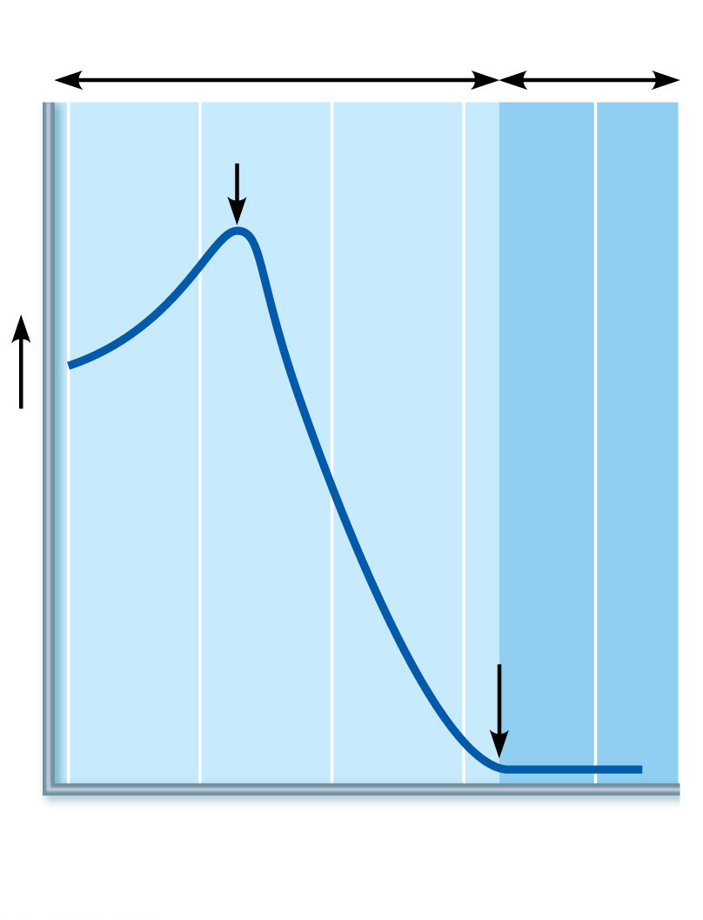
Figure 22.17 Resistance in respiratory passageways.
Conducting
zone
Respiratory
zone
Medium-sized
bronchi
Resistance
Terminal
bronchioles
1
5
10
15
20
23
Airway generation
(stage of branching)

Slide 25
Physical Factors Influencing Pulmonary Ventilation (cont.)
Alveolar surface tension
Surface tension: the attraction of liquid molecules to one another at a gas-liquid interface
Tends to draw liquid molecules closer together and reduce contact with dissimilar gas molecules
Resists any force that tends to increase surface area of liquid
Water, which has very high surface tension, coats alveolar walls in a thin film
Tends to cause alveoli to shrink to smallest size—that is, collapse

Slide 26
Physical Factors Influencing Pulmonary Ventilation (cont.)
Alveolar surface tension (cont.)
Surfactant is body’s detergent-like lipid and protein complex that helps reduce surface tension of alveolar fluid
Prevents alveolar collapse
Produced by type II alveolar cells

Slide 27
Physical Factors Influencing Pulmonary Ventilation (cont.)
Lung compliance
Lung compliance: measure of change in lung volume that occurs with given change in transpulmonary pressure
Measure of how much “stretch” the lung has
Normally high because of
Distensibility of lung tissue
Surfactant, which decreases alveolar surface tension
Higher lung compliance means it is easier to expand lungs

Slide 28
Physical Factors Influencing Pulmonary Ventilation (cont.)
Lung compliance (cont.)
Can be written mathematically as:
Where C_{L} equals compliance, ΔV_{L} equals change in lung volume, and Δ(P_{pul} − P_{ip}) equals change in transpulmonary pressure
Compliance can be diminished by:
Nonelastic scar tissue replacing lung tissue (fibrosis)
Reduced production of surfactant
Decreased flexibility of thoracic cage
ΔV_{L}
C_{L} =
Δ(P_{pul} - P_{ip})

Slide 29
22.5 Assessing Ventilation
Several respiratory volumes can be used to assess respiratory status
Respiratory volumes can be combined to calculate respiratory capacities, which can give information on a person’s respiratory status
Respiratory volumes and capacities are usually abnormal in people with pulmonary disorders
Spirometer: original, cumbersome clinical tool used to measure patient’s respiratory volumes
Electronic measuring devices used today

Slide 30
Respiratory Volumes (cont.)
Tidal volume (TV): amount of air moved into and out of lung with each breath
Averages ~500ml
Inspiratory reserve volume (IRV): amount of air that can be inspired forcibly beyond the tidal volume (2100–3200 ml)

Slide 31
Respiratory Volumes (cont.)
Expiratory reserve volume (ERV): amount of air that can be forcibly expelled from lungs (1000–1200 ml)
Residual volume (RV): amount of air that always remains in lungs
Needed to keep alveoli open

Slide 32
Respiratory Capacities
Combinations of two or more respiratory volumes
Inspiratory capacity (IC): sum of TV + IRV
Functional residual capacity (FRC): sum of RV + ERV
Vital capacity (VC): sum of TV + IRV + ERV
Total lung capacity (TLC): sum of all lung volumes (TV + IRV+ ERV + RV)

Slide 33
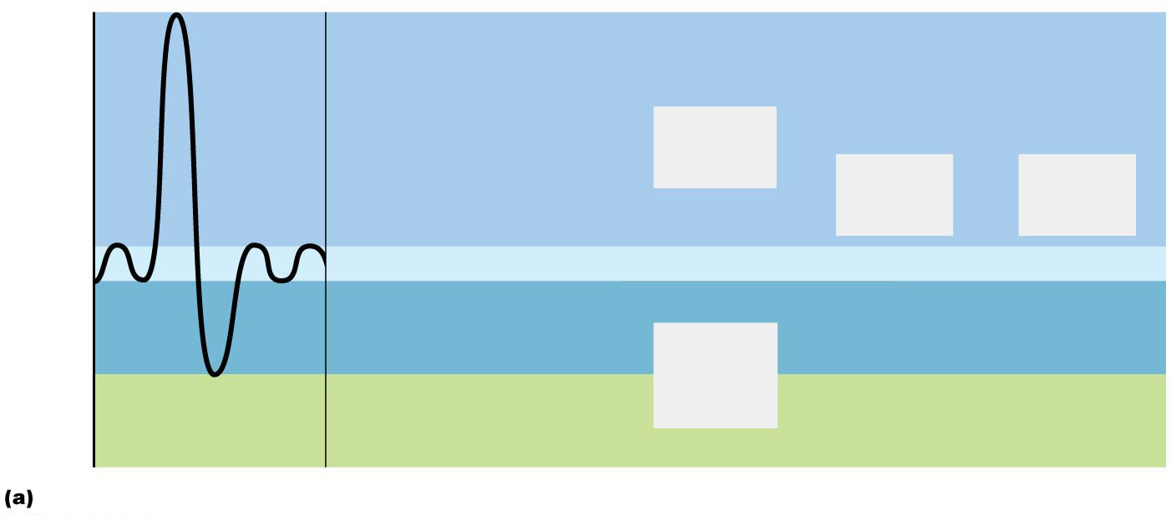
Figure 22.18a Respiratory volumes and capacities.
6000
5000
Inspiratory
reserve volume
3100 ml
Inspiratory
capacity
3600 ml
4000
Vital
capacity
4800 ml
Total lung
capacity
6000 ml
Milliliters (ml)
3000
Tidal volume 500 ml
2000
Expiratory
reserve volume
1200 ml
Functional
residual
capacity
2400 ml
1000
Residual volume
1200 ml
0
Spirographic record for a male

Slide 34
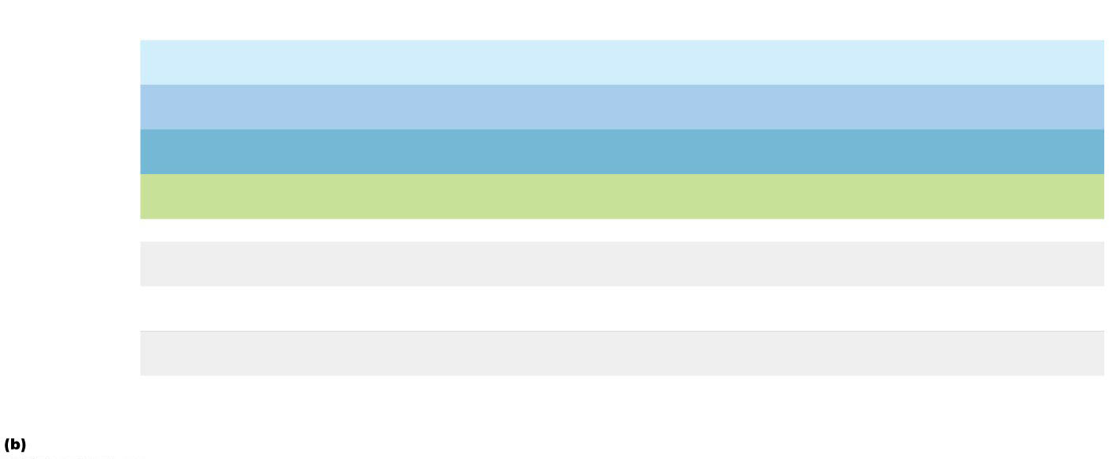
Figure 22.18b Respiratory volumes and capacities.
Measurement
Adult male
average value
Adult female
average value
Description
Tidal volume (TV)
500 ml
500 ml
Amount of air inhaled or exhaled with each breath under resting
conditions
Inspiratory reserve
volume (IRV)
3100 ml
1900 ml
Amount of air that can be forcefully inhaled after a normal tidal
volume inspiration
Respiratory
volumes
Expiratory reserve
volume (ERV)
Amount of air that can be forcefully exhaled after a normal tidal
volume expiration
1200 ml
700 ml
Residual volume (RV)
1200 ml
1100 ml
Amount of air remaining in the lungs after a forced expiration
Total lung capacity (TLC)
6000 ml
4200 ml
Maximum amount of air contained in lungs after a maximum
inspiratory effort: TLC = TV + IRV + ERV + RV
Vital capacity (VC)
4800 ml
3100 ml
Maximum amount of air that can be expired after a maximum
inspiratory effort: VC = TV + IRV + ERV
Respiratory
capacities
Maximum amount of air that can be inspired after a normal tidal
volume expiration: IC = TV + IRV
Inspiratory capacity (IC)
3600 ml
2400 ml
Functional residual
capacity (FRC)
2400 ml
1800 ml
Volume of air remaining in the lungs after a normal tidal volume
expiration: FRC = ERV + RV
Summary of respiratory volumes and capacities for males and females

Slide 35
Dead Space
Anatomical dead space: does not contribute to gas exchange
Consists of air that remains in passageways
~150 ml out of 500 ml TV
Alveolar dead space: space occupied by nonfunctional alveoli
Can be due to collapse or obstruction
Total dead space: sum of anatomical and alveolar dead space

Slide 36
Pulmonary Function Tests
Spirometry can distinguish between:
Obstructive pulmonary disease: increased airway resistance (example: bronchitis)
TLC, FRC, RV may increase because of hyperinflation of lungs
Restrictive disease: reduced TLC due to disease (example: tuberculosis) or exposure to environmental agents (example: fibrosis)
VC, TLC, FRC, RV decline because lung expansion is compromised

Slide 37
Pulmonary Function Tests (cont.)
Pulmonary functions tests can measure rate of gas movement
Forced vital capacity (FVC): amount of gas forcibly expelled after taking deep breath
Forced expiratory volume (FEV): amount of gas expelled during specific time interval of FVC
FEV₁: amount of air expelled in 1st second
Healthy individuals can expel 80% of FVC in 1st second
Patients with obstructive disease exhale less than 80% in 1st second, whereas those with restrictive disease exhale 80% or more even with reduced FVC

Slide 38
Alveolar Ventilation
Minute ventilation: total amount of gas that flows into or out of respiratory tract in 1 minute
Normal at rest = ~ 6 L/min
Normal with exercise = up to 200 L/min
Only rough estimate of respiratory efficiency
Alveolar ventilation rate (AVR): flow of gases into and out of alveoli during a particular time
Better indicator of effective ventilation

Slide 39
Alveolar Ventilation (cont.)
AVR takes into account amount of dead space, TV, and rate of breathing
Can be calculated by following equation:
Because dead space in an individual is normally constant, AVR is affected by TV and frequency
Significant increases in AVR are brought about by increasing TV rather than frequency
Rapid, shallow breathing can actually decrease AVR
AVR | = | frequency | × | (TV: dead space)
(ml/min) |  | (breaths/min) |  | (ml/breath)

Slide 40
Table 22.3 Effects of Breathing Rate and Depth on Alveolar Ventilation of Three Hypothetical Patients

Slide 41
22.6 Gas Exchange
Gas exchange occurs between lungs and blood as well as blood and tissues
External respiration: diffusion of gases between blood and lungs
Internal respiration: diffusion of gases between blood and tissues
Both processes are subject to:
Basic properties of gases
Composition of alveolar gas

Slide 42
Basic Properties of Gases
Dalton’s law of partial pressures
Total pressure exerted by mixture of gases is equal to sum of pressures exerted by each gas
Partial pressure
Pressure exerted by each gas in mixture
Directly proportional to its percentage in mixture

Slide 43
Basic Properties of Gases (cont.)
Total atmospheric pressure equals 760 mm Hg
Nitrogen makes up ~78.6% of air; therefore, partial pressure of nitrogen, P_{N2}, can be calculated:
0.786 × 760 mm Hg = 597 mm Hg due to N₂
Oxygen makes up 20.9% of air, so P_{O2} equals:
0.209 × 760 mm Hg = 159 mm Hg
Air also contains 0.04% CO2, 0.5% water vapor, and insignificant amounts of other gases
At high altitudes, partial pressures declines, but at lower altitudes (under water), partial pressures increase significantly

Slide 44
Table 22.3 Effects of Breathing Rate and Depth on Alveolar Ventilation of Three Hypothetical Patients

Slide 45
Basic Properties of Gases (cont.)
Henry’s law
For gas mixtures in contact with liquids:
Each gas will dissolve in the liquid in proportion to its partial pressure
At equilibrium, partial pressures in the two phases will be equal
Amount of each gas that will dissolve depends on:
Solubility: CO₂ is 20× more soluble in water than O₂, and little N₂ will dissolve
Temperature: as temperature of liquid rises, solubility decreases

Slide 46
Composition of Alveolar Gas
Alveoli contain more CO₂ and water vapor than atmospheric air because of:
Gas exchanges in lungs (O₂ diffuses out of lung, and CO₂ diffuses into lung)
Humidification of air by conducting passages
Mixing of alveolar gas with each breath
Newly inspired air mixes with air that was left in passageways between breaths

Slide 47
External Respiration
External respiration (pulmonary gas exchange) involves the exchange of O₂ and CO₂ across respiratory membranes
Exchange is influenced by:
Partial pressure gradients and gas solubilities
Thickness and surface area of respiratory membrane
Ventilation-perfusion coupling: matching of alveolar ventilation with pulmomary blood perfusion

Slide 48
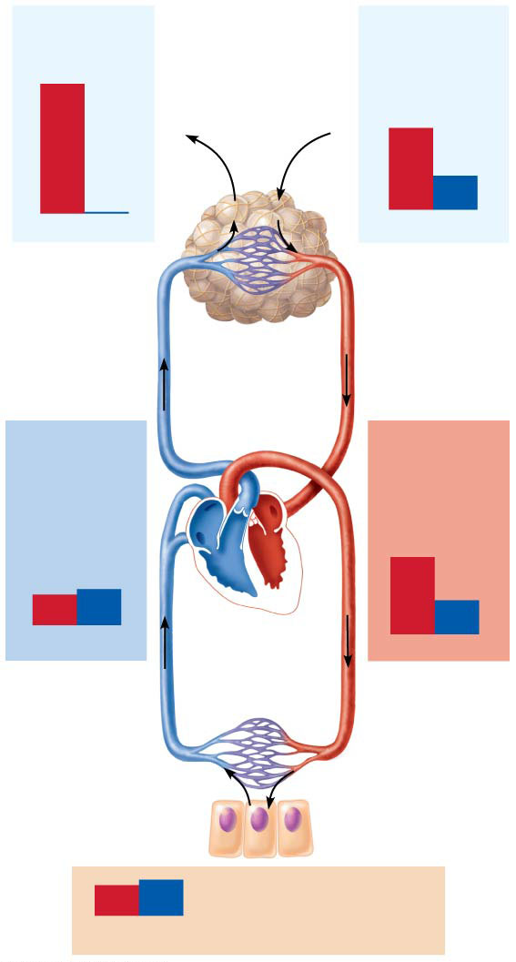
External Respiration (cont.)
Inspired air:
Alveoli of lungs:
P_{O2}
160 mm Hg
0.3 mm Hg
P_{O2}
104 mm Hg
40 mm Hg
Partial pressure gradients and gas solubilities
Steep partial pressure gradient for O₂ exists between blood and lungs
Venous blood P_{O2} = 40 mm Hg
Alveolar P_{O2} = 104 mm Hg
Drives oxygen flow into blood
Equilibrium is reached across respiratory membrane in ~0.25 seconds, but it takes red blood cell ~0.75 seconds to travel from start to end of pulmonary capillary
P_{CO2}
P_{CO2}
O₂
CO₂
CO₂
O₂
O₂
CO₂
External
respiration
Pulmonary
arteries
Alveoli
Pulmonary
veins (P_{O2}
100 mm Hg)
Blood leaving
tissues and
entering lungs:
Blood leaving
lungs and
entering tissue
capillaries:
P_{O2}
40 mm Hg
45 mm Hg
P_{O2}
100 mm Hg
40 mm Hg
P_{CO2}
P_{CO2}
O₂
CO₂
Heart
O₂
CO₂
Systemic
veins
Systemic
arteries
Internal
respiration
CO₂
O₂
Tissues:
O₂
CO₂
P_{O2}
less than 40 mm Hg
greater than 45 mm Hg
P_{CO2}

Slide 49
External Respiration
Inspired air:
Alveoli of lungs:
P_{O2}
160 mm Hg
0.3 mm Hg
P_{O2}
104 mm Hg
40 mm Hg
P_{CO2}
P_{CO2}
Partial pressure gradient for CO₂ is less steep
Though gradient is not as steep, CO₂ still diffuses in equal amounts with oxygen
Reason is that CO₂ is 20× more soluble in plasma and alveolar fluid than oxygen
O₂
CO₂
CO₂
O₂
O₂
CO₂
External
respiration
Pulmonary
arteries
Alveoli
Pulmonary
veins (P_{O2}
100 mm Hg)
Blood leaving
tissues and
entering lungs:
Blood leaving
lungs and
entering tissue
capillaries:
P_{O2}
40 mm Hg
45 mm Hg
P_{O2}
100 mm Hg
40 mm Hg
P_{CO2}
P_{CO2}
O₂
CO₂
Heart
O₂
CO₂
Systemic
veins
Systemic
arteries
Internal
respiration
CO₂
O₂
Tissues:
O₂
CO₂
P_{O2}
less than 40 mm Hg
greater than 45 mm Hg
P_{CO2}

Slide 50
Figure 22.19 Partial pressure gradients promoting gas movements in the body.
Inspired air:
Alveoli of lungs:
P_{O2}
160 mm Hg
0.3 mm Hg
P_{O2}
104 mm Hg
40 mm Hg
P_{CO2}
P_{CO2}
O₂
CO₂
CO₂
O₂
O₂
CO₂
External
respiration
Pulmonary
arteries
Alveoli
Pulmonary
veins (P_{O2}
100 mm Hg)
Blood leaving
tissues and
entering lungs:
Blood leaving
lungs and
entering tissue
capillaries:
P_{O2}
40 mm Hg
45 mm Hg
P_{O2}
100 mm Hg
40 mm Hg
P_{CO2}
P_{CO2}
O₂
CO₂
Heart
O₂
CO₂
Systemic
veins
Systemic
arteries
Internal
respiration
CO₂
O₂
Tissues:
O₂
CO₂
P_{O2}
less than 40 mm Hg
greater than 45 mm Hg
P_{CO2}

Slide 51
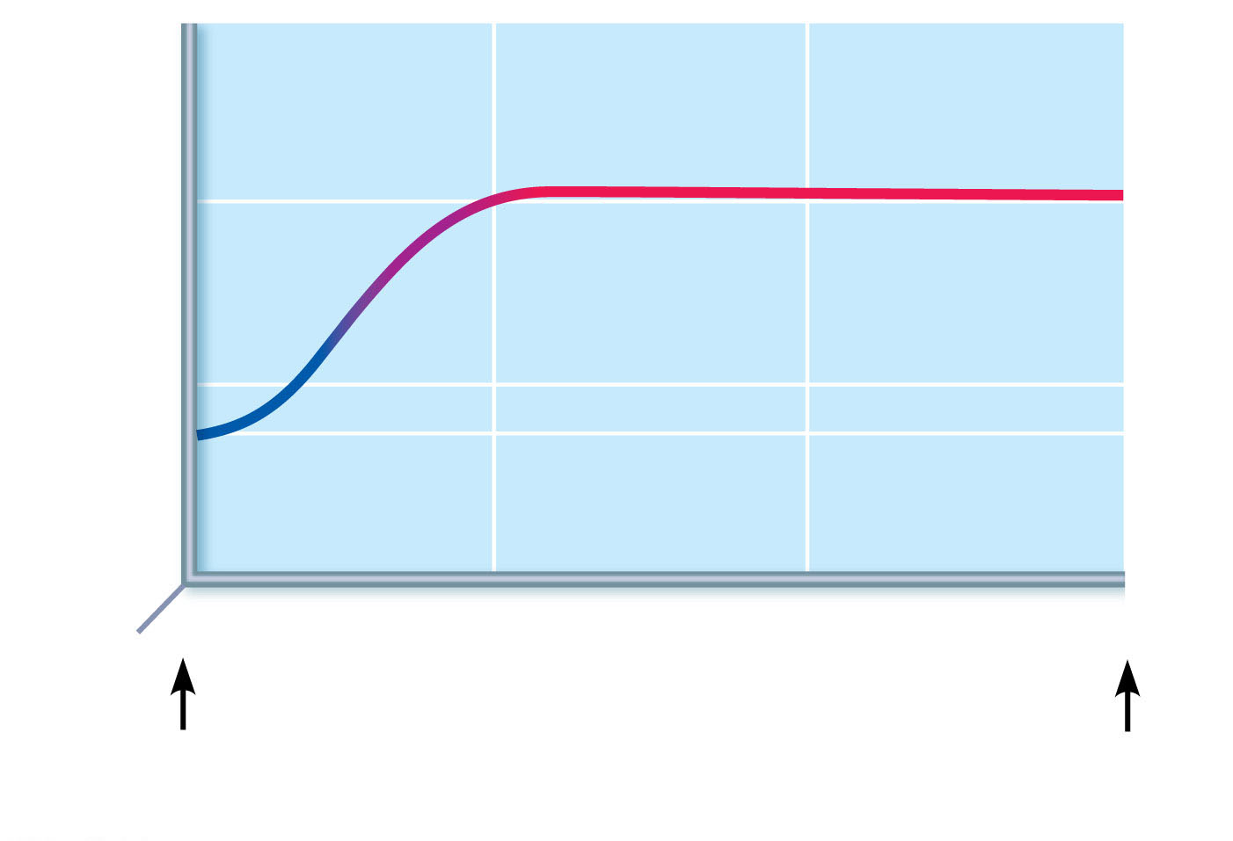
Figure 22.20 Oxygenation of blood in the pulmonary capillaries at rest.
150
100
P_{O2} 104 mm Hg
P_{O2} (mm Hg)
50
40
0
0
0.25
0.50
0.75
Time in the
pulmonary capillary (s)
Start of
capillary
End of
capillary

Slide 52
External Respiration (cont.)
Thickness and surface area of the respiratory membrane
Respiratory membranes are very thin
0.5 to 1 μm thick
Large total surface area of the alveoli is 40× the surface area of the skin

Slide 53
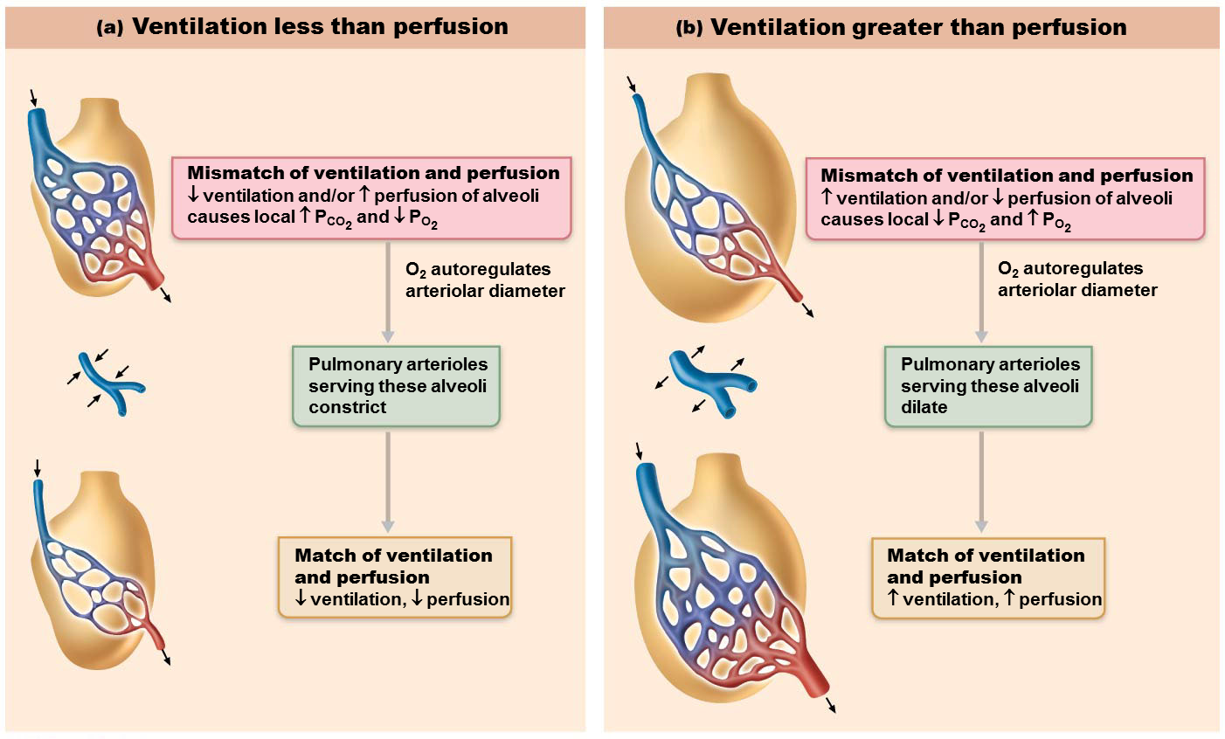
External Respiration (cont.)
Ventilation-perfusion coupling
Perfusion: blood flow reaching alveoli
Ventilation: amount of gas reaching alveoli
Ventilation and perfusion rates must be matched for optimal, efficient gas exchange
Both are controlled by local autoregulatory mechanisms
P_{O2} controls perfusion by changing arteriolar diameter
P_{CO2} controls ventilation by changing bronchiolar diameter

Slide 54
External Respiration (cont.)
Influence of local P_{O2} on perfusion
Changes in P_{O2} in alveoli cause changes in diameters of arterioles
Where alveolar O₂ is high, arterioles dilate
Where alveolar O₂ is low, arterioles constrict
Directs blood to go to alveoli, where oxygen is high, so blood can pick up more oxygen
Influence of local P_{CO2} on perfusion
Changes in P_{CO2} in alveoli cause changes in diameters of bronchioles
Where alveolar CO₂ is high, bronchioles dilate
Where alveolar CO₂ is low, bronchioles constrict
Allows elimination of CO₂ more rapidly

Slide 55
External Respiration (cont.)
Balancing ventilation and perfusion
Changing diameters of local arterioles and bronchioles synchronizes ventilation-perfusion
Ventilation-perfusion is never balanced for all alveoli because:
Regional variations may be present, due to effect of gravity on blood and air flow
Occasionally, alveolar ducts plugged with mucus cause unventilated areas

Slide 56
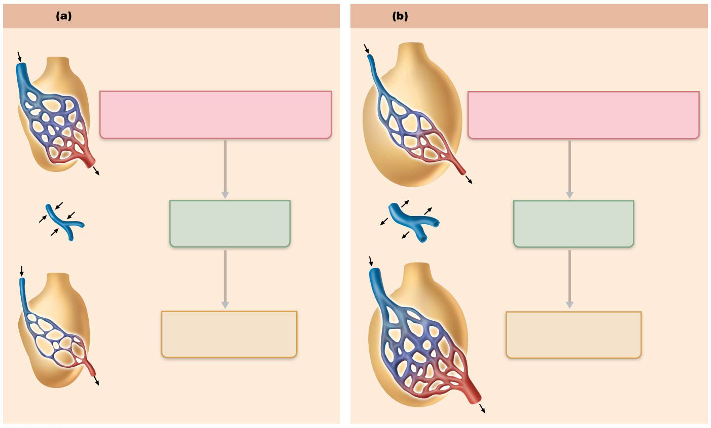
Figure 22.21 Ventilation-perfusion coupling.
Ventilation less than perfusion
Ventilation greater than perfusion
Mismatch of ventilation and perfusion
↓ ventilation and/or ↑ perfusion of alveoli
causes local ↑ P_{CO2} and ↓ P_{O2}
Mismatch of ventilation and perfusion
↑ ventilation and/or ↓ perfusion of alveoli
causes local ↓ P_{CO2} and ↑ P_{O2}
O₂ autoregulates
arteriolar diameter
O₂ autoregulates
arteriolar diameter
Pulmonary arterioles
serving these alveoli
constrict
Pulmonary arterioles
serving these alveoli
dilate
Match of ventilation
and perfusion
↓ ventilation, ↓ perfusion
Match of ventilation
and perfusion
↑ ventilation, ↑ perfusion

Slide 57
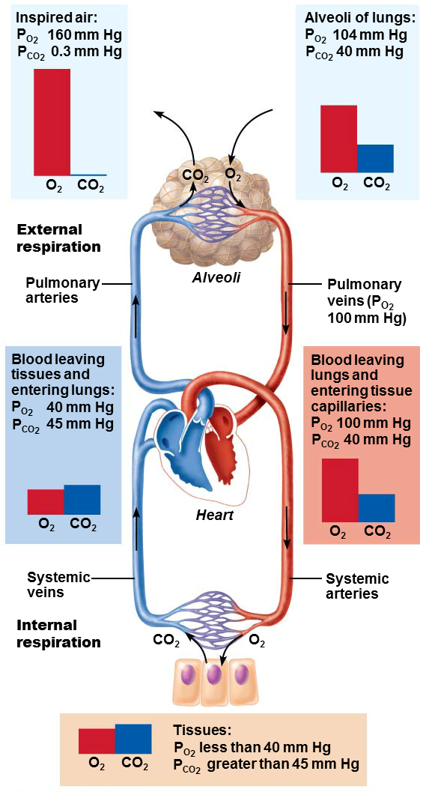
Internal Respiration
Internal respiration involves capillary gas exchange in body tissues
Partial pressures and diffusion gradients are reversed compared to external respiration
Tissue P_{O2} is always lower than in arterial blood P_{O2}, so oxygen moves from blood to tissues
Tissue P_{CO2} is always higher than arterial blood P_{CO2}, so CO₂ moves from tissues into blood
Venous blood returning to heart has P_{O2} of 40 mm Hg and P_{CO2} of 45 mm Hg

