Slide 2
Independent/Group Notes
Your book
https://www.youtube.com/watch?v=X9ZZ6tcxArI
http://science.nationalgeographic.com/science/health-and-human-body/human-body/heart-article/
https://www.khanacademy.org/science/health-and-medicine/human-anatomy-and-physiology/heart-introduction/v/layers-of-the-heart

Slide 3
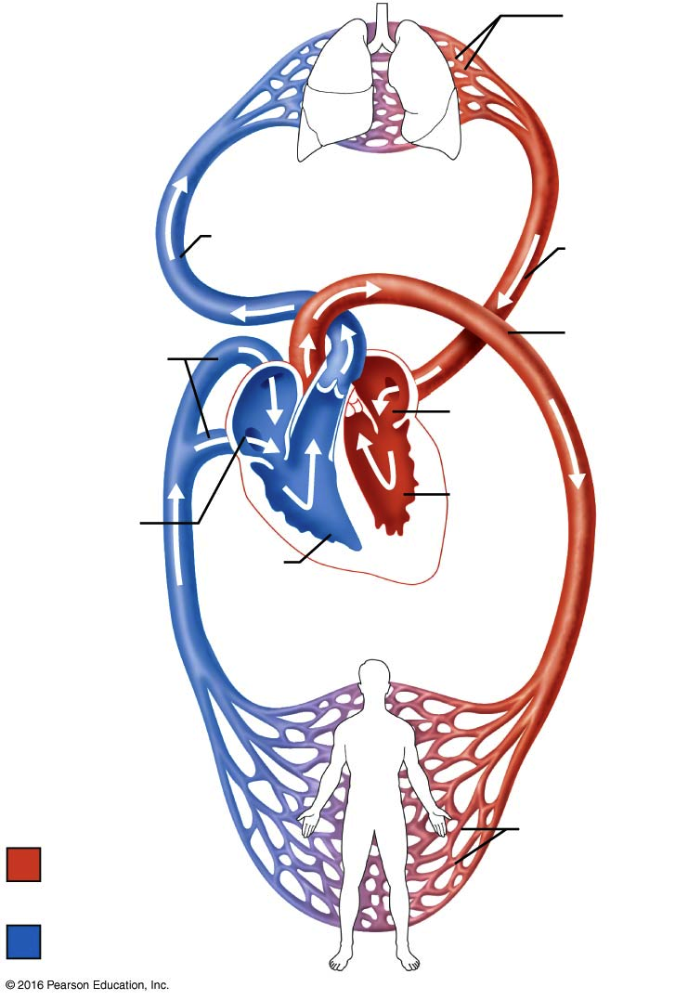
The Pulmonary and Systemic Circuits

Slide 4
The Pulmonary and Systemic Circuits
 | Description of Blood Flow | Importance
Pulmonary Circuit
Systemic Circuit

Slide 5
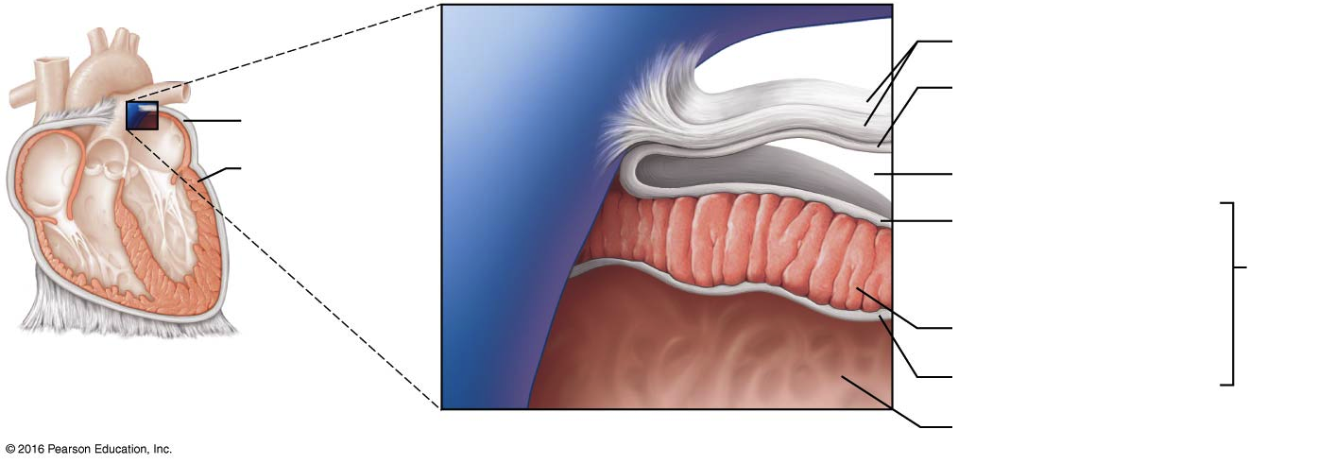
The layers of the pericardium and of the heart wall.

Slide 6
The layers of the pericardium and of the heart wall.
 | Composition | Importance
Heart chamber
Fibrous pericardium
Parietal layer of serous pericardium
Pericardial cavity

Slide 7
The layers of the pericardium and of the heart wall.
 | Composition | Importance
Endocardium
Myocardium
Epicardium

Slide 8
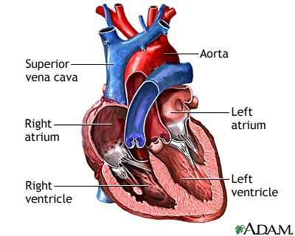
Heart Chambers

Slide 9
Heart Chambers
 | Blood Flow Description | Importance
Right Atrium
Right Ventricle
Left Atrium
Left Ventricle

Slide 10
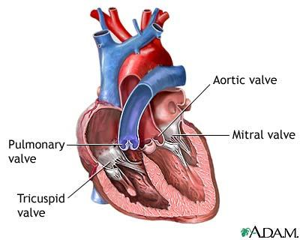
Valves of the Heart

Slide 11
Major Vessels & Valves
 | Blood Flow Description | Importance
Aortic (semi-lunar)
Mitral (atrioventricular)
Pulmonary (semi-lunar)
Superior Vena Cava
Inferior Vena Cava

Slide 12
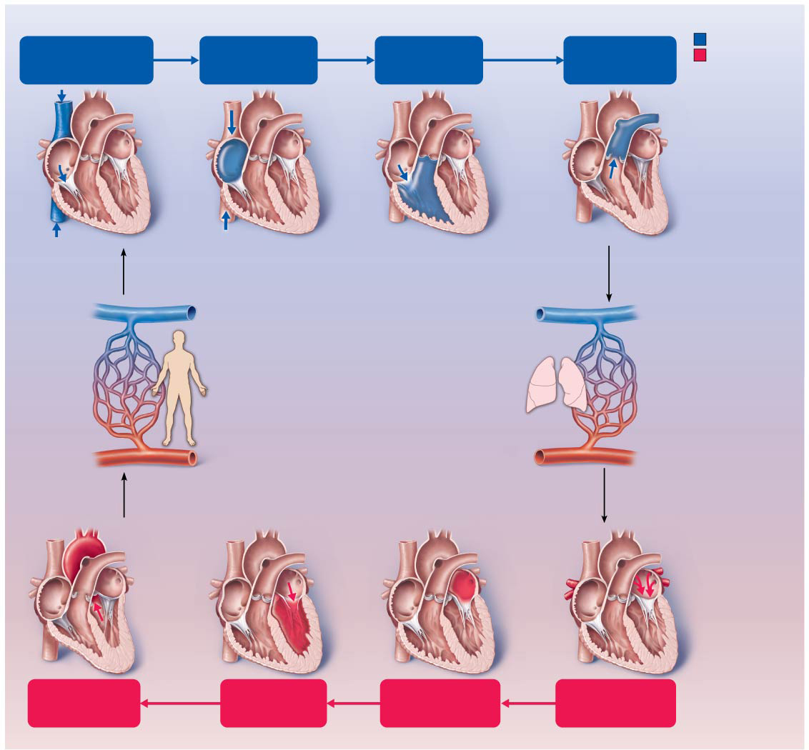
Superior vena cava (SVC)
Inferior vena cava (IVC)
Coronary sinus
Tricuspid
valve
Pulmonary
semilunar valve
Oxygen-poor blood
Right
atrium
Right
ventricle
Pulmonary
trunk
Oxygen-rich blood
Pulmonary
arteries
SVC
Coronary
sinus
Pulmonary
trunk
Right
atrium
Tricuspid
valve
Pulmonary
semilunar
valve
IVC
Right
ventricle
Oxygen-poor blood
returns from the body
tissues back to the heart.
Oxygen-poor blood is carried
in two pulmonary arteries to
the lungs (pulmonary circuit)
to be oxygenated.
To lungs
To heart
Systemic
capillaries
Pulmonary
capillaries
To body
Oxygen-rich blood is
delivered to the body
tissues (systemic circuit).
Oxygen-rich blood
returns to the heart via
the four pulmonary veins.
To heart
Aorta
Pulmonary
veins
Aortic
semilunar
valve
Mitral
valve
Left
atrium
Left
ventricle
Aortic
semilunar valve
Left
ventricle
Mitral
valve
Left
atrium
Four
pulmonary
veins
Aorta

Slide 13
Veins/Arteries in Blood Flow
 | Blood Flow Description | Importance
Aorta
Pulmonary Veins
Pulmonary Trunk
Pulmonary Arteries

Slide 14
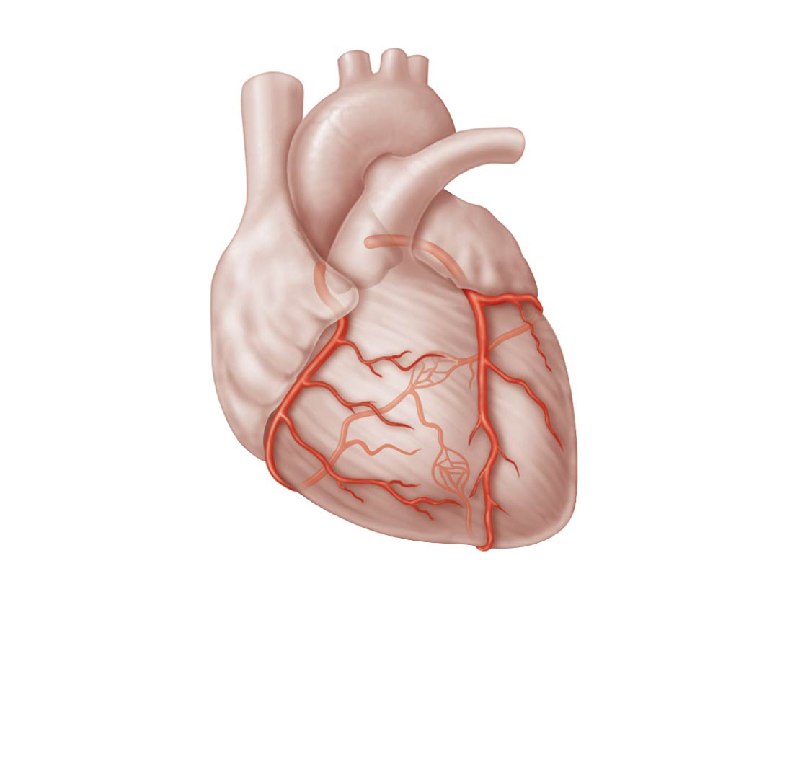
Coronary Circulation
Aorta
Pulmonary
trunk
Superior
vena cava
Left atrium
Anastomosis
(junction of
vessels)
Left
coronary
artery
Right
atrium
Circumflex
artery
Right
coronary
artery
Left
ventricle
Right
ventricle
Anterior
interventricular
artery
Right
marginal
artery
Posterior
interventricular
artery

Slide 15
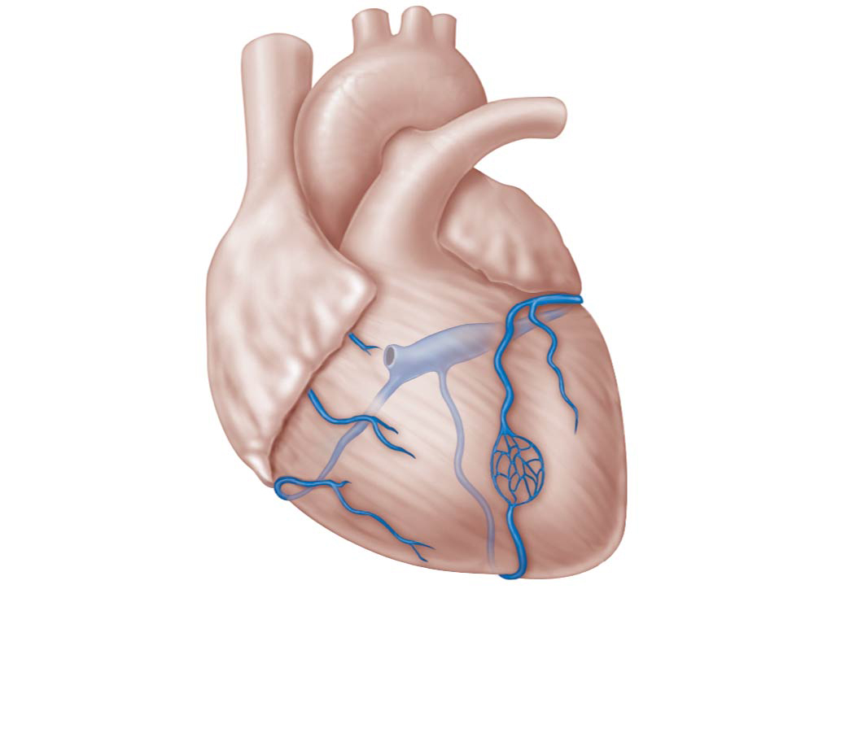
Coronary Circulation
Superior
vena cava
Great
cardiac
vein
Anterior
cardiac
veins
Coronary
sinus
Small
cardiac
vein
Middle
cardiac
vein

Slide 16
Coronary Circulation
 | Blood Flow Description
Coronary Sinus
Cardiac Veins
Left Coronary Artery
Right Coronary Artery

Slide 17
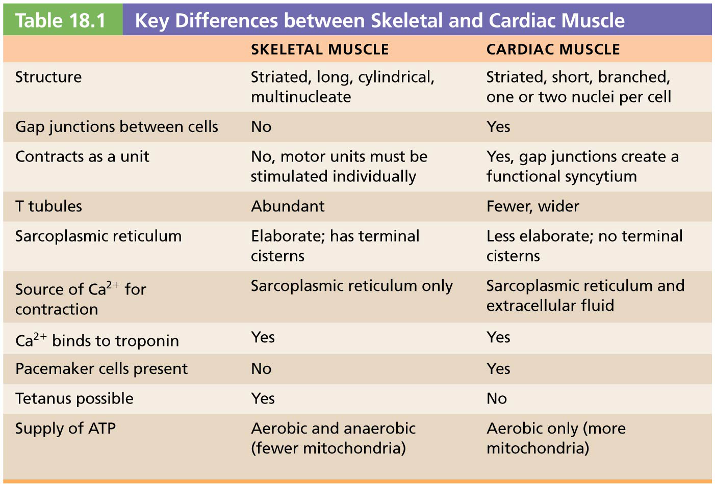
 | Blood Flow Description | Importance
Aorta
Pulmonary Veins
Pulmonary Trunk
Pulmonary Arteries

Slide 18
18.1 Heart Anatomy
The Pulmonary and Systemic Circuits
Heart is a transport system consisting of two side-by-side pumps
Right side receives oxygen-poor blood from tissues
Pumps blood to lungs to get rid of CO₂, pick up O₂, via pulmonary circuit
Left side receives oxygenated blood from lungs
Pumps blood to body tissues via systemic circuit

Slide 19
The Pulmonary and Systemic Circuits (cont.)
Receiving chambers of heart
Right atrium
Receives blood returning from systemic circuit
Left atrium
Receives blood returning from pulmonary circuit
Pumping chambers of heart
Right ventricle
Pumps blood through pulmonary circuit
Left ventricle
Pumps blood through systemic circuit

Slide 20
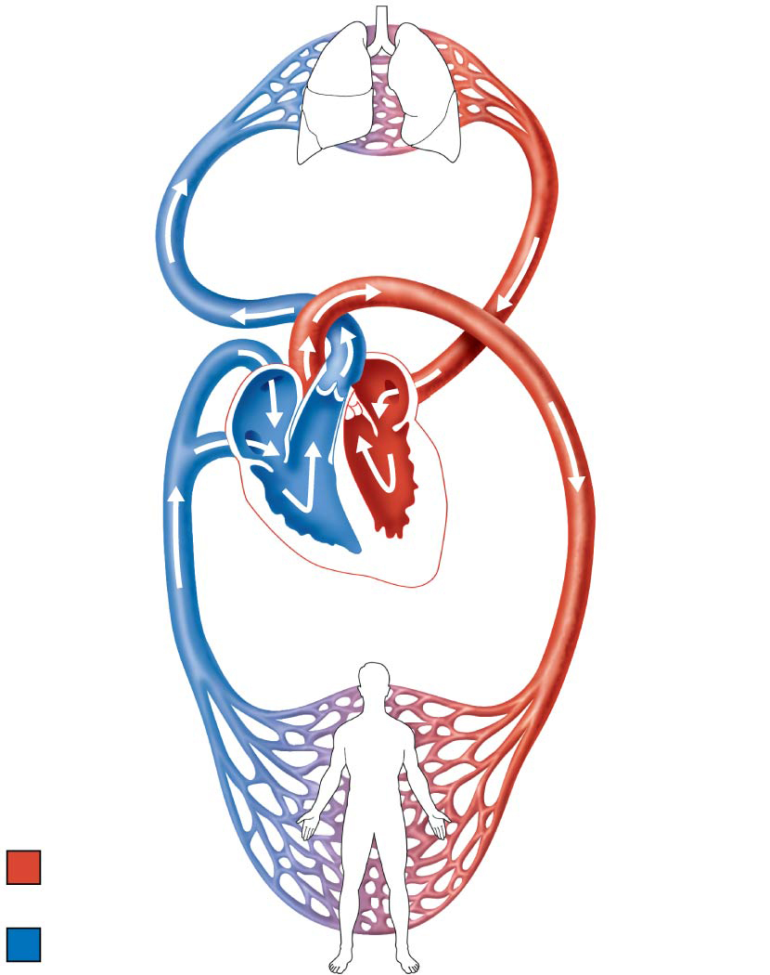
Figure 18.1 The systemic and pulmonary circuits.
Capillary beds
of lungs where
gas exchange
occurs
Pulmonary Circuit
Pulmonary
arteries
Pulmonary
veins
Aorta and
branches
Venae
cavae
Left
atrium
Left
ventricle
Right
atrium
Right
ventricle
Heart
Systemic Circuit
Capillary beds
of all body
tissues where gas
exchange occurs
Oxygen-rich,
CO₂-poor blood
Oxygen-poor,
CO₂-rich blood

Slide 21
Size, Location, and Orientation of Heart
Approximately the size of a fist
Weighs less than 1 pound
Location
In mediastinum between second rib and fifth intercostal space
On superior surface of diaphragm
Two-thirds of heart to left of midsternal line
Anterior to vertebral column, posterior to sternum

Slide 22
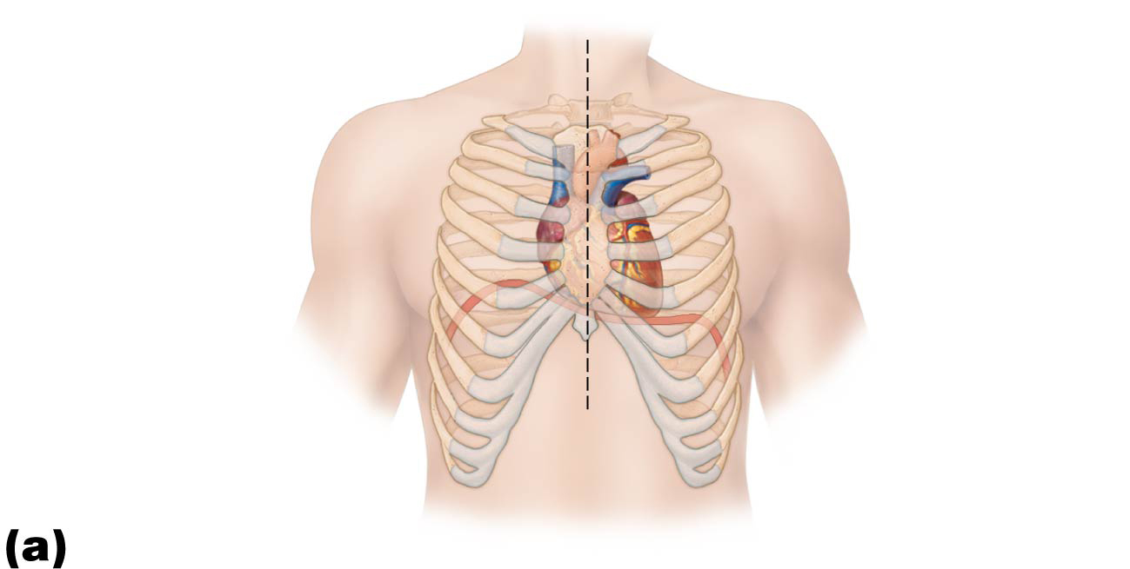
Figure 18.2a Location of the heart in the mediastinum.
Midsternal line
2nd rib
Sternum
Diaphragm
Location of
apical
impulse

Slide 23
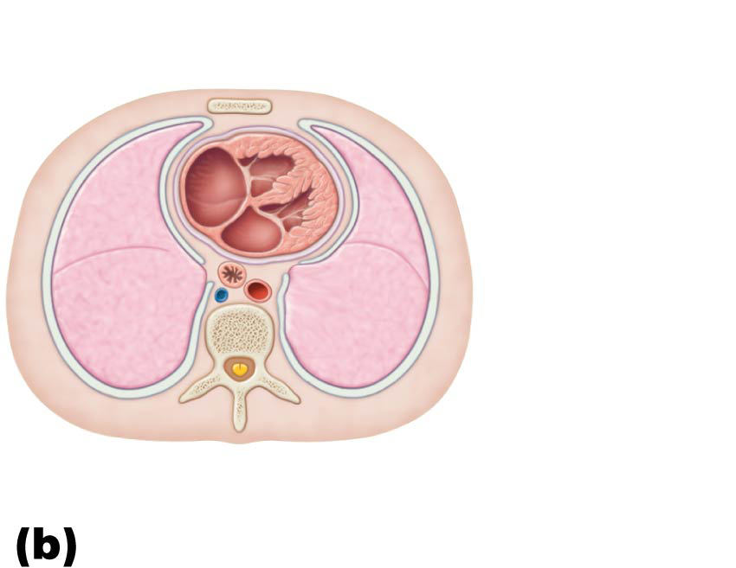
Figure 18.2b Location of the heart in the mediastinum.
Mediastinum
Heart
Left lung
Body of T₈
vertebra
Posterior

Slide 24
Size, Location, and Orientation of Heart (cont.)
Base (posterior surface) leans toward right shoulder
Apex points toward left hip
Apical impulse palpated between fifth and sixth ribs, just below left nipple

Slide 25
Figure 18.2a Location of the heart in the mediastinum.
Midsternal line
2nd rib
Sternum
Diaphragm
Location of
apical
impulse

Slide 26
Figure 18.2b Location of the heart in the mediastinum.
Mediastinum
Heart
Left lung
Body of T₈
vertebra
Posterior

Slide 27
Coverings of the Heart
Pericardium: double-walled sac that surrounds heart; made up of two layers
Superficial fibrous pericardium: functions to protect, anchor heart to surrounding structures, and prevent overfilling
Deep two-layered serous pericardium
Parietal layer lines internal surface of fibrous pericardium
Visceral layer (epicardium) on external surface of heart
Two layers separated by fluid-filled pericardial cavity (decreases friction)

Slide 28
Layers of the Heart Wall
Three layers of heart wall
Epicardium: visceral layer of serous pericardium
Myocardium: circular or spiral bundles of contractile cardiac muscle cells
Cardiac skeleton: crisscrossing, interlacing layer of connective tissue
Anchors cardiac muscle fibers
Supports great vessels and valves
Limits spread of action potentials to specific paths

Slide 29
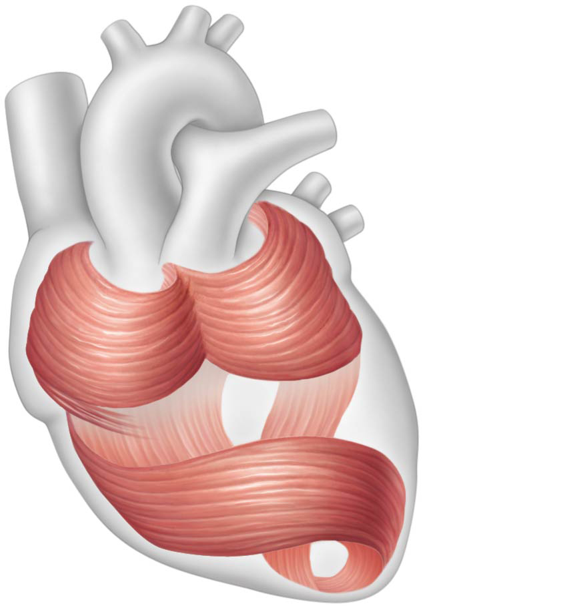
Figure 18.4 The circular and spiral arrangement of cardiac muscle bundles in the myocardium of the heart.
Cardiac
muscle
bundles

Slide 30
Layers of the Heart Wall (cont.)
Endocardium: innermost layer; is continuous with endothelial lining of blood vessels
Lines heart chambers and covers cardiac skeleton of valves

Slide 31
Figure 18.3 The layers of the pericardium and of the heart wall.
Pulmonary
trunk
Fibrous pericardium
Parietal layer of serous
pericardium
Pericardium
Myocardium
Pericardial cavity
Epicardium (visceral
layer of serous
pericardium)
Heart
wall
Myocardium
Endocardium
Heart chamber

Slide 32
Chambers and Associated Great Vessels
Internal features
Four chambers
Two superior atria
Two inferior ventricles
Interatrial septum: separates atria
Fossa ovalis: remnant of foramen ovale of fetal heart
Interventricular septum: separates ventricles

Slide 33
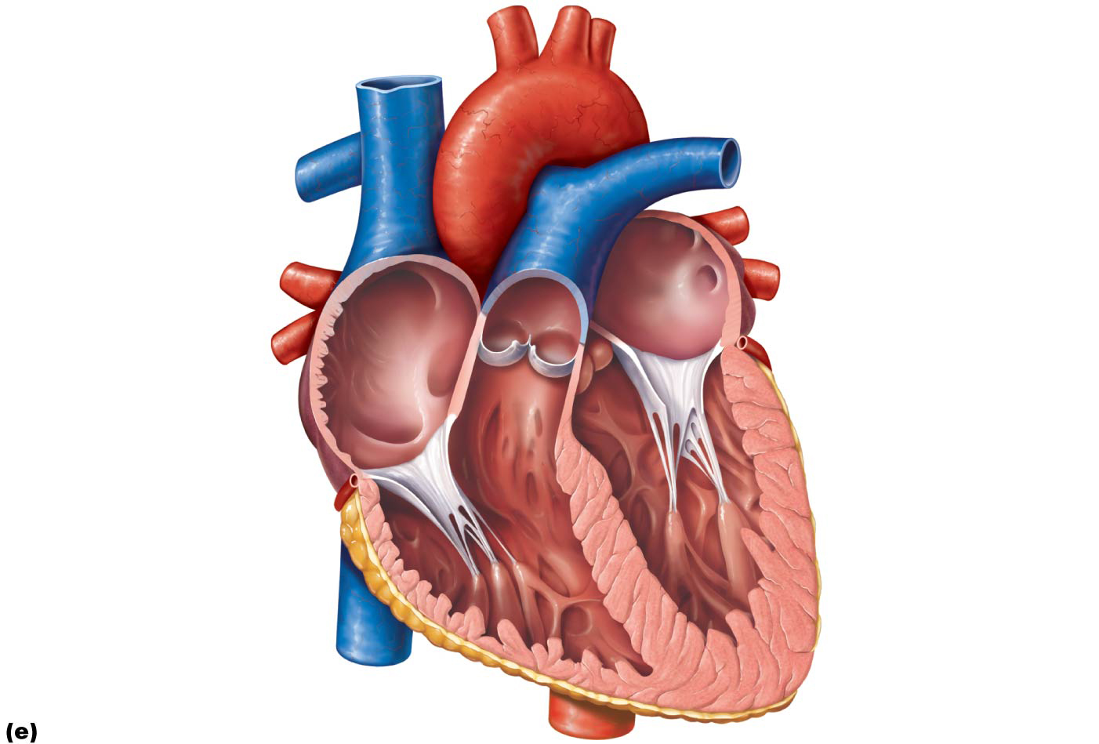
Figure 18.5e Gross anatomy of the heart.
Aorta
Superior vena cava
Left pulmonary artery
Right pulmonary artery
Left atrium
Pulmonary trunk
Left pulmonary veins
Right atrium
Mitral (bicuspid) valve
Right pulmonary veins
Fossa ovalis
Aortic valve
Pectinate muscles
Pulmonary valve
Tricuspid valve
Right ventricle
Left ventricle
Chordae tendineae
Papillary muscle
Trabeculae carneae
Interventricular septum
Epicardium
Inferior vena cava
Myocardium
Endocardium
Frontal section

Slide 34
Chambers and Associated Great Vessels (cont.)
Surface features
Coronary sulcus (atrioventricular groove)
Encircles junction of atria and ventricles
Anterior interventricular sulcus
Anterior position of interventricular septum
Posterior interventricular sulcus
Landmark on posteroinferior surface

Slide 35
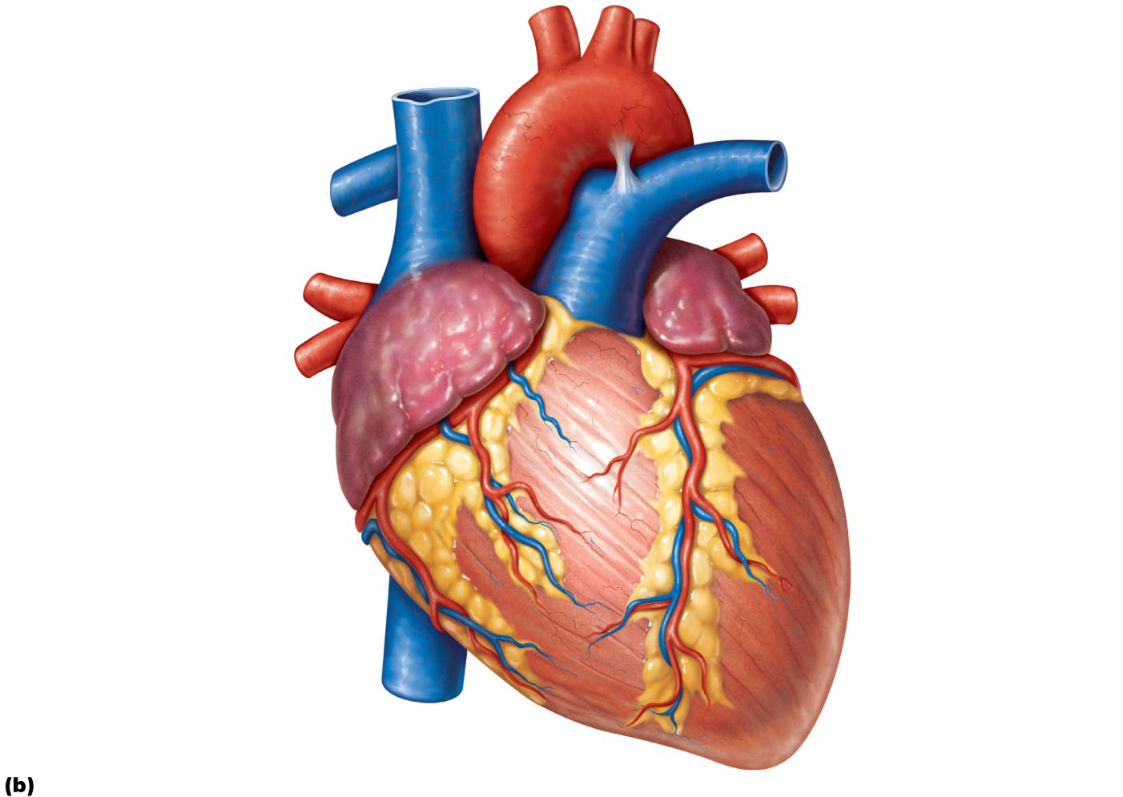
Figure 18.5b Gross anatomy of the heart.
Brachiocephalic trunk
Left common carotid
artery
Left subclavian artery
Superior vena cava
Aortic arch
Right pulmonary artery
Ligamentum arteriosum
Left pulmonary artery
Ascending aorta
Left pulmonary veins
Pulmonary trunk
Auricle of
left atrium
Right pulmonary veins
Right atrium
Circumflex artery
Right coronary artery
(in coronary sulcus)
Left coronary artery
(in coronary sulcus)
Anterior cardiac vein
Left ventricle
Right ventricle
Right marginal artery
Great cardiac vein
Small cardiac vein
Anterior interventricular
artery (in anterior
interventricular sulcus)
Inferior vena cava
Apex
Anterior view

Slide 36
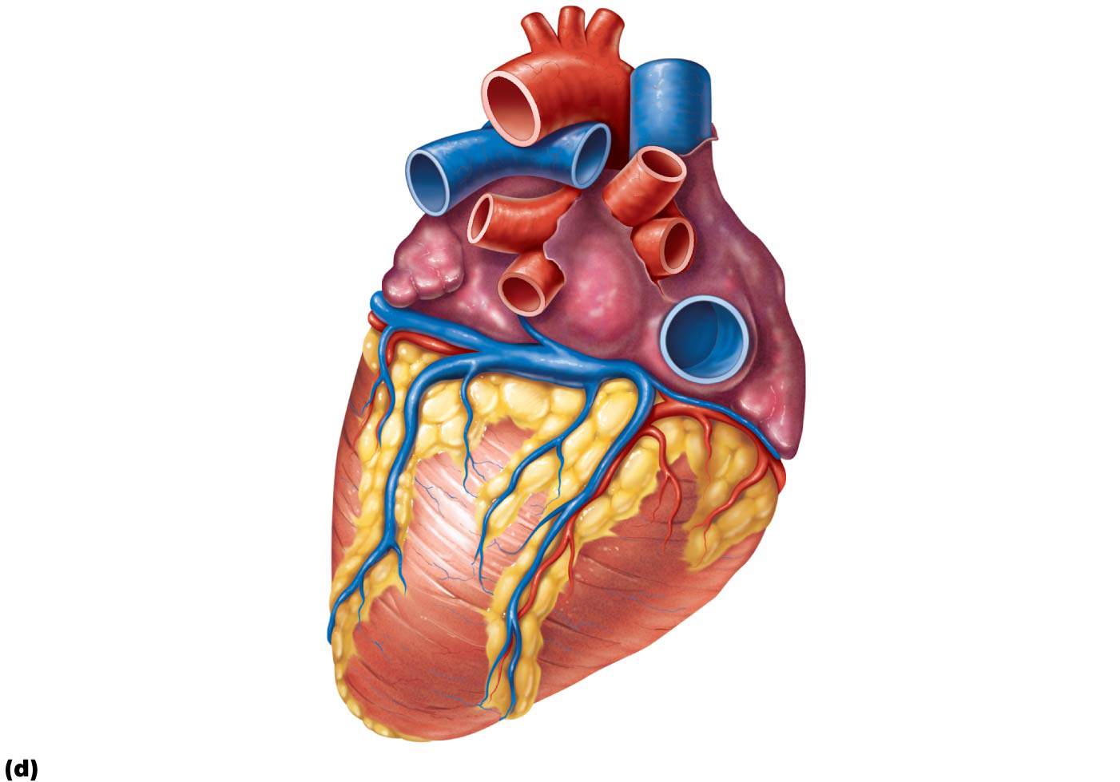
Figure 18.5d Gross anatomy of the heart.
Aorta
Superior vena cava
Left pulmonary artery
Right pulmonary artery
Right pulmonary veins
Left pulmonary veins
Auricle of left atrium
Right atrium
Left atrium
Inferior vena cava
Great cardiac vein
Coronary sinus
Posterior vein of
left ventricle
Right coronary artery
(in coronary sulcus)
Posterior interventricular
artery (in posterior
interventricular sulcus)
Left ventricle
Middle cardiac vein
Apex
Right ventricle
Posterior surface view

Slide 37
Chambers and Associated Great Vessels (cont.)
Atria: the receiving chambers
Small, thin-walled chambers; contribute little to propulsion of blood
Auricles: appendages that increase atrial volume
Right atrium: receives deoxygenated blood from body
Anterior portion is smooth-walled
Posterior portion contains ridges formed by pectinate muscles
Posterior and anterior regions are separated by crista terminalis

Slide 38
Chambers and Associated Great Vessels (cont.)
Atria: the receiving chambers (cont.)
Three veins empty into right atrium:
Superior vena cava: returns blood from body regions above the diaphragm
Inferior vena cava: returns blood from body regions below the diaphragm
Coronary sinus: returns blood from coronary veins
Left atrium: receives oxygenated blood from lungs
Pectinate muscles found only in auricles
Four pulmonary veins return blood from lungs

Slide 39
Figure 18.5e Gross anatomy of the heart.
Aorta
Superior vena cava
Left pulmonary artery
Right pulmonary artery
Left atrium
Pulmonary trunk
Left pulmonary veins
Right atrium
Mitral (bicuspid) valve
Right pulmonary veins
Fossa ovalis
Aortic valve
Pectinate muscles
Pulmonary valve
Tricuspid valve
Right ventricle
Left ventricle
Chordae tendineae
Papillary muscle
Trabeculae carneae
Interventricular septum
Epicardium
Inferior vena cava
Myocardium
Endocardium
Frontal section

Slide 40
Chambers and Associated Great Vessels (cont.)
Ventricles: the discharging chambers
Make up most of the volume of heart
Right ventricle: most of anterior surface
Left ventricle: posteroinferior surface
Trabeculae carneae: irregular ridges of muscle on ventricular walls
Papillary muscles: project into ventricular cavity
Anchor chordae tendineae that are attached to heart valves

Slide 41
Chambers and Associated Great Vessels (cont.)
Ventricles: the discharging chambers (cont.)
Thicker walls than atria
Actual pumps of heart
Right ventricle
Pumps blood into pulmonary trunk
Left ventricle
Pumps blood into aorta (largest artery in body)

Slide 42
Figure 18.5e Gross anatomy of the heart.
Aorta
Superior vena cava
Left pulmonary artery
Right pulmonary artery
Left atrium
Pulmonary trunk
Left pulmonary veins
Right atrium
Mitral (bicuspid) valve
Right pulmonary veins
Fossa ovalis
Aortic valve
Pectinate muscles
Pulmonary valve
Tricuspid valve
Right ventricle
Left ventricle
Chordae tendineae
Papillary muscle
Trabeculae carneae
Interventricular septum
Epicardium
Inferior vena cava
Myocardium
Endocardium
Frontal section

Slide 43
18.2 Heart Valves
Ensure unidirectional blood flow through heart
Open and close in response to pressure changes
Two major types of valves
Atrioventricular valves located between atria and ventricles
Semilunar valves located between ventricles and major arteries

Slide 44
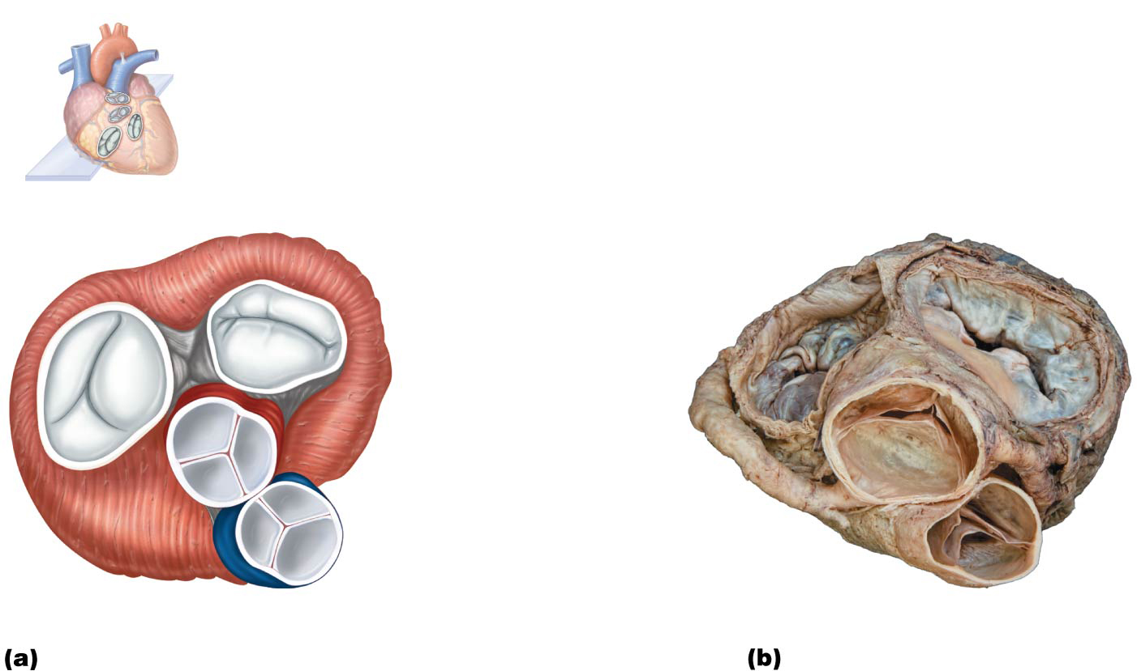
Figure 18.6-1 Heart valves.
Pulmonary valve
Aortic valve
Area of cutaway
Mitral valve
Tricuspid valve
Myocardium
Mitral
(left atrioventricular)
valve
Tricuspid
(right atrioventricular)
valve
Aortic
valve
Pulmonary
valve
Cardiac
skeleton
Anterior

Slide 45
Atrioventricular (AV) Valves
Two atrioventricular (AV) valves prevent backflow into atria when ventricles contract
Tricuspid valve (right AV valve): made up of three cusps and lies between right atria and ventricle
Mitral valve (left AV valve, bicuspid valve): made up of two cusps and lies between left atria and ventricle
Chordae tendineae: anchor cusps of AV valves to papillary muscles that function to:
Hold valve flaps in closed position
Prevent flaps from everting back into atria

Slide 46
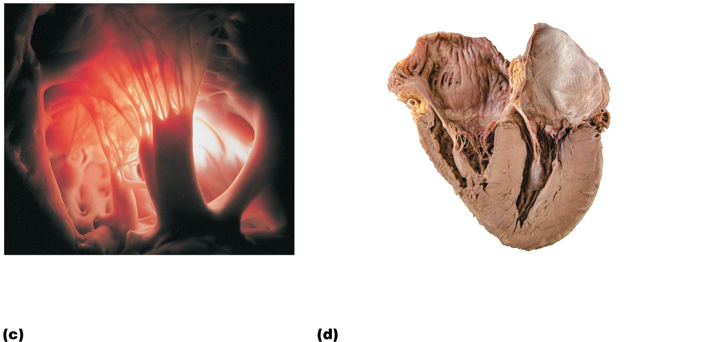
Figure 18.6-2 Heart valves (continued).
Right
atrium
Left atrium
Tricuspid
valve
Chordae
tendineae
Mitral valve
Myocardium
of left
ventricle
Myocardium
of right
ventricle
Papillary
muscles
Interventricular
septum
Chordae tendineae
attached to tricuspid
valve flap
Papillary
muscle

Slide 47
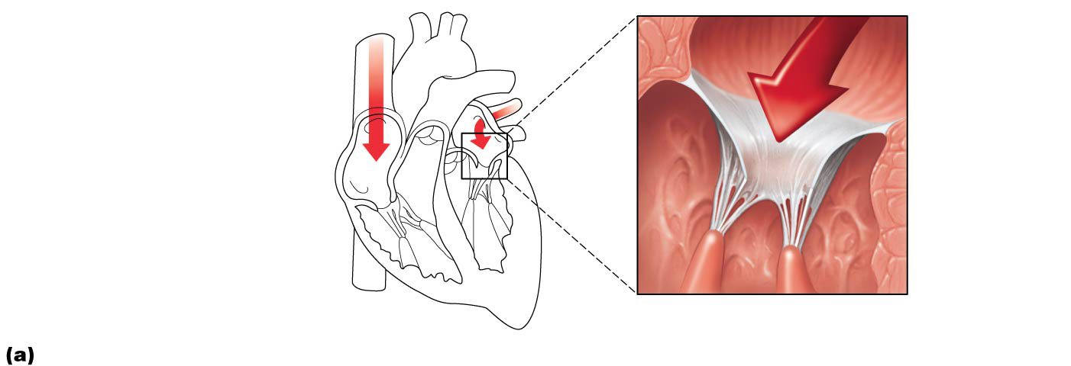
Figure 18.7a The function of the atrioventricular (AV) valves.
1
Blood returning to the
heart fills atria, pressing
against the AV valves. The
increased pressure forces
AV valves open.
Direction of
blood flow
Atrium
Cusp of
atrioventricular
valve (open)
2
As ventricles fill, AV valve
flaps hang limply into ventricles.
Chordae
tendineae
3
Atria contract, forcing
additional blood into ventricles.
Papillary
muscle
Ventricle
AV valves open; atrial pressure greater than ventricular pressure

Slide 48
Semilunar (SL) valves
Two semilunar (SL) valves prevent backflow from major arteries back into ventricles
Open and close in response to pressure changes
Each valve consists of three cusps that roughly resemble a half moon
Pulmonary semilunar valve: located between right ventricle and pulmonary trunk
Aortic semilunar valve: located between left ventricle and aorta

Slide 49
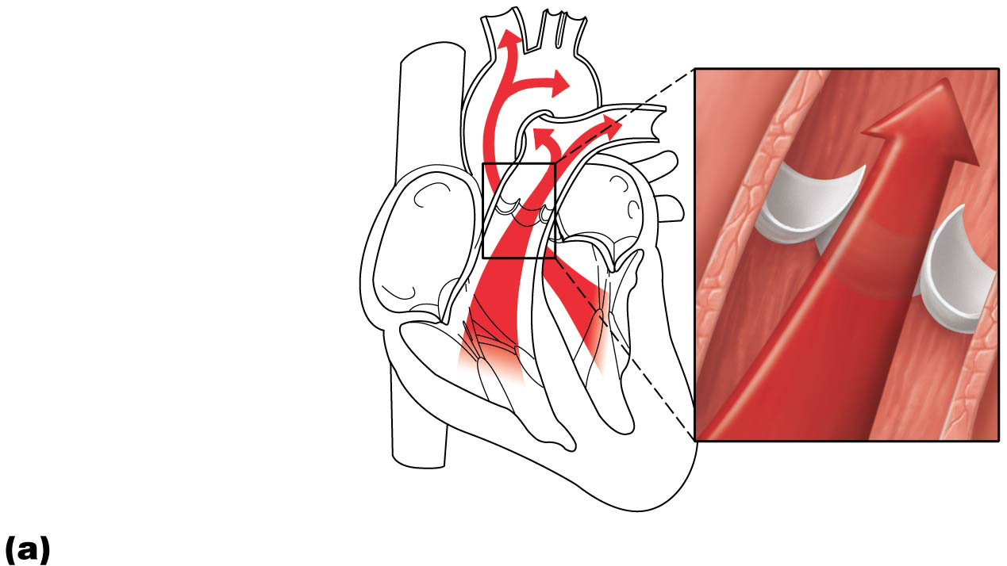
Figure 18.8a The function of the semilunar (SL) valves.
Aorta
Pulmonary
trunk
As ventricles contract
and intraventricular
pressure rises, blood
is pushed up against
semilunar valves,
forcing them open.
Semilunar valves open

Slide 50
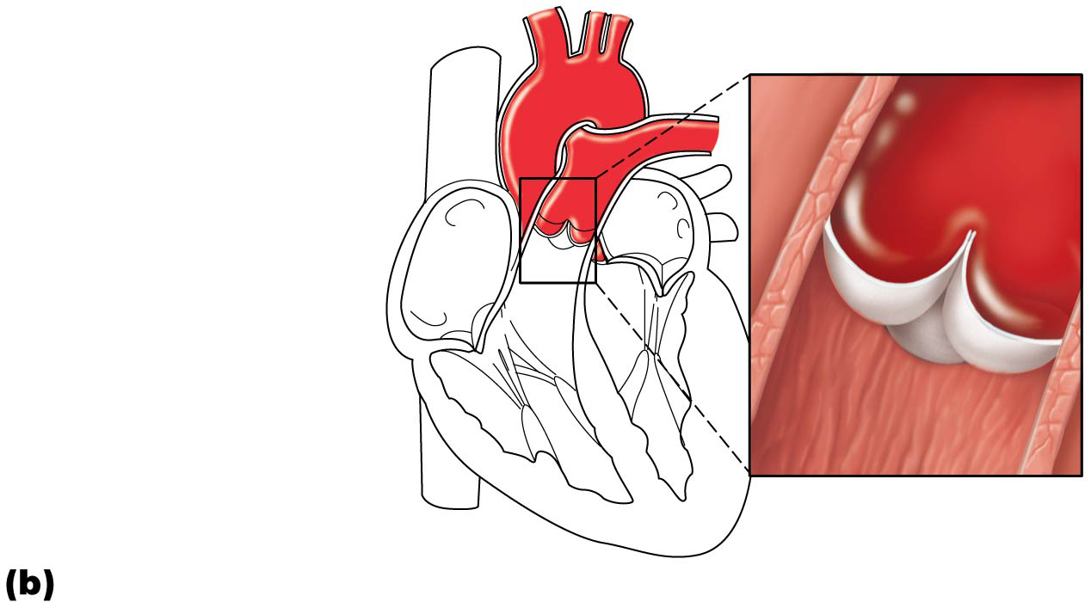
Figure 18.8b The function of the semilunar (SL) valves.
As ventricles relax
and intraventricular
pressure falls, blood
flows back from
arteries, filling the
cusps of semilunar
valves and forcing
them to close.
Semilunar valves closed

Slide 51
18.3 Pathway of Blood Through Heart
Right side of the heart
Superior vena cava (SVC), inferior vena cava (IVC), and coronary sinus →
Right atrium →
Tricuspid valve →
Right ventricle →
Pulmonary semilunar valve →
Pulmonary trunk →
Pulmonary arteries →
Lungs

Slide 52
18.3 Pathway of Blood Through Heart
Left side of the heart
Four pulmonary veins →
Left atrium →
Mitral valve →
Left ventricle →
Aortic semilunar valve →
Aorta →
Systemic circulation

Slide 53
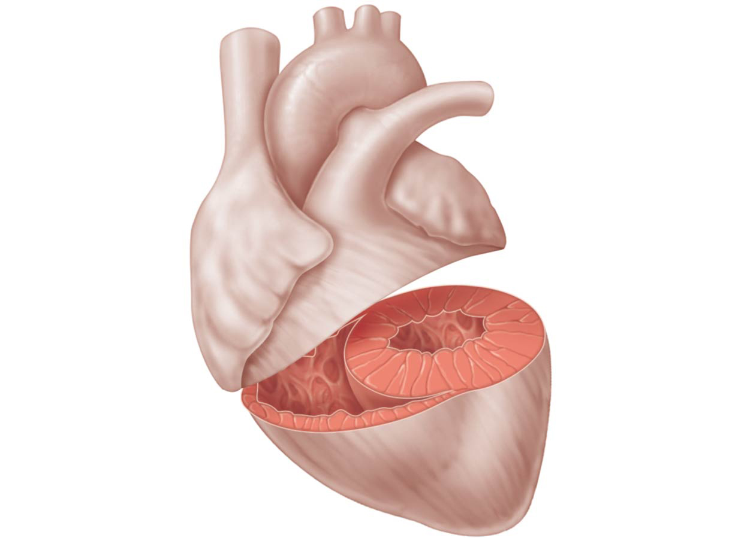
Figure 18.9 Anatomical differences between the right and left ventricles.
Left
ventricle
Right
ventricle
Interventricular
septum

Slide 54
Coronary Circulation
Coronary circulation
Functional blood supply to heart muscle itself
Shortest circulation in body
Delivered when heart is relaxed
Left ventricle receives most of coronary blood supply

Slide 55
Coronary Circulation (cont.)
Coronary arteries
Both left and right coronary arteries arise from base of aorta and supply arterial blood to heart
Both encircle heart in coronary sulcus
Branching of coronary arteries varies among individuals
Arteries contain many anastomoses (junctions)
Provide additional routes for blood delivery
Cannot compensate for coronary artery occlusion
Heart receives 1/20th of body’s blood supply

Slide 56
Coronary Circulation (cont.)
Coronary arteries (cont.)
Left coronary artery supplies interventricular septum, anterior ventricular walls, left atrium, and posterior wall of left ventricle; has two branches:
Anterior interventricular artery
Circumflex artery
Right coronary artery supplies right atrium and most of right ventricle; has two branches:
Right marginal artery
Posterior interventricular artery

Slide 57
Figure 18.10a Coronary circulation.
Aorta
Pulmonary
trunk
Superior
vena cava
Left atrium
Anastomosis
(junction of
vessels)
Left
coronary
artery
Right
atrium
Circumflex
artery
Right
coronary
artery
Left
ventricle
Right
ventricle
Anterior
interventricular
artery
Right
marginal
artery
Posterior
interventricular
artery

Slide 58
Coronary Circulation (cont.)
Coronary veins
Cardiac veins collect blood from capillary beds
Coronary sinus empties into right atrium; formed by merging cardiac veins
Great cardiac vein of anterior interventricular sulcus
Middle cardiac vein in posterior interventricular sulcus
Small cardiac vein from inferior margin
Several anterior cardiac veins empty directly into right atrium anteriorly

Slide 59
Figure 18.10b Coronary circulation.
Superior
vena cava
Great
cardiac
vein
Anterior
cardiac
veins
Coronary
sinus
Small
cardiac
vein
Middle
cardiac
vein

Slide 60
Figure 18.5d Gross anatomy of the heart.
Aorta
Superior vena cava
Left pulmonary artery
Right pulmonary artery
Right pulmonary veins
Left pulmonary veins
Auricle of left atrium
Right atrium
Left atrium
Inferior vena cava
Great cardiac vein
Coronary sinus
Posterior vein of
left ventricle
Right coronary artery
(in coronary sulcus)
Posterior interventricular
artery (in posterior
interventricular sulcus)
Left ventricle
Middle cardiac vein
Apex
Right ventricle
Posterior surface view

Slide 61
How Does the Physiology of Skeletal and Cardiac Muscle Differ?
Similarities with skeletal muscle
Muscle contraction is preceded by depolarizing action potential
Depolarization wave travels down T tubules; causes sarcoplasmic reticulum (SR) to release Ca²⁺
Excitation-contraction coupling occurs
Ca²⁺ binds troponin causing filaments to slide

Slide 62
How Does the Physiology of Skeletal and Cardiac Muscle Differ? (cont.)
Differences between cardiac and skeletal muscle
Some cardiac muscle cells are self-excitable
Two kinds of myocytes
Contractile cells: responsible for contraction
Pacemaker cells: noncontractile cells that spontaneously depolarize
Initiate depolarization of entire heart
Do not need nervous system stimulation, in contrast to skeletal muscle fibers

Slide 63
How Does the Physiology of Skeletal and Cardiac Muscle Differ? (cont.)
Heart contracts as a unit
All cardiomyocytes contract as unit (functional syncytium), or none contract
Contraction of all cardiac myocytes ensures effective pumping action
Skeletal muscles contract independently
Influx of Ca²⁺ from extracellular fluid triggers Ca²⁺ release from SR
Depolarization opens slow Ca²⁺ channels in sarcolemma, allowing Ca²⁺ to enter cell
Extracellular Ca²⁺ then causes SR to release its intracellular Ca²⁺
Skeletal muscles do not use extracellular Ca²⁺

Slide 64
How Does the Physiology of Skeletal and Cardiac Muscle Differ? (cont.)
Tetanic contractions cannot occur in cardiac muscles
Cardiac muscle fibers have longer absolute refractory period than skeletal muscle fibers
Absolute refractory period is almost as long as contraction itself
Prevents tetanic contractions
Allows heart to relax and fill as needed to be an efficient pump

Slide 65
How Does the Physiology of Skeletal and Cardiac Muscle Differ? (cont.)
The heart relies almost exclusively on aerobic respiration
Cardiac muscle has more mitochondria than skeletal muscle so has greater dependence on oxygen
Cannot function without oxygen
Skeletal muscle can go through fermentation when oxygen not present
Both types of tissues can use other fuel sources
Cardiac is more adaptable to other fuels, including lactic acid, but must have oxygen

