Slide 2
Part 1 – Nutrients
Most nutrients are used for metabolic fuel, but some are for cell structures and molecular synthesis
Nutrient: substance in food needed for growth, maintenance, repair
Macronutrients: three major nutrients that make up the bulk of ingested food
Carbohydrates, lipids, and proteins
Micronutrients: two other nutrients that are required, but only in small amounts
Vitamins and minerals
Water is required, so technically it is a nutrient
Essential nutrients: nutrients that must be eaten because body cannot synthesize these from other nutrients
45–50 nutrients are considered essential

Slide 3
Part 1 – Nutrients
Nonessential nutrients are also vital to life, but if not enough is available, liver can usually convert another nutrient into one needed
Energy value is measured in kilocalories (kcal)
A calorie is the amount of heat needed to raise temperature of 1 kg H₂O by 1°C
One dietary “Calorie” equals 1 kcal

Slide 4
Part 1 – Nutrients
USDA’s MyPlate: guidelines represented as portions on a dinner plate
Food groups represented
Fruits
Vegetables
Grains
Protein
Dairy
Basic dietary principles: eat only what you need (eat less overall); eat plenty of fruits, vegetables, and whole grains; avoid junk food

Slide 5
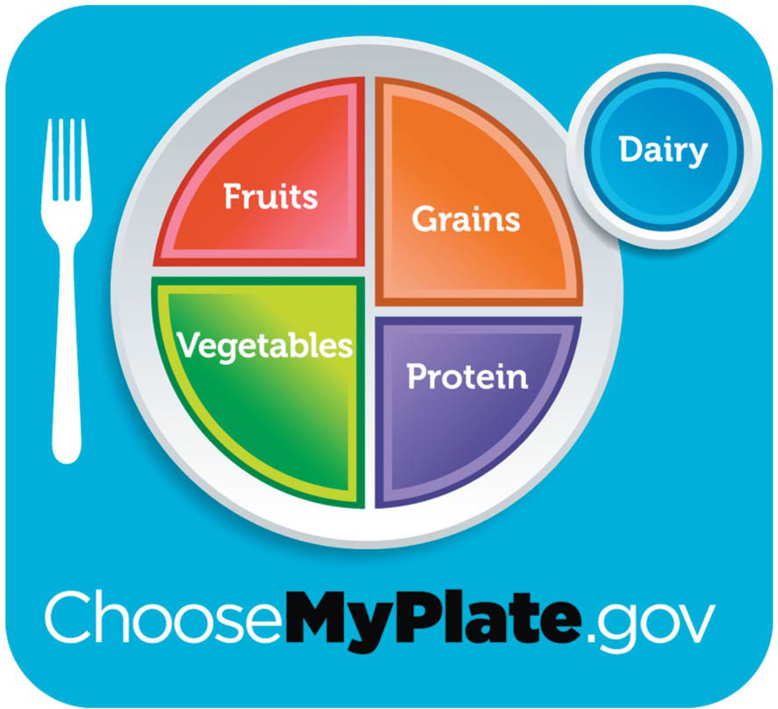
Figure 24.1 USDA’s MyPlate food guide.

Slide 6
24.1 Role of Carbohydrates, Lipids, and Proteins
Carbohydrates
Dietary sources
Primarily from plants, such as starch (complex carbohydrates) in grains and vegetables
Sugars (mono- and disaccharides) in fruits, sugarcane, sugar beets, honey, and milk
Insoluble fiber: cellulose in vegetables provides roughage
Soluble fiber: pectin in apples and citrus fruits reduces blood cholesterol levels
Small amount in milk sugar, glycogen in meats

Slide 7
Carbohydrates (cont.)
Uses in body
Glucose: fuel most used by cells to make ATP
Some cells use fat for energy
Neurons and RBCs rely entirely on glucose
Neurons die quickly without glucose
Excess glucose is converted to glycogen or fat, then stored
Fructose and galactose are converted to glucose by liver before entering circulation

Slide 8
Carbohydrates (cont.)
Dietary requirements
Recommended daily intake: 45–65% of total calories
Should consist mostly of complex carbohydrates (whole grains and vegetables)
Simple carbohydrates should be limited
High amounts of sugars can lead to obesity, as well as nutritional deficiencies
American diet is ~ 46% carbohydrates that include rice, pasta, or breads
Tend to be inexpensive, so higher percentages seen in low-income groups

Slide 9
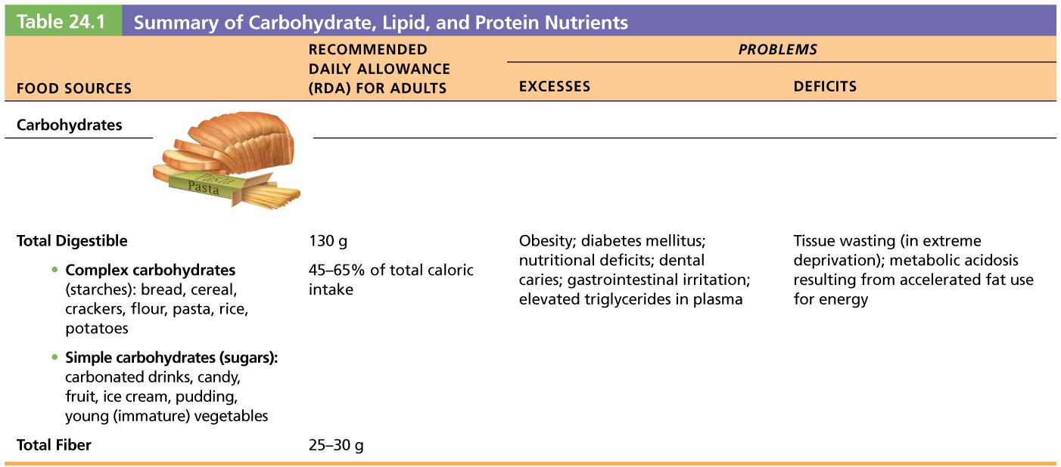
Table 24.1-1 Summary of Carbohydrate, Lipid, and Protein Nutrients

Slide 10
Lipids
Dietary sources
Triglycerides (neutral fats): most abundant form
Found in saturated fats in meat, dairy foods, tropical oils, or hydrogenated oils (trans fats)
Unsaturated fats found in seeds, nuts, olive oil, and most vegetable oils
Cholesterol found in egg yolk, meats, organ meats, shellfish, and milk products
Liver makes ~85% cholesterol
Liver can convert some fatty acids into others, but essential fatty acids (examples: linoleic and linolenic acid found in most oils) must be eaten

Slide 11
Lipids (cont.)
Uses in body
Adipose tissue offers protection, insulation, fuel storage
Phospholipids essential in myelin sheaths and all cell membranes
Cholesterol stabilizes membranes; precursor of bile salts, steroid hormones
Prostaglandins → smooth muscle contraction, BP control, inflammation
Help absorb fat-soluble vitamins
Major fuel of hepatocytes and skeletal muscle

Slide 12
Lipids (cont.)
Dietary requirements
American Heart Association recommendations
Fats: 30% or less of total caloric intake
Saturated fats: 10% or less of total fat intake
Cholesterol: no more than 300 mg/day (about 1-1/2 egg yolks)
Goal is to keep cholesterol < 200 mg/dl

Slide 13
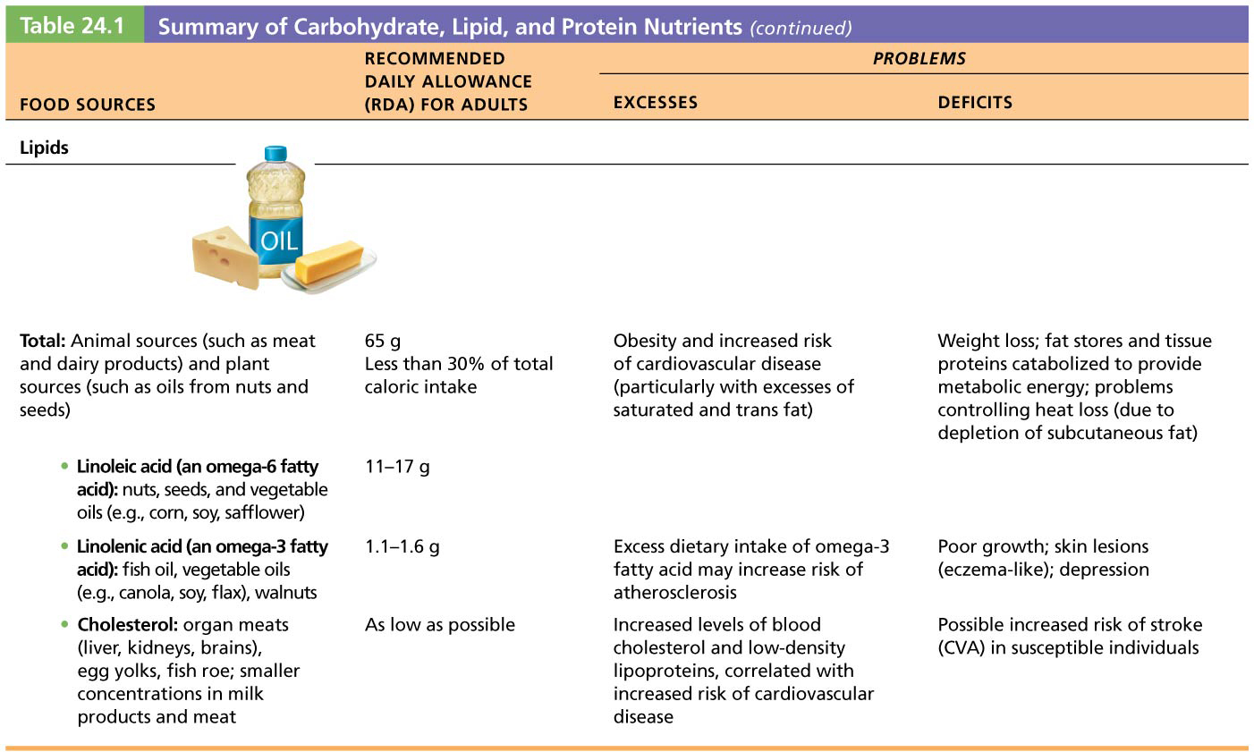
Table 24.1-2 Summary of Carbohydrate, Lipid, and Protein Nutrients (continued)

Slide 14
Proteins
Dietary sources
Animal products (eggs, milk, fish, most meats), as well as soybeans, are considered complete proteins
Contain all needed essential amino acids
Legumes, nuts, and cereals contain incomplete proteins (lack some essential amino acids)
Legumes and cereal grains together contain all essential amino acids

Slide 15
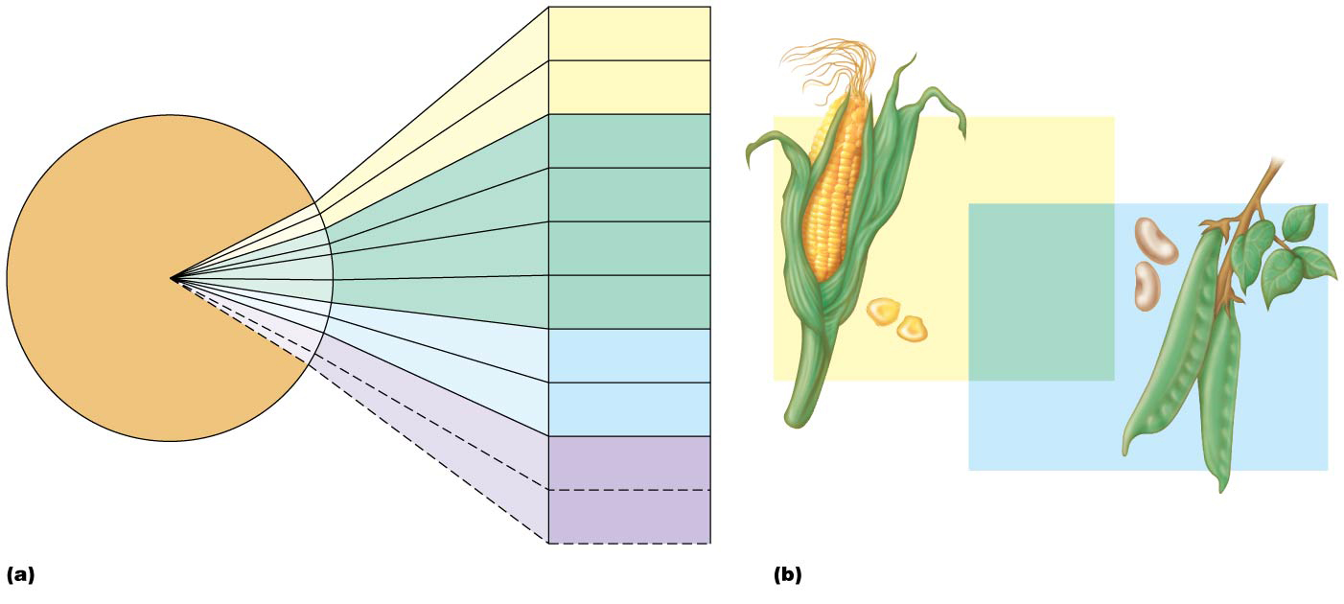
Figure 24.2 Essential amino acids.
Tryptophan
Methionine
Valine
Tryptophan
Beans
and other
legumes
Threonine
Methionine
Valine
Total
protein
needs
Phenylalanine
Threonine
Leucine
Phenylalanine
Isoleucine
Leucine
Lysine
Corn and
other grains
Isoleucine
Histidine
(Infants)
Lysine
Arginine
(Infants)
Essential amino acids
Corn and beans together can provide all eight
essential amino acids

Slide 16
Proteins (cont.)
Uses in body
Structural materials
Example: keratin (skin), collagen and elastin (connective tissue), and muscle proteins
Functional molecules
Example: enzymes and some hormones
Three factors help determine whether amino acids are used to synthesize proteins or burned as fuel:
All-or-none rule
All amino acids needed must be present for protein synthesis to occur; if not all are present, then amino acids are used for energy

Slide 17
Proteins (cont.)
Uses in body (cont.)
Adequacy of caloric intake
Protein is used as fuel if insufficient carbohydrate or fat is available
Hormonal controls
Anabolic hormones (GH, sex hormones) accelerate protein synthesis and growth
Adrenal glucocorticoids (released during stress) promote protein breakdown and conversion of amino acids to glucose

Slide 18
Proteins (cont.)
Uses in body (cont.)
Nitrogen balance
Homeostatic state where rate of protein synthesis equals rate of breakdown and loss
Positive nitrogen balance: synthesis exceeds breakdown (normal in children, pregnant women, tissue repair)
Negative nitrogen balance: breakdown exceeds synthesis (example: stress, burns, infection, injury, poor dietary proteins, starvation)

Slide 19
Proteins (cont.)
Dietary requirements
Needs reflect age, size, metabolic rate, nitrogen balance
Rule of thumb: daily intake of 0.8 g per kg body weight
American diet provides more than needed

Slide 20
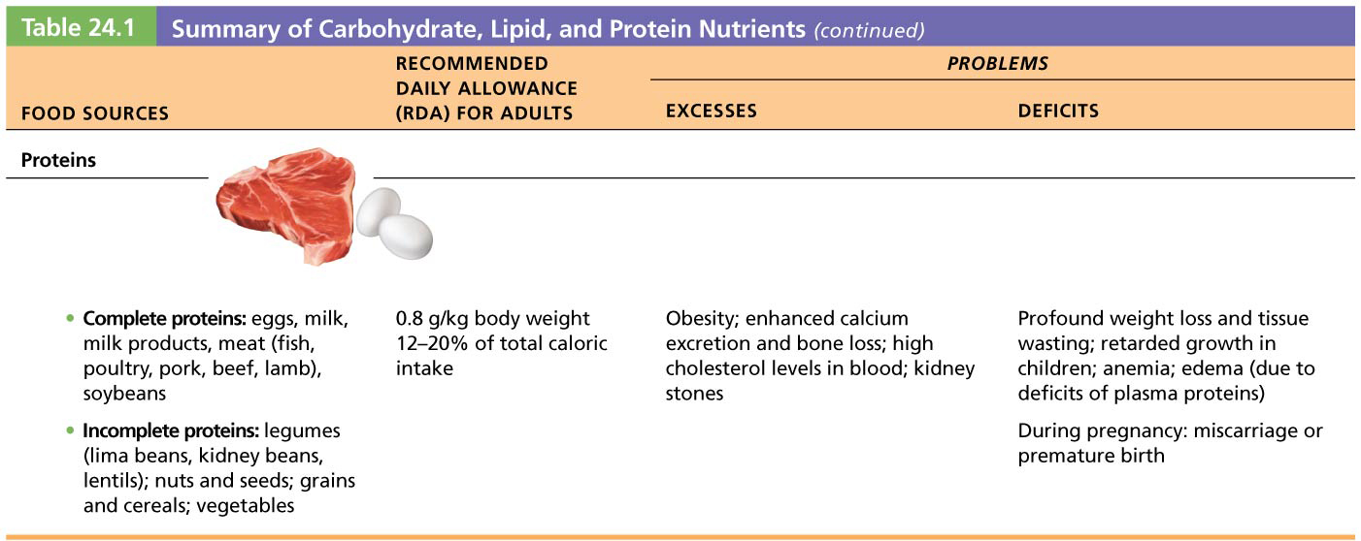
Table 24.1-3 Summary of Carbohydrate, Lipid, and Protein Nutrients (continued)

Slide 21
24.2 Role of Vitamins and Minerals
Vitamins
Organic compounds that are crucial in helping body use nutrients
Most function as coenzymes
Most must be ingested, except:
Vitamin D (made in skin)
Some B and K synthesized by intestinal bacteria
Beta-carotene (e.g., from carrots) converted in body to vitamin A
No one food group contains all vitamins

Slide 22
Vitamins (cont.)
Two types of vitamins based on solubility
Water-soluble vitamins
B complex and C are absorbed with water
B₁₂ absorption requires intrinsic factor
Not stored in the body
Any not used within 1 hour are excreted
Fat-soluble vitamins
A, D, E, and K are absorbed with lipid digestion products
Stored in body, except for vitamin K
Excessive consumption can cause health problems

Slide 23
Vitamins (cont.)
Dangerous free radicals are generated during normal metabolism
Vitamins C, E, and A and mineral selenium are antioxidants that neutralize these free radicals
Broccoli, cauliflower, brussels sprouts are all good sources of vitamins A and C
Megadoses of vitamins are useless and may actually cause serious health problems, depending on vitamin involved

Slide 24
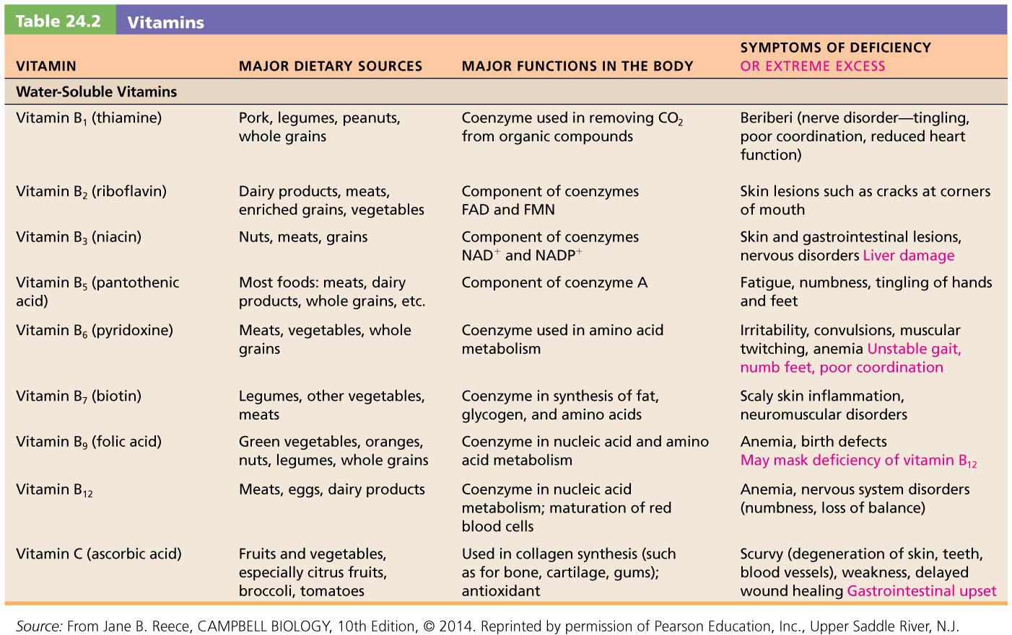
Table 24.2-1 Vitamins

Slide 25
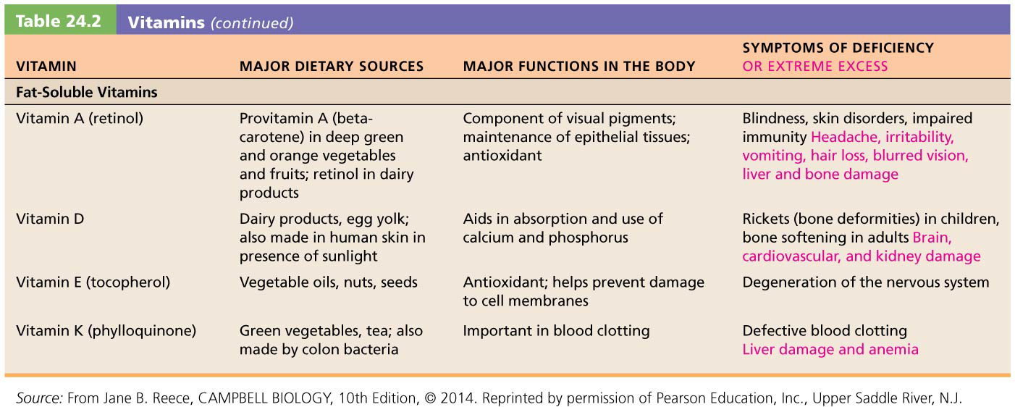
Table 24.2-2 Vitamins (continued)

Slide 26
Minerals
Seven minerals are required in moderate amounts:
Calcium, phosphorus, potassium, sulfur, sodium, chlorine, and magnesium
Others are required in trace amounts
Work with nutrients to ensure proper body functioning
Uptake and excretion are balanced to prevent toxic overload

Slide 27
Minerals (cont.)
Examples of uses in body
Calcium, phosphorus, and magnesium salts harden bone
Iron is essential for oxygen binding to hemoglobin
Iodine is necessary for thyroid hormone synthesis
Sodium and chloride are major electrolytes in blood
Mineral-rich foods
Vegetables, legumes, milk, some meats

Slide 28
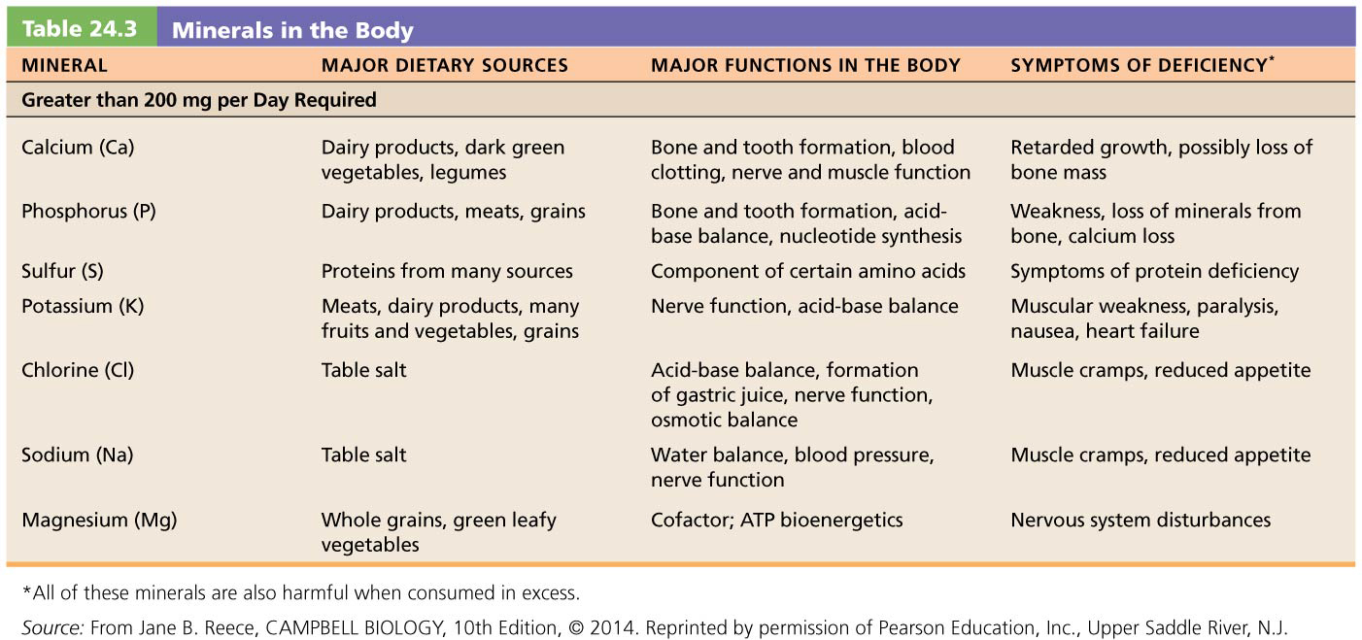
Table 24.3-1 Minerals in the Body

Slide 29
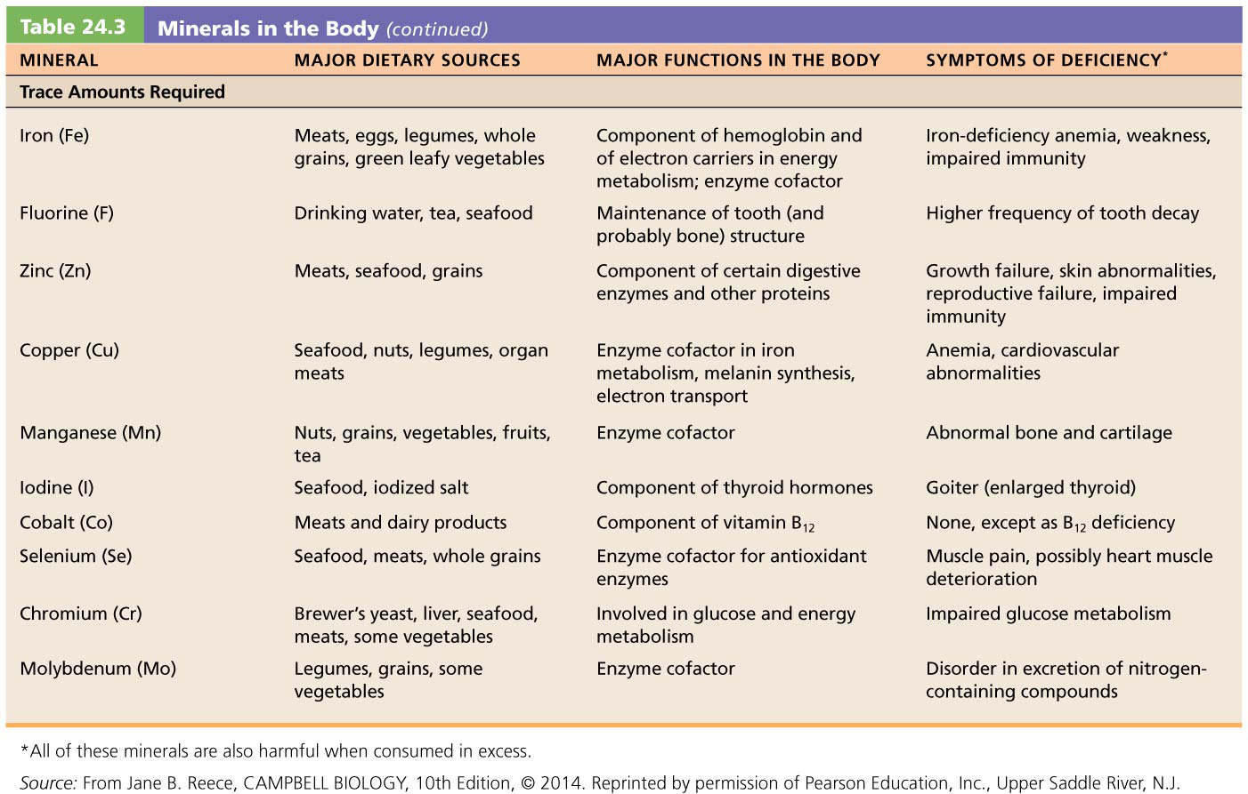
Table 24.3-2 Minerals in the Body (continued)

Slide 30
Part 2 – Metabolism
Metabolism: sum of all biochemical reactions inside a cell involving nutrients
Anabolism and Catabolism
Anabolism: synthesis of large molecules from small ones (example: synthesis of proteins from amino acids
Catabolism: hydrolysis of complex structures to simpler ones (example: breakdown of proteins into amino acids)

Slide 31
Anabolism and Catabolism (cont.)
Cellular respiration: catabolic breakdown of food fuels whereby energy from food is captured to form ATP in cells
Goal of cellular respiration is to trap chemical energy in ATP
Energy can also be stored in glycogen and fats, which can be broken down later
Phosphorylation: enzymes shift high-energy phosphate groups of ATP to other molecules
Phosphorylated molecules become activated to perform cellular functions

Slide 32
Anabolism and Catabolism (cont.)
Three stages in processing nutrients
Stage 1: Digestion, absorption, and transport to tissues
Stage 2: Cellular processing (in cytoplasm)
Synthesis of lipids, proteins, and glycogen, or
Catabolism (glycolysis) into pyruvic acid and acetyl CoA
Stage 3: Oxidative breakdown of intermediates into CO₂, water, and ATP
Occurs in mitochondria
Cellular respiration consists of glycolysis of stage 2 and all of stage 3

Slide 33
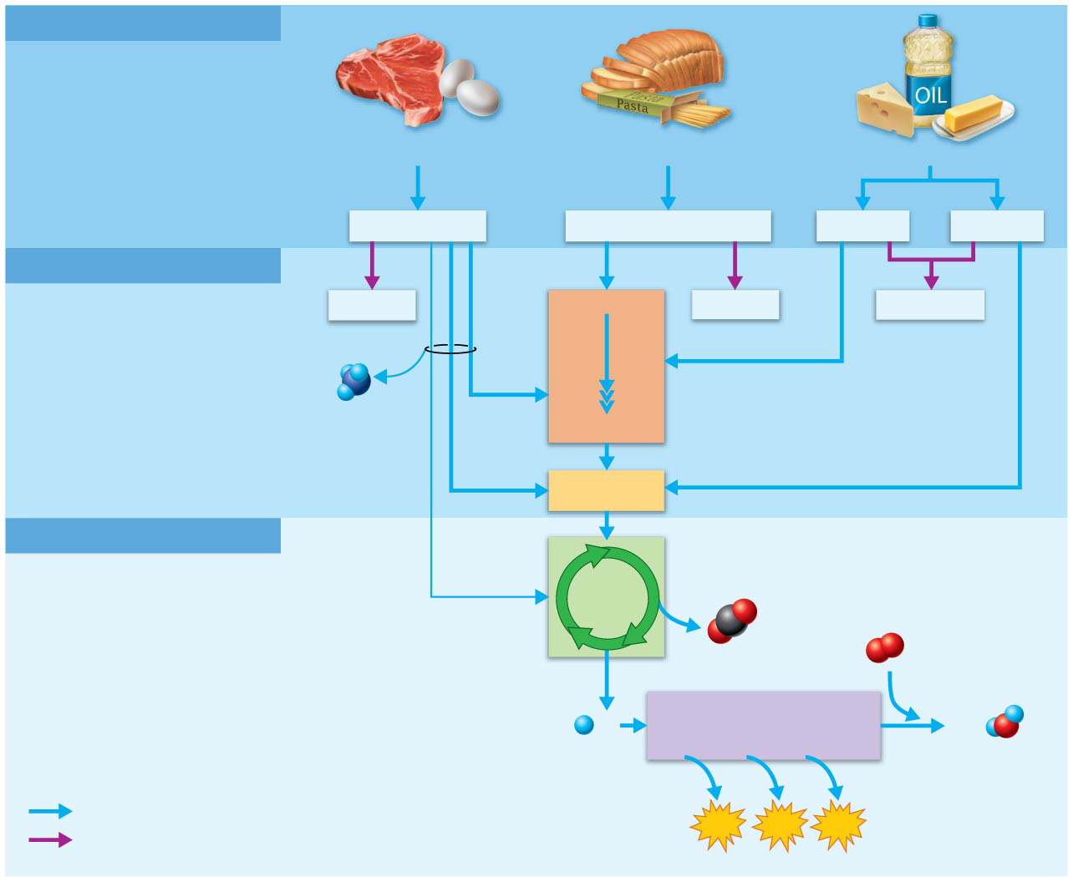
Figure 24.3 Three stages of metabolism of energy-containing nutrients.
Stage 1: GI Tract
Nutrients are:
• Digested into absorbable units.
• Absorbed into the blood and transported to tissue cells.
PROTEINS
CARBOHYDRATES
FATS
Amino acids
Glucose and other sugars
Glycerol
Fatty acids
Stage 2: Tissue Cells
Anabolism or catabolism:
• In anabolism, nutrients are built into macromolecules.
• In catabolism, nutrients are broken down to pyruvic acid and acetyl CoA.
• Glycolysis is the major catabolic pathway.
Proteins
Glucose
Glycogen
Triglycerides
Glycolysis
NH₃
Pyruvic acid
Acetyl CoA
Stage 3: Mitochondria
Oxidative breakdown of stage 2 products:
• CO₂ is released.
• The H atoms removed are ultimately delivered to molecular oxygen, forming water.
• Some of the energy released is used to form ATP.
• The citric acid cycle and oxidative phoshorylation are the major pathways.
Citric
acid
cycle
Infrequent
CO₂
O₂
H
Oxidative phosphorylation
(in electron transport chain)
H₂O
Catabolic reactions
ATP
ATP
ATP
Anabolic reactions

Slide 34
Oxidation-Reduction Reactions and the Role of Coenzymes
Oxidation reactions: involve the gain of oxygen or loss of hydrogen atoms (and their electrons)
Oxidation-reduction (redox) reactions
Oxidized substances lose electrons and energy
Reduced substances gain electrons and energy
Redox reactions are catalyzed by enzymes that usually require a B vitamin coenzyme
Dehydrogenases catalyze removal of hydrogen atoms
Oxidases catalyze transfer of oxygen

Slide 35
Oxidation-Reduction Reactions and the Role of Coenzymes (cont.)
Two important coenzymes act as hydrogen (or electron) acceptors in oxidative pathway
Nicotinamide adenine dinucleotide (NAD⁺)
Flavin adenine dinucleotide (FAD)

Slide 36
ATP Synthesis
Two mechanisms are used to make ATP from captured energy that is liberated during cellular respiration
Substrate-level phosphorylation
High-energy phosphate groups are directly transferred from phosphorylated substrates to ADP
Occurs twice in glycolysis and once in Krebs cycle
Necessary enzymes are in cytosol for glycolysis and in mitochondria for Krebs cycle

Slide 37
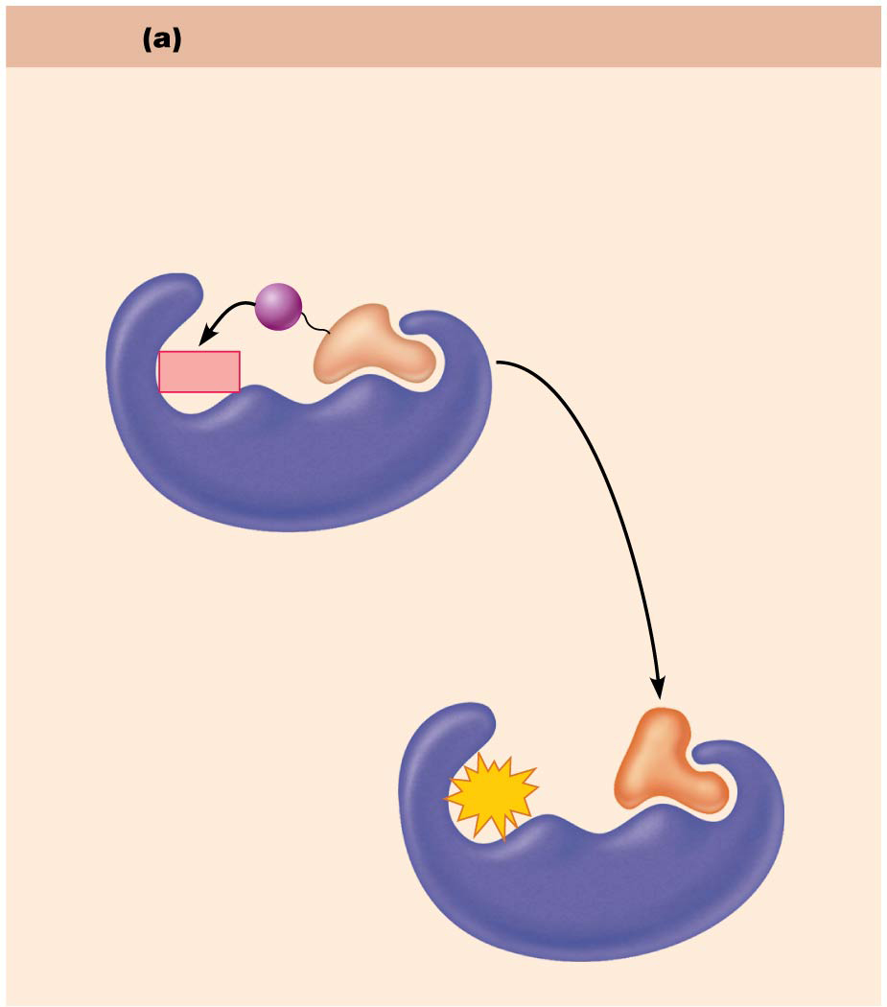
Figure 24.4a Mechanisms of phosphorylation.
Substrate-level phosphorylation
• A high-energy phosphate group is transferred directly from a substrate to ADP to form ATP.
• Occurs in the cytosol and mitochondrial matrix.
P
ADP
Substrate
Enzyme
Catalysis
ATP
Product
Enzyme

Slide 38
ATP Synthesis (cont.)
Oxidative phosphorylation
More complex process, but produces most ATP
Chemiosmotic process: couples movement of substances across membranes to chemical reactions
Energy released from oxidation of food is used to pump H⁺ across inner mitochondrial membrane, creating a steep H⁺ concentration gradient
As H⁺ flows back through ATP synthase membrane channel protein, energy from flow is used to phosphorylate ADP

Slide 39
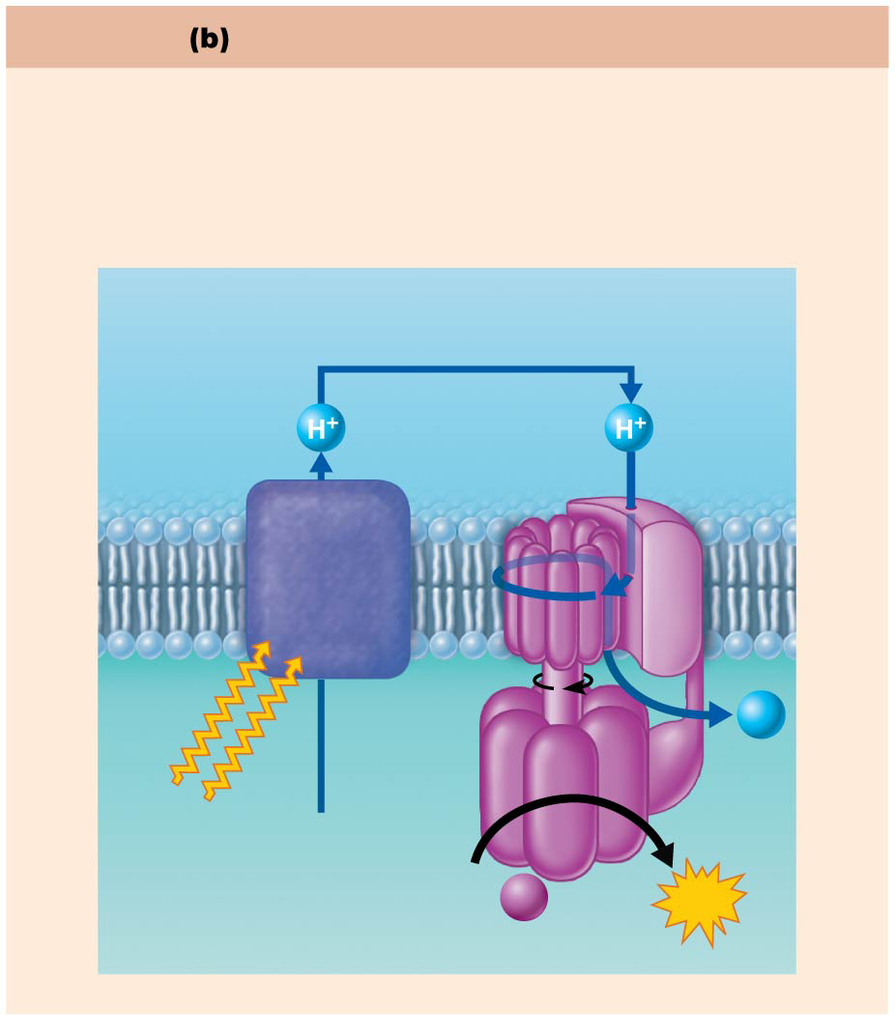
Figure 24.4b Mechanisms of phosphorylation.
Oxidative phosphorylation
• Electron transport proteins “pump” protons, creating a proton gradient.
• ATP synthase uses the energy of the proton gradient to bind phosphate groups to ADP.
• Occurs only in the mitochondrial matrix.
High H⁺ concentration in
intermembrane space
Inner
mitochondrial
membrane
Proton
pumps
(electron
transport
chain)
H⁺
ATP
synthase
Energy
from food
ADP +
P_{i}
ATP
Low H⁺ concentration
in mitochondrial matrix

Slide 40
24.4 Carbohydrate Metabolism
When glucose enters a cell, it is phosphorylated to glucose-6-phosphate
Most cells lack enzymes for reverse reaction, so glucose becomes trapped inside cell
Only cells in intestine, kidney, and liver can reverse reaction and release glucose
Keeps intracellular glucose concentration low, which ensures continued glucose entry

Slide 41
Oxidation of Glucose
Glucose is catabolized via following reaction:
C₆H₁₂O₆ + 6O₂ → 6H₂O + 6CO₂ + 32 ATP + heat
glucose oxygen water carbon dioxide
Complete glucose catabolism requires three pathways
Glycolysis
Krebs cycle
Electron transport chain and oxidative phosphorylation

Slide 42
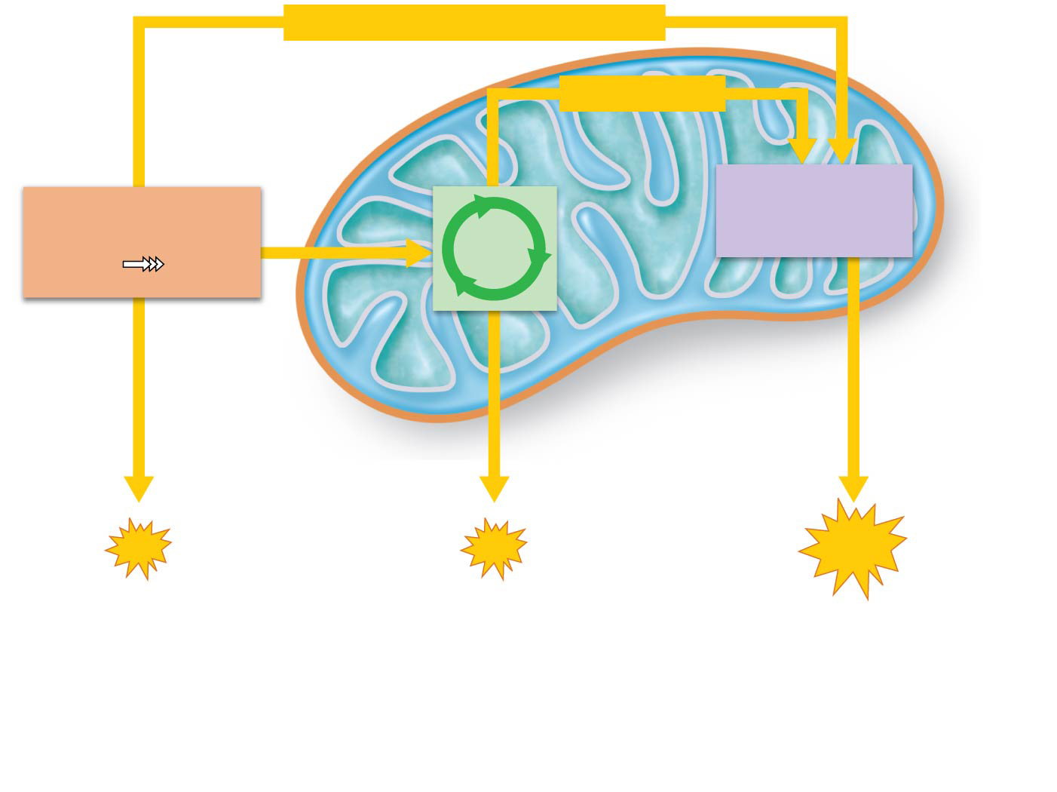
Figure 24.5 During cellular respiration, ATP is formed in the cytosol and in the mitochondria.
Chemical energy (high-energy electrons)
Chemical energy
Electron transport
chain and oxidative
phosphorylation
Glycolysis
Citric
acid
cycle
Glucose
Pyruvic
acid
Inner
mitochondrial
membrane (cristae)
Mitochondrion
Cytosol
Via oxidative
phosphorylation
Via substrate-level
phosphorylation
ATP
ATP
ATP
1
2
3
Glycolysis, in the cytosol,
breaks down each glucose
molecule into two molecules
of pyruvic acid.
The pyruvic acid then enters
the mitochondrial matrix, where
the citric acid cycle oxidizes it to
CO₂. During glycolysis and the
citric acid cycle, substrate-level
phosphorylation forms small
amounts of ATP.
Energy-rich electrons picked up
by coenzymes are transferred to
the electron transport chain, built into
the inner mitochondrial membrane. The
electron transport chain carries out
oxidative phosphorylation, which
generates most of the ATP in cellular
respiration.

Slide 43
Oxidation of Glucose (cont.)
http://highered.mheducation.com/sites/0072507470/student_view0/chapter25/animation__how_glycolysis_works.html
Glycolysis
Also called glycolytic pathway
Involves 10-step pathway
Anaerobic: occurs despite presence/absence of O₂
Occurs in cytosol
Glucose is broken into two pyruvic acid molecules
Three major phases
Phase 1: Sugar activation
Phase 2: Sugar cleavage
Phase 3: Sugar oxidation and ATP formation

Slide 44
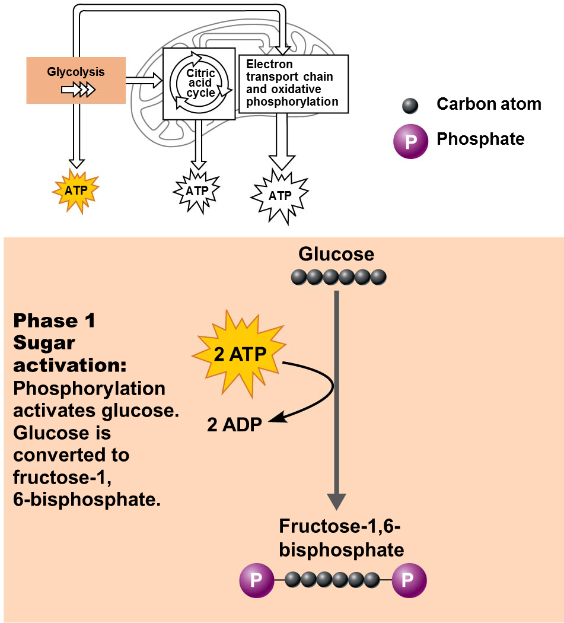
Oxidation of Glucose (cont.)
Phase 1: Sugar activation
Glucose is phosphorylated by ATP to fructose-6-bisphosphate
It is phosphorylated again by a second ATP, resulting in fructose-1,6-bisphosphate
This phase referred to as energy investment phase because input of energy is required
2 ATP used up will be recouped later
Provides activation energy needed to start pathway
Acts to “prime” system

Slide 45
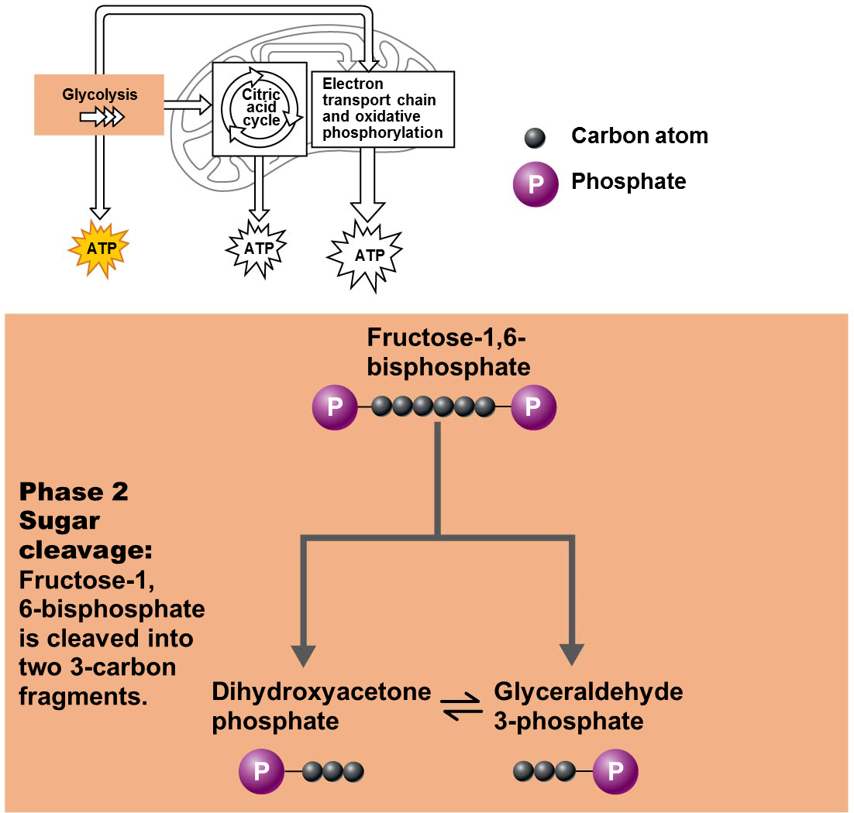
Oxidation of Glucose (cont.)
Phase 2: Sugar cleavage
Fructose-1,6-bisphosphate is split into two 3-carbon fragments
Fragments can interconvert into one of two isomers:
Dihydroxyacetone phosphate
Glyceraldehyde 3-phosphate

Slide 46
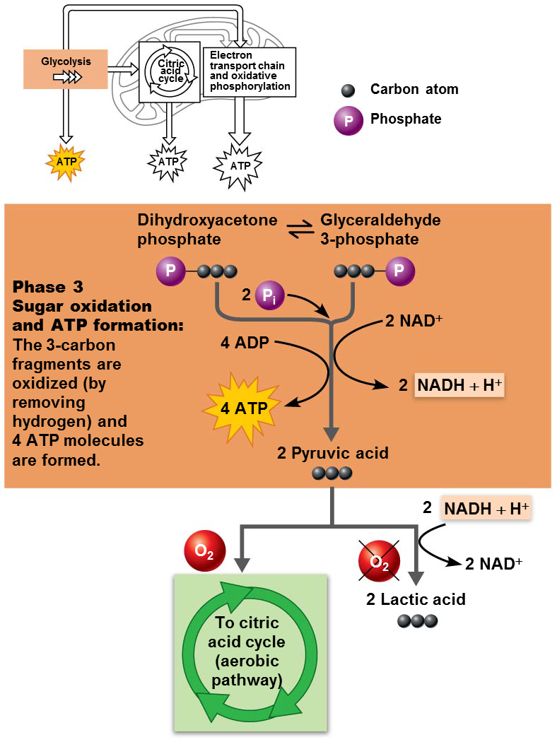
Oxidation of Glucose (cont.)
Phase 3: Sugar oxidation and ATP formation
Six steps involved, with two major events
(a) Each 3-carbon fragment is oxidized by removal of a pair of H, which is picked up by NAD⁺, forming reduced NADH + H⁺
H carries a portion of glucose’s energy
(b) Inorganic phosphate groups (P_{i}) are then attached to each oxidized fragment
Cleavage of these phosphate groups from both fragments will result in formation of 2 pyruvic acid and 4 ATPs by substrate-level phosphorylation

Slide 47
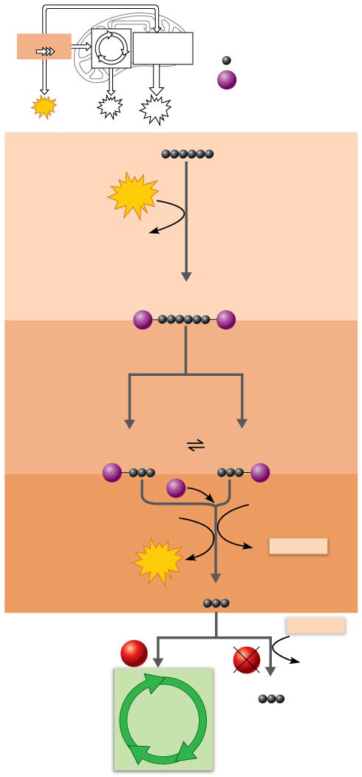
Figure 24.6 The three major phases of glycolysis.
Glycolysis
Citric
acid
cycle
Electron
transport chain
and oxidative
phosphorylation
Carbon atom
P
Phosphate
ATP
ATP
ATP
Glucose
Phase 1
Sugar
activation:
Phosphorylation
activates glucose.
Glucose is
converted to
fructose-1,
6-bisphosphate.
2 ATP
2 ADP
Fructose-1,6-
bisphosphate
P
P
Phase 2
Sugar
cleavage:
Fructose-1,
6-bisphosphate
is cleaved into
two 3-carbon
fragments.
Dihydroxyacetone
phosphate
Glyceraldehyde
3-phosphate
P
P
Phase 3
Sugar oxidation
and ATP formation:
The 3-carbon
fragments are
oxidized (by
removing
hydrogen) and
4 ATP molecules
are formed.
2
P_{i}
4 ADP
2 NAD⁺
4 ATP
2
NADH + H⁺
2 Pyruvic acid
2
NADH + H⁺
O₂
O₂
2 NAD⁺
To citric
acid cycle
(aerobic
pathway)
2 Lactic acid

Slide 48
Oxidation of Glucose (cont.)
Glycolysis (cont.)
Although 4 total ATPs are made, the 2 ATPs needed to prime system in phase 1 must be subtracted
So, final products of glycolysis are:
2 pyruvic acids (C₃H₄O₃)
2 reduced NAD⁺ (NADH + H⁺)
Net gain of 2 ATP
For glycolysis to continue, more NAD⁺ must be present to accept more hydrogen atoms

Slide 49
Oxidation of Glucose (cont.)
Glycolysis (cont.)
Supply of NAD⁺ is limited
NADH must donate its accepted hydrogen atoms to become NAD⁺ again to be free to pick up more H⁺ so glycolysis can continue
If oxygen is present, NADH will transfer its H to proteins in electron transport chain
Occurs in mitochondria
If no oxygen is present, NADH will give hydrogen atoms back to pyruvic acid, reducing it to lactic acid

Slide 50
Oxidation of Glucose (cont.)
Glycolysis (cont.)
Fate of lactic acid
Some may leave cell and be picked up by liver, which can convert it back to glucose-6-phosphate
Some may be oxidized back to pyruvic acid when oxygen becomes available
Can then enter aerobic pathways
Prolonged anaerobic metabolism can lead to acid-base problems
Glycolysis results in faster ATP production than aerobic respiration, but yields far less ATP

Slide 51
Oxidation of Glucose (cont.)
http://highered.mheducation.com/sites/0072507470/student_view0/chapter25/animation__how_the_krebs_cycle_works__quiz_1_.html
Citric acid cycle
Also called Krebs cycle
Occurs in mitochondrial matrix
Fueled by pyruvic acid from glucose breakdown and fatty acids from fat breakdown
Pyruvic acid must be actively transported into mitochondria because it is a charged molecule
Once inside mitochondria, pyruvic acid enters transitional phase

Slide 52
Oxidation of Glucose (cont.)
Citric acid cycle (cont.)
Transitional phase is where each pyruvic acid is converted to acetyl coenzyme A (acetyl CoA) in three steps
Decarboxylation: 1 carbon from pyruvic acid is removed, producing CO₂ gas, which diffuses into blood to be expelled by lungs
Oxidation: remaining 2-C fragment is oxidized to acetic acid by removal of H atoms, which are picked up by NAD⁺
Formation of acetyl CoA: acetic acid combines with coenzyme A to form acetyl CoA

Slide 53
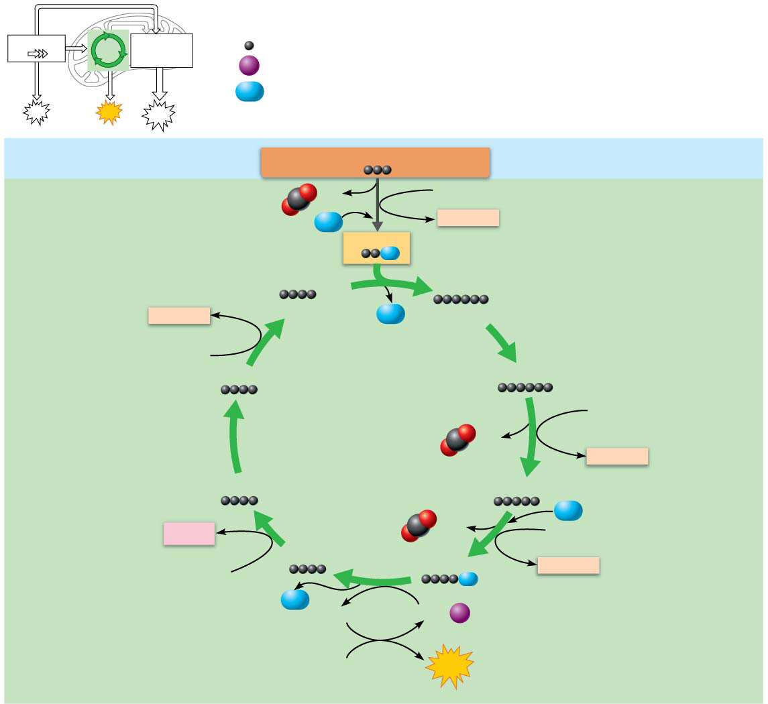
Figure 24.7 Simplified version of the citric acid (Krebs) cycle.
Glycolysis
Citric
acid
cycle
Electron
transport chain
and oxidative
phosphorylation
Carbon atom
P_{i}
Inorganic phosphate
CoA
Coenzyme A
ATP
ATP
ATP
Cytosol
Pyruvic acid from glycolysis
Mitochondrion
(matrix)
CO₂
NAD⁺
Transitional
phase
CoA
NADH + H⁺
Acetyl CoA
Oxaloacetic acid
Citric acid
NADH + H⁺
(pickup molecule)
CoA
(initial reactant)
NAD⁺
Malic acid
Isocitric acid
NAD⁺
Citric acid
cycle
CO₂
NADH + H⁺
Fumaric acid
α-Ketoglutaric acid
CO₂
CoA
FADH₂
NAD⁺
Succinic acid
Succinyl-CoA
NADH + H⁺
FAD
CoA
GTP
GDP +
P_{i}
ADP
ATP

Slide 54
Oxidation of Glucose (cont.)
Citric acid cycle (cont.)
Coenzyme A then shuttles its acetic acid to an enzyme in citric acid cycle that joins it to 4-carbon oxaloacetic acid
Produces 6-carbon citric acid
During eight steps, original acetic acid is decarboxylated and oxidized to keto acid intermediates, resulting in NADH + H⁺, FADH₂ and CO₂
In final step, oxaloacetic acid regenerated

Slide 55
Oxidation of Glucose (cont.)
Citric acid cycle (cont.)
For each turn of the cycle, we get:
2 CO₂ from decarboxylation
4 molecules of reduced enzymes
3 NADH + H⁺ and 1 FADH₂
1 ATP (by substrate level phosphorylation)
Started with 2 pyruvic acid molecules, so amount of final products from 1 glucose is doubled:
4 CO₂, 6 NADH + H⁺, 2 FADH₂, and 2 ATP
Adding products of transitional phase, total final products for breakdown of 1 glucose are:
6 CO₂, 8 NADH + H⁺, 2 FADH₂, and 2 ATP

Slide 56
Figure 24.7 Simplified version of the citric acid (Krebs) cycle.
Glycolysis
Citric
acid
cycle
Electron
transport chain
and oxidative
phosphorylation
Carbon atom
P_{i}
Inorganic phosphate
CoA
Coenzyme A
ATP
ATP
ATP
Cytosol
Pyruvic acid from glycolysis
Mitochondrion
(matrix)
CO₂
NAD⁺
Transitional
phase
CoA
NADH + H⁺
Acetyl CoA
Oxaloacetic acid
Citric acid
NADH + H⁺
(pickup molecule)
CoA
(initial reactant)
NAD⁺
Malic acid
Isocitric acid
NAD⁺
Citric acid
cycle
CO₂
NADH + H⁺
Fumaric acid
α-Ketoglutaric acid
CO₂
CoA
FADH₂
NAD⁺
Succinic acid
Succinyl-CoA
NADH + H⁺
FAD
CoA
GTP
GDP +
P_{i}
ADP
ATP

Slide 57
Oxidation of Glucose (cont.)
Citric acid cycle (cont.)
NADH must be oxidized to ensure there is plenty of NAD⁺ so glycolysis, transitional phase and citric acid cycle can continue
NADH will be oxidized in electron transport chain
Breakdown products of fats and proteins can also enter citric acid cycle at certain points to be further broken down
Also, cycle intermediates may be used as building materials for anabolic reactions rather than just catabolic reactions

Slide 58
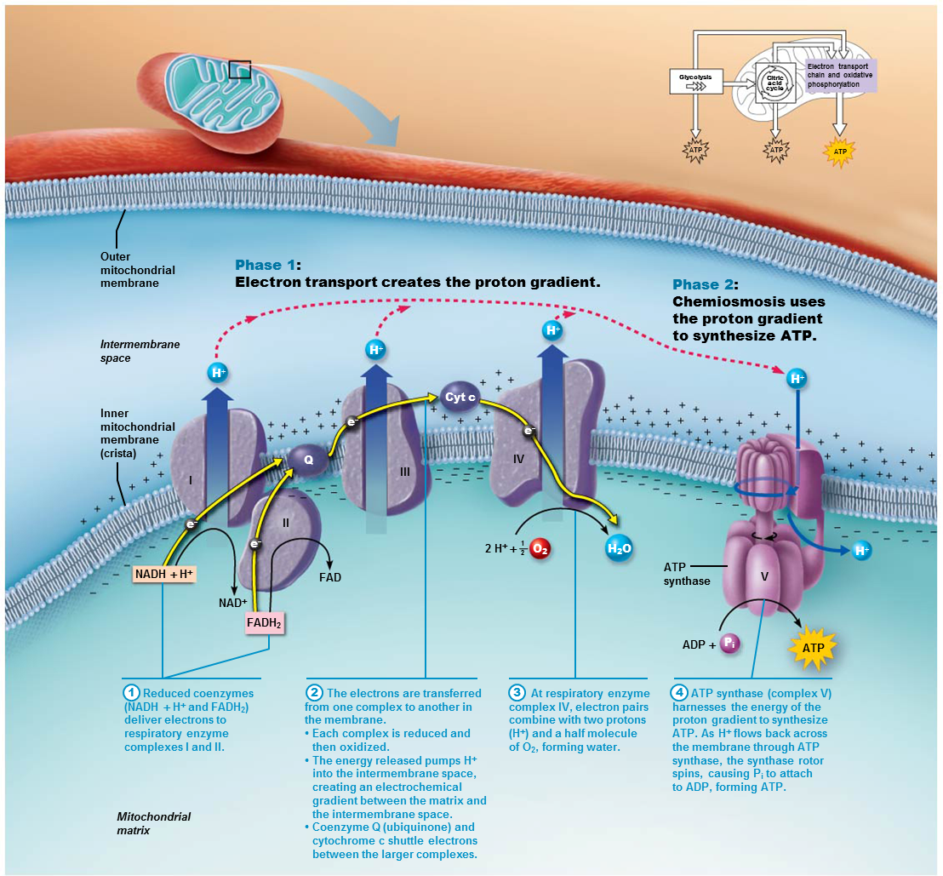
Oxidation of Glucose (cont.)
Electron transport chain and oxidative phosphorylation
Oxidative phosphorylation consists of two phases:
Phase 1: Electron transport chain creates a proton (H⁺) gradient across mitochondrial membrane using high-energy electrons removed from H from food fuels
Phase 2: Chemiosmosis uses the energy of the proton gradient to synthesize ATP
http://highered.mheducation.com/sites/0072507470/student_view0/chapter25/animation__electron_transport_system_and_atp_synthesis__quiz_1_.html

Slide 59
Oxidation of Glucose (cont.)
Phase 1: Electron transport chain
ETC: only pathway that directly uses oxygen
Citric acid cycle will not run if oxygen is not present, but does not directly use oxygen
Overview
NADH + H⁺ and FADH₂ (from glycolysis and Krebs cycle) deliver hydrogen atoms taken from glucose to ETC proteins
ETC will use energy harnessed in electrons of hydrogen to pump H⁺ across membrane to create proton gradient
Some H⁺ will combine with O₂ to produce water

Slide 60
Oxidation of Glucose (cont.)
Phase 1: Electron transport chain (cont.)
ETC harvests energy of food fuels a little bit at a time to avoid damage to cell
ETC involves a chain of carrier proteins, located on inner mitochondrial membrane, that contain metal atoms (cofactors)
Flavins: proteins derived from riboflavin (ETC complexes I and II)
Cytochromes: proteins with iron-containing pigment (complexes III and IV)
Neighboring complexes cluster together to form respiratory enzyme complexes
Each protein of complex is alternately reduced and oxidized as it picks up and passes off an electron

Slide 61
Oxidation of Glucose (cont.)
Phase 1: Electron transport chain (cont.)
Three major steps involved in ETC
Step 1. Complexes I and II accept hydrogen from NADH and FADH₂
NAD⁺ and FAD can now return to glycolysis and Krebs cycle
Step 2. Hydrogen atoms are split into H⁺ (proton) + electrons (e−)
Electrons are passed down chain
Each complex is reduced when it accepts e−, then oxidized when it passes electron on to next complex (coenzyme Q and cytochrome C act to shuttle electron between complexes)
A little energy from electron is released with each transfer
Energy released is used by complexes I, III, and IV to pump H⁺ out into intermembrane space of mitochondria, creating an H⁺ concentration gradient
Step 3
At complex IV, electron pairs combine with some H⁺ and a molecule of oxygen to form water 2H⁺ + 2e− + ½ O₂ → H₂O

Slide 62
Oxidation of Glucose (cont.)
Phase 1: Electron transport chain (cont.)
Net reaction for ETC
Coenzyme-2H + ½ (O₂) → Coenzyme + H₂O
reduced oxidized
coenzyme coenzyme
Electrons cascade “downhill” from NADH + H⁺ to progressively lower energy levels until finally delivered to oxygen
Energy from electrons is used to pump H⁺ into inner membrane space, creating an electrochemical proton (H⁺) gradient

Slide 63
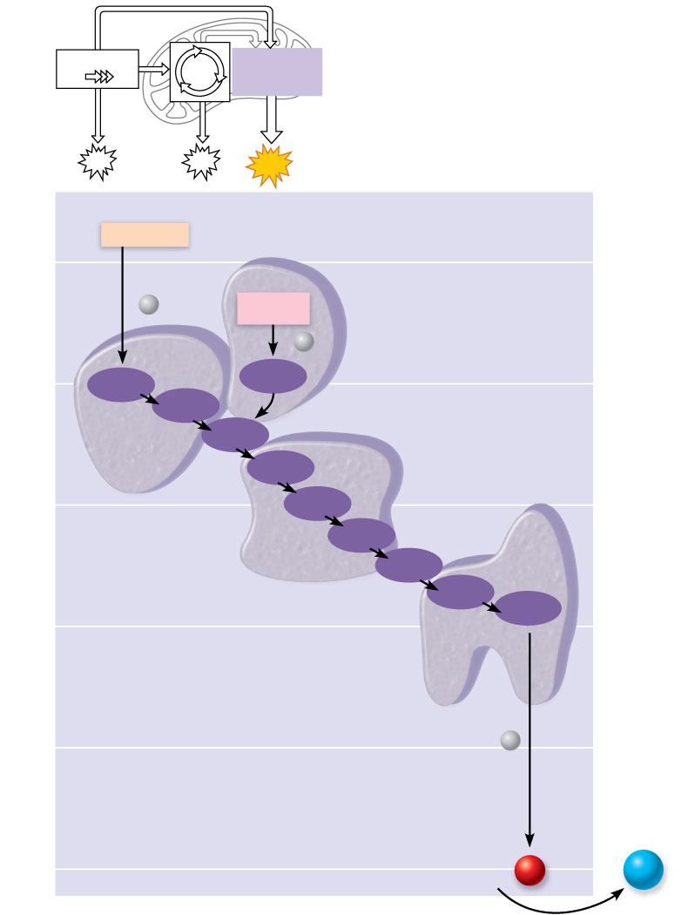
Figure 24.8 Energy is harvested at each step in the electron transport chain.
Glycolysis
Citric
acid
cycle
Electron
transport chain
and oxidative
phosphorylation
ATP
ATP
ATP
NADH+H⁺
50
2
e–
FADH₂
I
2
e–
40
FMN
Fe•S
Fe•S
II
Q
Cyt b
III
30
Fe•S
Free energy relative to O₂ (kcal/mol)
Cyt c₁
IV
Cyt c
Cyt a
Cyt a₃
20
10
Energy lost as heat
2
e–
(originally from
NADH or FADH₂)
0
2 H⁺ +
1
O₂
H₂O
2

Slide 64
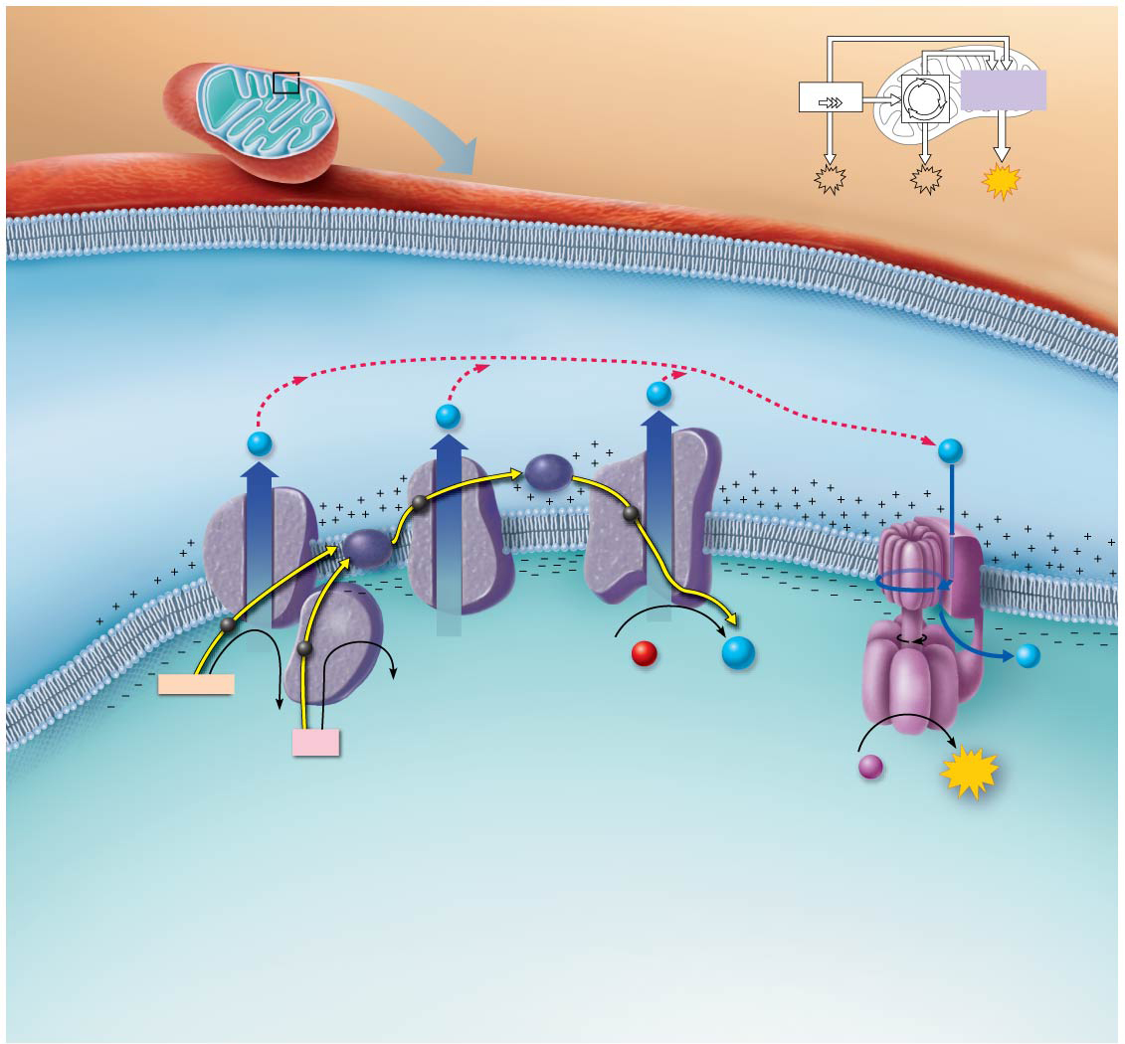
Focus Figure 24.1 Oxidative phosphorylation has two phases: Phase 1: The electron transport chain creates a proton (H⁺) gradient across the inner mitochondrial membrane using high-energy electrons removed from food fuels. Phase 2: Chemiosmosis uses the energy of the proton gradient to synthesize ATP.
Glycolysis
Citric
acid
cycle
Electron transport
chain and oxidative
phosphorylation
ATP
ATP
ATP
Outer
mitochondrial
membrane
Phase 1:
Electron transport creates the proton gradient.
Phase 2:
Chemiosmosis uses
the proton gradient
to synthesize ATP.
Intermembrane
space
H⁺
H⁺
H⁺
H⁺
Inner
mitochondrial
membrane
(crista)
Cyt c
e–
e–
Q
III
IV
I
e–
II
e–
2 H⁺ +
1
O₂
H₂O
H⁺
2
ATP
synthase
NADH + H⁺
FAD
V
NAD⁺
FADH₂
ADP +
P_{i}
ATP
1
2
3
ATP synthase (complex V)
harnesses the energy of the
proton gradient to synthesize
ATP. As H⁺ flows back across
the membrane through ATP
synthase, the synthase rotor
spins, causing P_{i} to attach
to ADP, forming ATP.
Reduced coenzymes
(NADH + H⁺ and FADH₂)
deliver electrons to
respiratory enzyme
complexes I and II.
The electrons are transferred
from one complex to another in
the membrane.
• Each complex is reduced and
then oxidized.
• The energy released pumps H⁺
into the intermembrane space,
creating an electrochemical
gradient between the matrix and
the intermembrane space.
• Coenzyme Q (ubiquinone) and
cytochrome c shuttle electrons
between the larger complexes.
At respiratory enzyme
complex IV, electron pairs
combine with two protons
(H⁺) and a half molecule
of O₂, forming water.
4
Mitochondrial
matrix

Slide 65
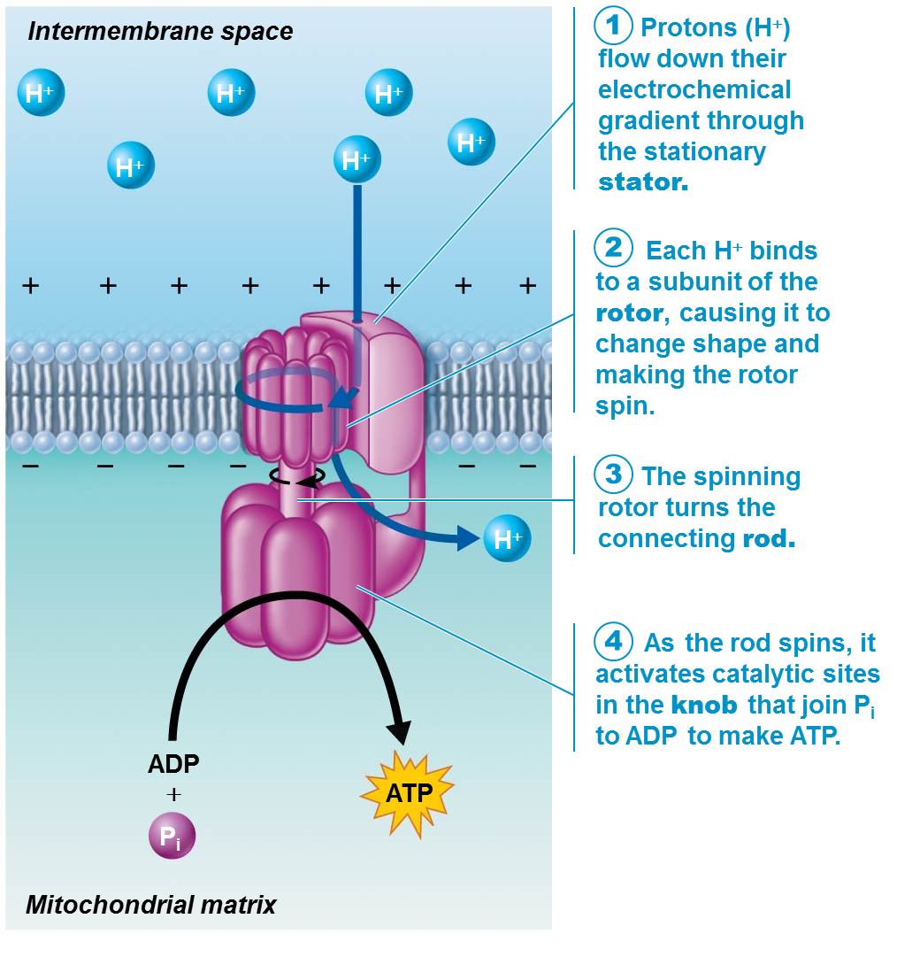
Oxidation of Glucose (cont.)
Phase 2: Chemiosmosis
Proton concentration gradient formed also creates (1) pH gradient and (2) voltage gradient across membrane
H⁺ is attracted to matrix side of membrane because of all of these gradients, but membrane is impermeable to H⁺
H⁺ can re-enter matrix only via a mitochondrial membrane channel protein called ATP synthase (complex V)
ATP synthase is a small rotary motor that drives the addition of an inorganic phosphate (Pi) to ADP, creating ATP

Slide 66
Oxidation of Glucose (cont.)
Phase 2: Chemiosmosis (cont.)
Steps of ATP synthase production of ATP
H⁺ ions flow down gradients through stationary stator of ATP synthase
As they pass rotor mechanism, they bind to one subunit, causing it to change shape and spin
Spinning rotor turns a connecting rod
As rod spins, it activates catalytic sites on knob that join P_{i} to ADP, forming ATP

Slide 67
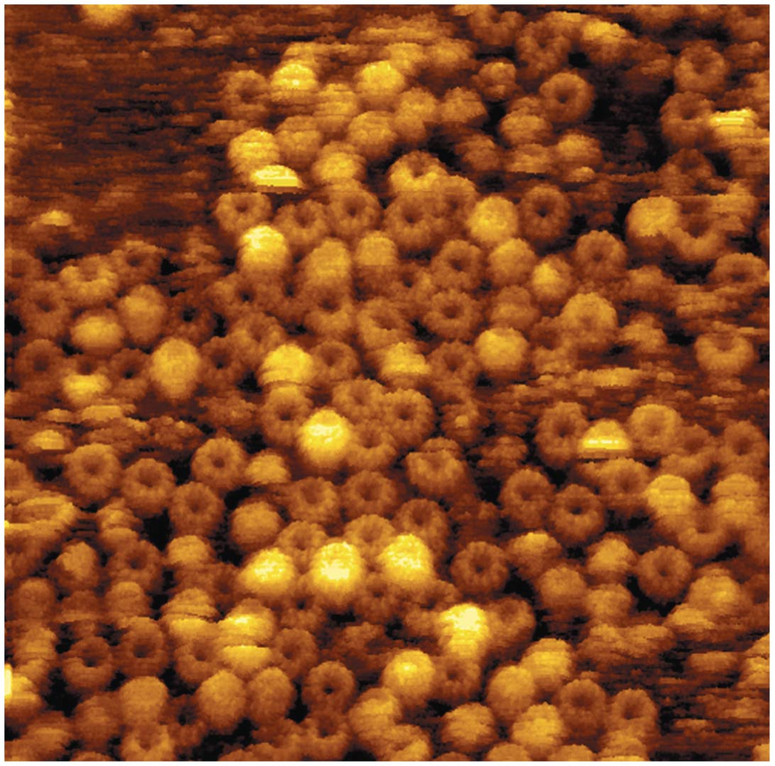
Figure 24.9 Atomic force microscopy reveals the structure of energy-converting ATP synthase rotor rings.

Slide 68
Oxidation of Glucose (cont.)
Phase 2: Chemiosmosis (cont.)
ATP synthase works like an ion pump in reverse
Proton gradient also drives energy needed for ADP, pyruvic acid, inorganic phosphate, and calcium to cross into inner mitochondrial membrane

Slide 69
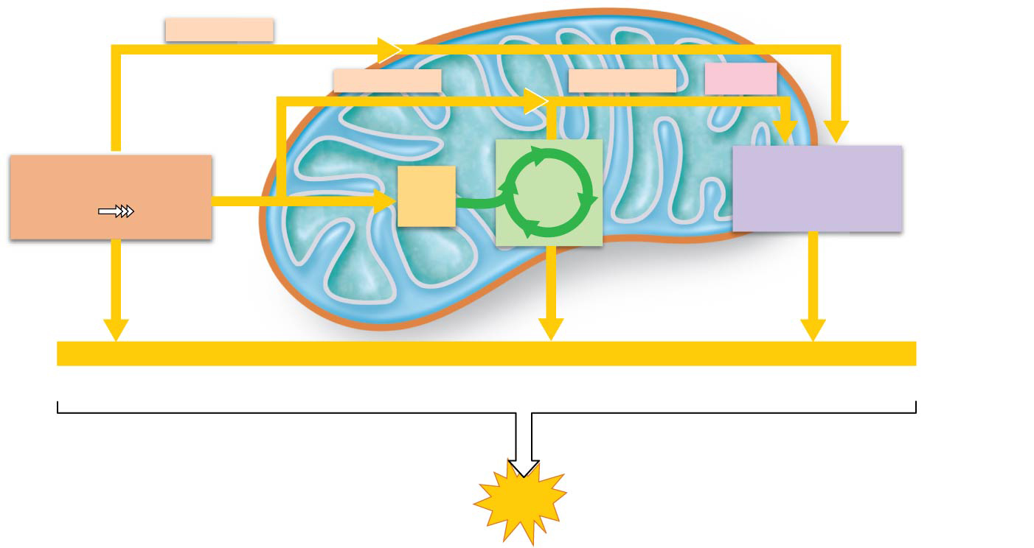
Figure 24.11 Energy yield during cellular respiration.
Cytosol
Mitochondrion
2 NADH + H⁺
Electron
shuttle across
mitochondrial
membrane
2 NADH + H⁺
6 NADH + H⁺
2 FADH₂
Glycolysis
2
Acetyl
CoA
Citric
acid
cycle
Electron transport
chain and oxidative
phosphorylation
Glucose
Pyruvic
acid
(4 ATP – 2 ATP
used for
activation
energy)
10 NADH + H⁺ × 2.5 ATP
2 FADH₂ × 1.5 ATP
Net +2 ATP
+2 ATP
+ about 28 ATP
by substrate-level
phosphorylation
by substrate-level
phosphorylation
by oxidative
phosphorylation
–2 ATP (average shuttle cost)
About
30 ATP
Typical
ATP yield
per glucose

Slide 70
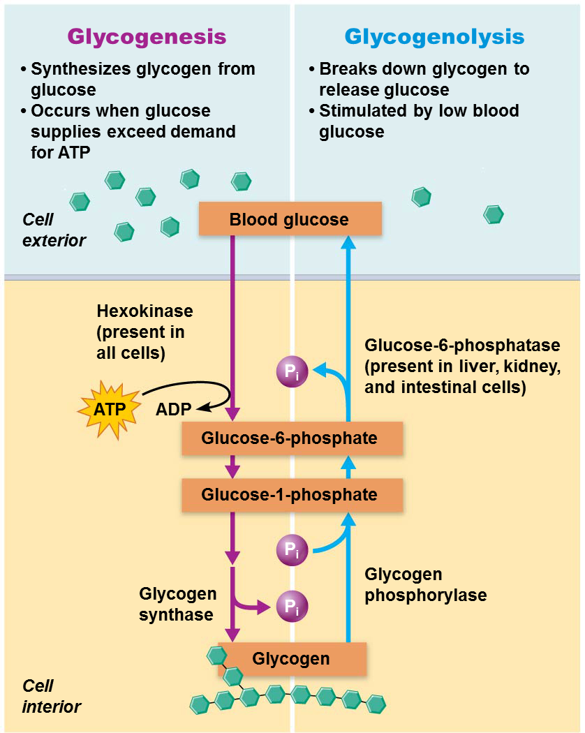
Glycogenesis, Glycogenolysis, and Gluconeogensis
Cells cannot store large amounts of ATP
Rising intracellular levels of ATP inhibit glucose catabolism and promote glycogen or fat formation
Glycogenesis
Glycogen can be formed with excess glucose
Catalyzed by glycogen synthase
Glucose is converted to glucose-6-phosphate, then converted to isomer glucose-1-phosphate
Terminal phosphate is removed as enzyme catalyzes attachment of glucose to growing chain
Mostly occurs in liver and skeletal muscle cells

Slide 71
Glycogenesis, Glycogenolysis, and Gluconeogensis (cont.)
Glycogenolysis
Breakdown of glycogen via glycogen phosphorylase in response to low blood glucose
Enzyme splits and phosphorylates terminal glucose on glycogen
Forms glucose-1-phosphate, which is converted to glucose-6-phosphate, which then can enter glycolysis in that cell
Liver cells, as well as some kidney and intestinal cells, also contain enzyme glucose-6-phosphatase that removes terminal phosphate, producing free glucose
Glucose can enter bloodstream to be used by other cells

Slide 72
Glycogenesis, Glycogenolysis, and Gluconeogensis (cont.)
Gluconeogenesis
Process of forming new (neo) glucose from noncarbohydrate sources
Occurs in the liver
Glucose can be formed from glycerol and amino acids when blood glucose levels drop
Protects against damaging effects of low blood glucose levels (hypoglycemia)
Especially important for nervous system

Slide 73
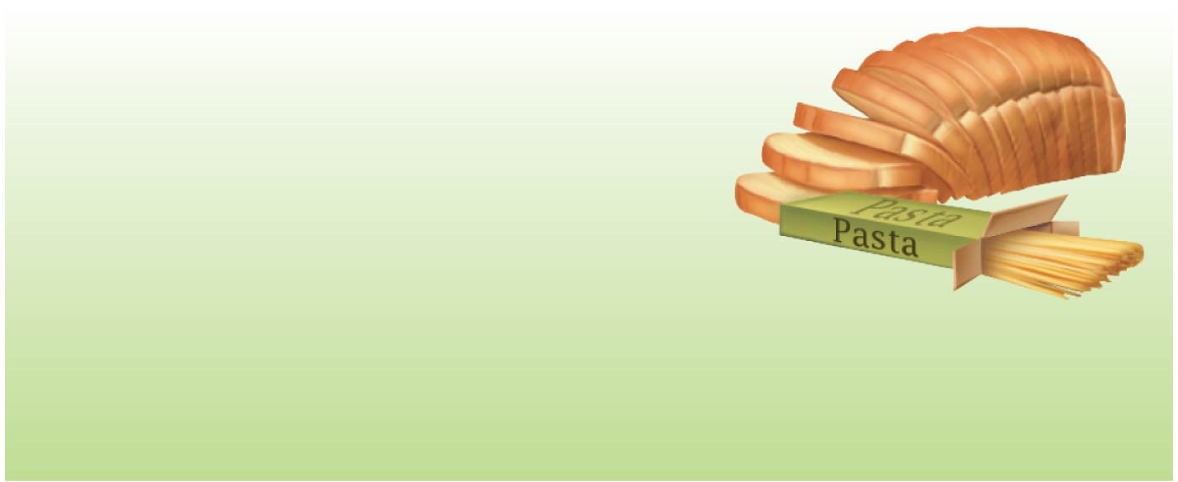
Figure 24.12 Quick summary of carbohydrate reactions.
Glycolysis: Converts glucose to pyruvic acid
Glycogenesis: Polymerizes glucose to form glycogen
Glycogenolysis: Hydrolyzes glycogen to glucose monomers
Gluconeogenesis: Forms glucose from noncarbohydrate precursors

Slide 74
24.5 Lipid Metabolism
Lipids provide a greater energy yield than from glucose or protein catabolism
Fat catabolism yields 9 kcal per gram versus 4 kcal per gram of carbohydrate or protein
Most products of fat digestion are transported in lymph as chylomicrons
Hydrolyzed by endothelial enzymes into fatty acids and glycerol

Slide 75
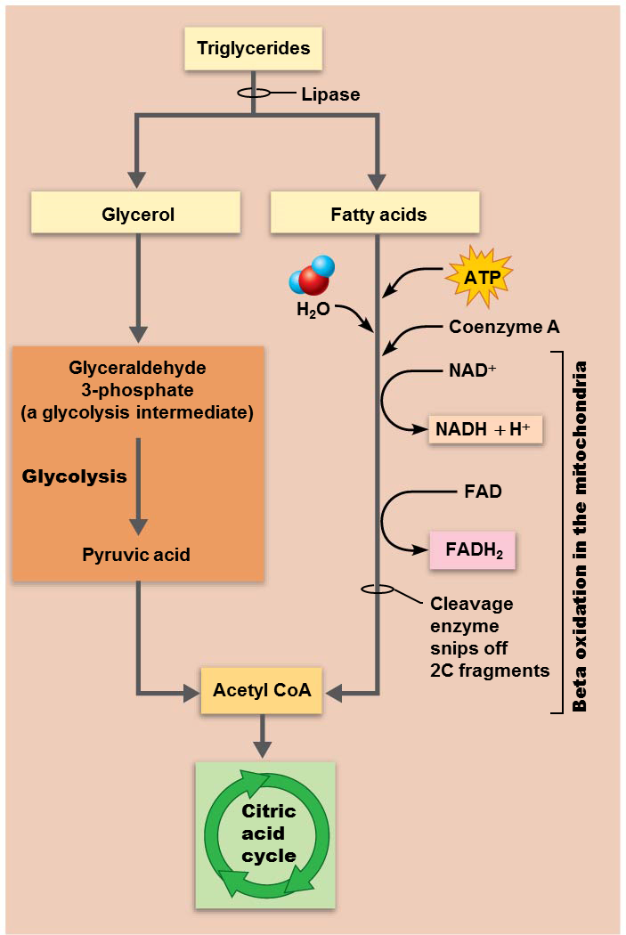
Oxidation of Glycerol and Fatty Acids
Only triglycerides are routinely oxidized for energy
Two building blocks of triglycerides are oxidized separately
Glycerol breakdown
Glycerol is broken down into glyceraldehyde 3-phosphate (same as in glycolysis), which then enters citric acid cycle
ATP yield is roughly half that of glucose because glyceraldehyde is only a half glucose
Yields 15 ATP/glycerol

Slide 76
Oxidation of Glycerol and Fatty Acids (cont.)
Fatty acid breakdown
Fatty acids undergo beta oxidation in mitochondria:
Fatty acid chains are broken into two-carbon acetic acid fragments, and coenzymes (FAD and NAD⁺) are reduced in process
Acetic acid fragment fuses with CoA to form acetyl CoA, which enters citric acid cycle
Reduced coenzymes enter electron transport chain
Referred to as “beta” oxidation because two carbons are broken off fatty acid chain, allowing third-position carbon to be oxidized

Slide 77
Lipogenesis
Lipogenesis: triglyceride synthesis that occurs when cellular ATP and glucose levels are high
Dietary glycerol and fatty acids not needed for energy are stored as triglycerides
50% is stored in adipose tissue; other 50% is deposited in other areas
Glucose is easily converted to fat because acetyl CoA is an intermediate in glucose catabolism and the starting point for fatty acid synthesis

Slide 78
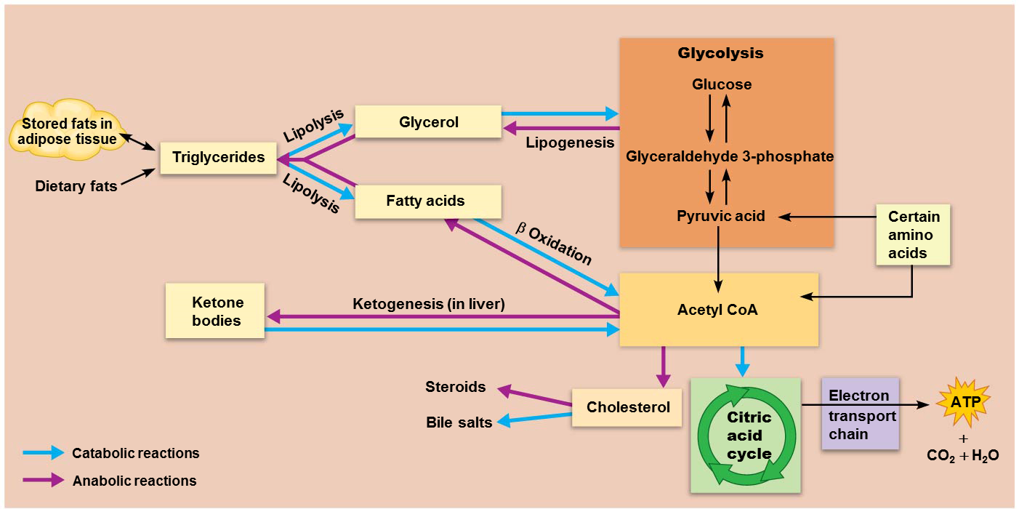
Lipolysis (cont.)
Lipolysis: breakdown of stored fats into glycerol and fatty acids; reverse of lipogenesis
Fatty acids are actually preferred by liver, cardiac muscle, resting skeletal muscle for fuel
Lipolysis is accelerated when carbohydrate intake is inadequate

Slide 79
Lipolysis (cont.)
Beta oxidation of the released fatty acids results in production of large amounts of acetyl CoA
Acetyl CoA can enter citric acid cycle only if enough intermediates (oxaloacetic acid) are available
If intermediates are not available, acetyl CoA can accumulate

Slide 80
Lipogenesis (cont.)
Lipolysis (cont.)
Accumulated acetyl CoA can be converted by ketogenesis in liver to ketone bodies (ketones)
Ketone bodies include acetoacetic acid, β-hydroxybutyric acid, and acetone

Slide 81
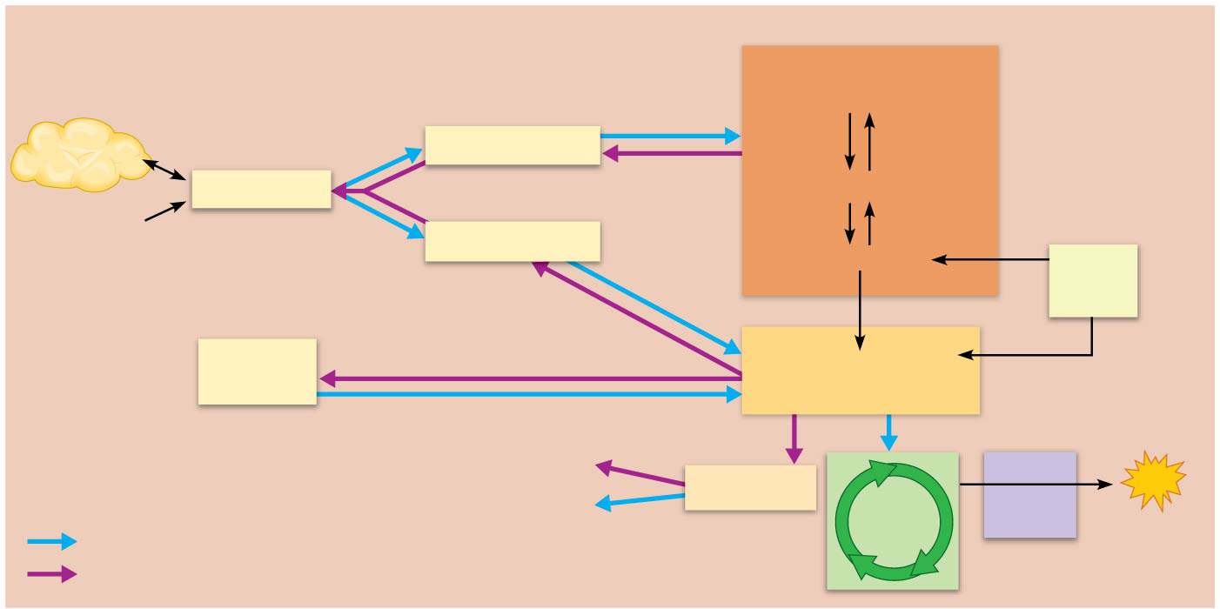
Figure 24.16 Lipid metabolism.
Glycolysis
Glucose
Stored fats in
adipose tissue
Lipolysis
Glycerol
Triglycerides
Lipogenesis
Glyceraldehyde 3-phosphate
Dietary fats
Lipolysis
Fatty acids
Pyruvic acid
Certain
amino
acids
β Oxidation
Ketone
bodies
Ketogenesis (in liver)
Acetyl CoA
Steroids
Electron
ATP
Bile salts
Cholesterol
Citric
acid
cycle
transport
chain
+
CO₂ + H₂O
Catabolic reactions
Anabolic reactions

Slide 82
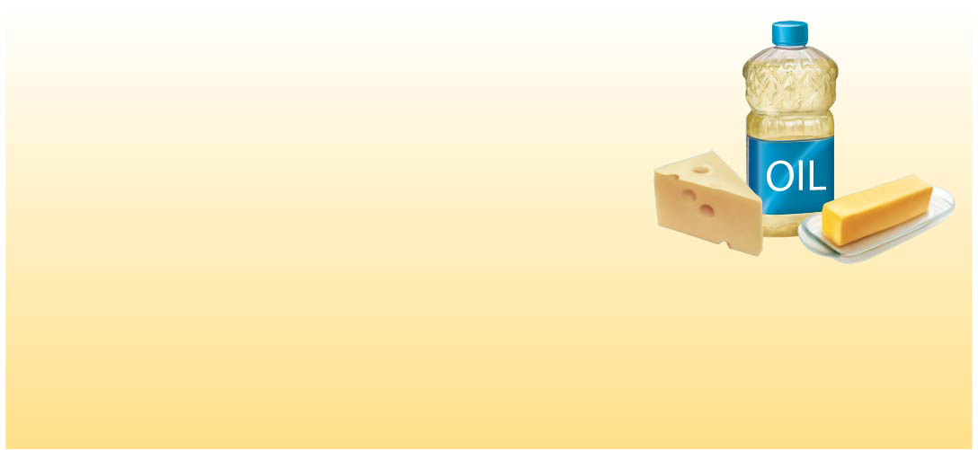
Figure 24.14 Quick summary of lipid reactions.
Beta oxidation: Converts fatty acids to acetyl CoA
Lipolysis: Breaks down lipids to fatty acids and glycerol
Lipogenesis: Forms lipids from acetyl CoA and glyceraldehyde 3-phosphate

