Slide 1
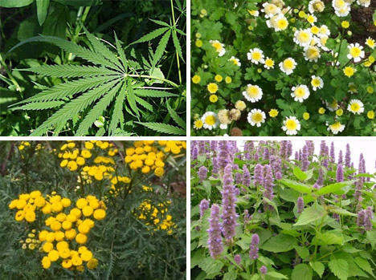
Kingdom Plantae
Transport

Slide 2
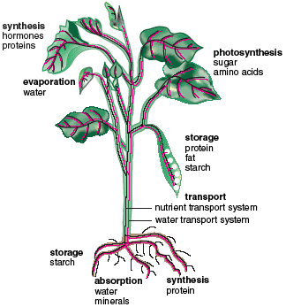
How Does…
Water and dissolved nutrients get upwards from the root?
Carbohydrates produced in leaves get to the rest of plant?

Slide 3
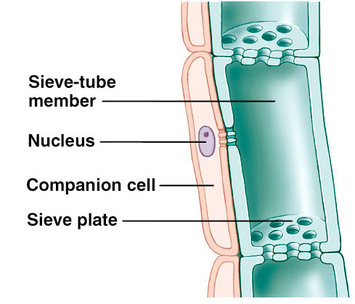
How do plants transport carbohydrates?
Movement of carbohydrates through vascular system is called translocation
Carbohydrates produced in photosynthetic organs (usually leaves) and often stored in roots
Movement of carbohydrates is through phloem
Movement can be up and down a plant

Slide 4
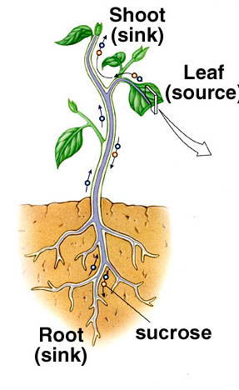
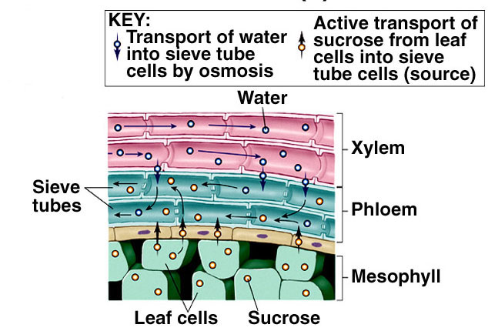
How do plants transport carbohydrates?

Slide 5
How do plants get nutrients and water up xylem?
Water molecules sticks to walls of xylem (adhesion) and to each other (cohesion)
Water moves through xylem
Air on leaf surfaces causes water to evaporate, creating a ‘pull’ on the water column
Process of evaporative water loss in plants is called transpiration

Slide 6
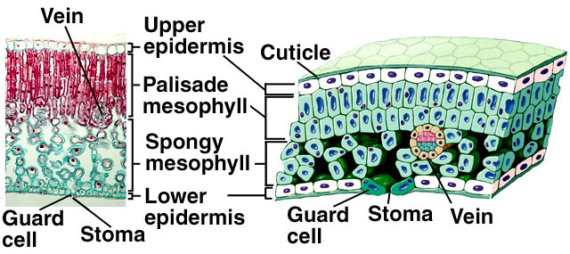
Transpiration
90% of water ‘absorbed’ by roots lost through transpiration in leaves
Transpiration through stomata, pores in leaves
Transpiration rate regulated by two guard cells surrounding each stoma
Movement of water is only in one direction (from roots to leaves)

Slide 7
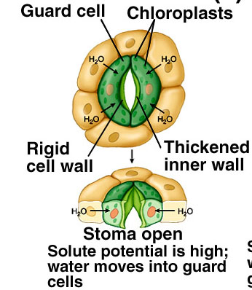
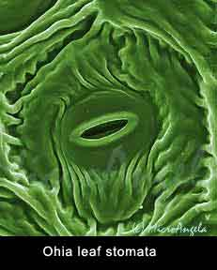
Transpiration
Action of guard cells
Guard cells open when water moves into cells by osmosis

