Slide 1
Taxonomy Learning Activities

Slide 2
Classification
Case Study: Guarding against deadly, eight-legged “black widow” immigrants
Read the article
Answer Black Widow article questions in your notebook

Slide 3
Hierarchical System of Classification
Kingdom
Phylum
Class
Order
Family
Genus
Species
King
Philip
Came
Over
For
Good
Soup
K___
P___
C___
O___
F___
G___
S___
General
Specific

Slide 4
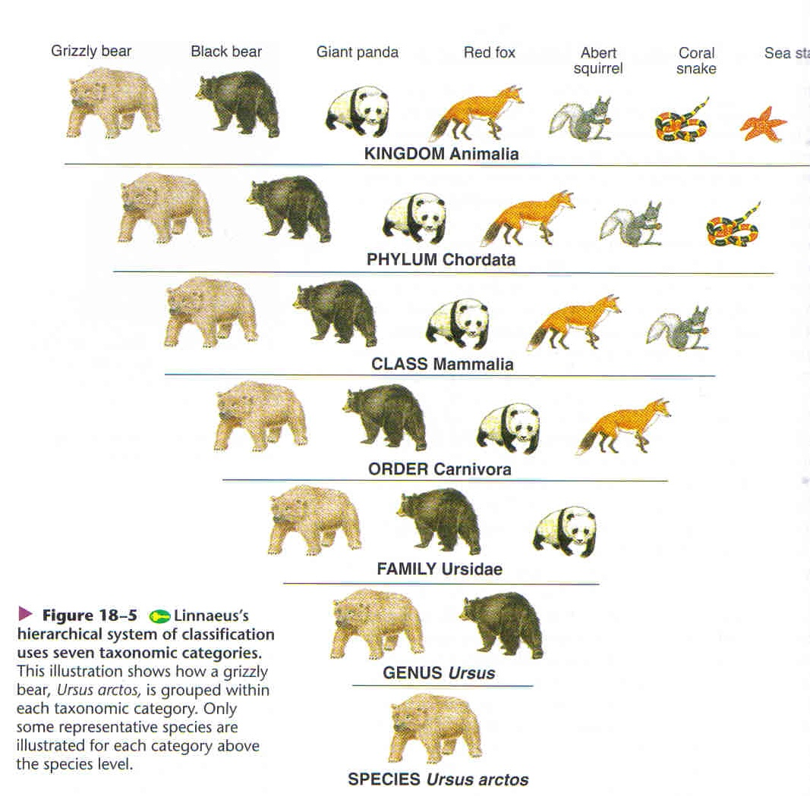

Slide 5
Binomial Nomenclature
Binomial Nomenclature is a two-name system that identifies an organism
Names in Binomial Nomenclature:
Both words are italicized, first is the genus and second is the species, & the genus is always capitalized
Genus species

Slide 6
Examples of Binomial Nomenclature
LACTOBACILLUS BULGARICUS
BIFIDUS REGULARIS
LACTOBACILLUS ACIDOPHILUS
Write these names correctly in binomial nomenclature.
Which two are most related? Why?
Circle the genus and underline the species of one of the organisms

Slide 7
Characteristics of Kingdoms, pp. 163-166
 | Eubacteria | Archaebacteria | Protista | Fungi | Plant | Animal
Cell Type (eukaryotic/ prokaryotic)
Cell Wall (yes/no)
Food Source (heterotrophic/ autotropic/ both)
Nucleus (yes/no)
Cell # (multicellular/ single-celled)
Tissue Systems (yes/ no)

Slide 8
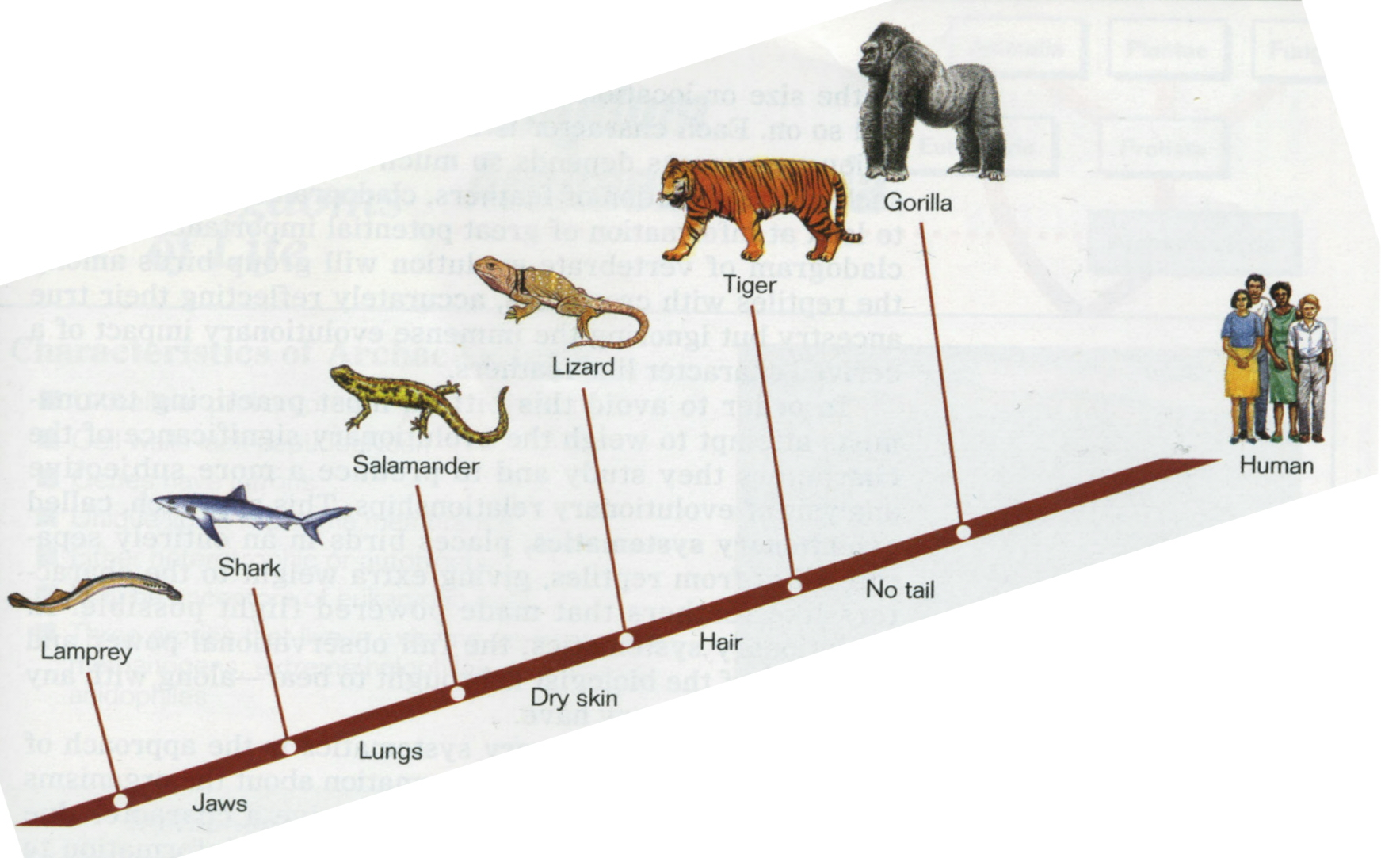
Cladogram
A cladogram shows the evolutionary history of a species
The diagram shows traits that developed with each new species

Slide 9
Evolution of the Kingdoms
Create a cladogram with the characteristics and organisms provided. Use the format on the next slide to complete the cladogram.
Characteristics:
No cell wall
Nucleus
Multicellular
Tissue systems
Organisms:
Protista
Plants
Animals
Fungi
Archaebacteria

Slide 10
Cladogram Format
Organism 2
Organism 3
Organism 4
Organism 5
Organism 6
Characteristic
4
Characteristic
3
Characteristic
2
Characteristic
1
Eubacteria

Slide 11
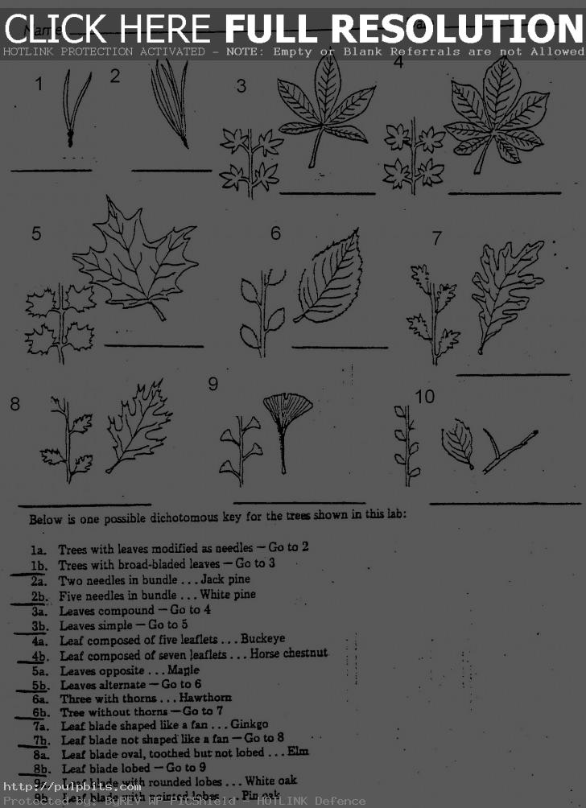
Dichotomous Key
A dichotomous key is used to classify organisms
Once the organism is classified, information about the organism can be determined
This is useful because:
It can show dangers to humans
It can show effects on the ecosystem
It can show changes in a species

Slide 12
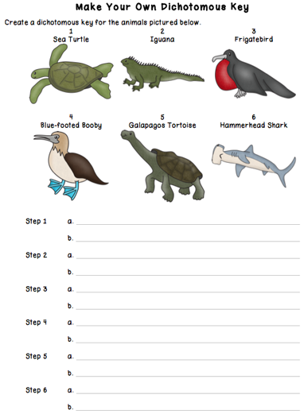

Slide 13
Taxonomony on OpenStax
Take notes from Biology OpenStax Textbook using taking the following information:
Ch. 22
Describe the GENERAL living conditions of Eubacteria (Bacteria) & Archeabacteria (Archaea)
Ch. 23
Describe 5 structural characteristics of Protista
Describe 2 ways Protista affect the ecosystem
Ch. 24
Describe 5 structural characteristics of Fungi
Describe 2 ways Fungi affect the ecosystem

Slide 14
Taxonomony on OpenStax
Take notes from Biology OpenStax Textbook using taking the following information:
Ch. 22
Describe the GENERAL living conditions of Eubacteria (Bacteria) & Archeabacteria (Archaea)
Ch. 23
Describe 5 structural characteristics of Protista
Describe 2 ways Protista affect the ecosystem
Ch. 24
Describe 5 structural characteristics of Fungi
Describe 2 ways Fungi affect the ecosystem

Slide 15
Taxonomony on OpenStax
Take notes from Biology OpenStax Textbook using taking the following information:
Ch. 22
Describe the GENERAL living conditions of Eubacteria (Bacteria) & Archeabacteria (Archaea)
Ch. 23
Describe 5 structural characteristics of Protista
Describe 2 ways Protista affect the ecosystem
Ch. 24
Describe 5 structural characteristics of Fungi
Describe 2 ways Fungi affect the ecosystem

Slide 16
Taxonomony on OpenStax
Take notes from Biology OpenStax Textbook using taking the following information:
Ch. 22
Describe the GENERAL living conditions of Eubacteria (Bacteria) & Archeabacteria (Archaea)
Ch. 23
Describe 5 structural characteristics of Protista
Describe 2 ways Protista affect the ecosystem
Ch. 24
Describe 5 structural characteristics of Fungi
Describe 2 ways Fungi affect the ecosystem

Slide 17
Taxonomony on OpenStax
Take notes from Biology OpenStax Textbook using taking the following information:
Ch. 22
Describe the GENERAL living conditions of Eubacteria (Bacteria) & Archeabacteria (Archaea)
Ch. 23
Describe 5 structural characteristics of Protista
Describe 2 ways Protista affect the ecosystem
Ch. 24
Describe 5 structural characteristics of Fungi
Describe 2 ways Fungi affect the ecosystem

Slide 18
Taxonomony on OpenStax
Take notes from Biology OpenStax Textbook using taking the following information:
Ch. 22
Describe the GENERAL living conditions of Eubacteria (Bacteria) & Archeabacteria (Archaea)
Ch. 23
Describe 5 structural characteristics of Protista
Describe 2 ways Protista affect the ecosystem
Ch. 24
Describe 5 structural characteristics of Fungi
Describe 2 ways Fungi affect the ecosystem

